Slide 1
Two Faithful Spies
Notes:
Sermon: Two Faithful Spies Scripture: Matthew 19:21
Opening Hymn # 369 Bringing in the sheaves
Closing Hymn # 615 Rise up o church of God
Children’s story – Moses, 8yr old deacon in El Salvador

Slide 2
I cast all my cares upon you
I lay all of my burdens
down at Your feet,
and anytime I don’t know
just what to do,
I will cast all my cares upon You.

Slide 3
Two Faithful Spies
Notes:
Read Numbers 13: 1-2
Here we see that God told Moses to send some spies into the Promised Land. They were to go in and check it out. To see what the obstacles were. To identify the layout of the land, the people, the vegetation. Was it in fact the kind of land that they expected it to be, was it a land flowing with milk and honey? So Moses sent 12 spies into the land, one leader from every tribe.
And notice what they said,
Read Numbers 13:27
It was in fact the kind of land that they were expecting. It was suitable to sustain life, the kind of place they could see spending the rest of their lives in, one that could be handed down to their posterity.
But, notice what the next verse says,
Read Numbers 13:28
It is a good land, it is a beautiful land, Nevertheless (but) it has more obstacles than we can overcome. Notice what God had said in verse I,

Slide 4
Send men to spy out the land of Canaan, which I am giving to the children of Israel
Notes:
Read slide
God had promised them that He was giving them the land. It was theirs, all they had to do was trust Him and follow His directions and they would have it.
Well, you know the story, don’t you?
Caleb and Joshua gave a good report, they were two faithful spies, and they tried to convince the people that God was going to give their enemies into their hands.
But 10 of the 12 spies convinced them that they could not take the land, and Numbers 14:2 says, they all complained against Moses and Aaron.
So God says, you’re all going back out into the desert and your all going to die there, this whole generation – everyone except Caleb and Joshua. Then I’m going to bring your children, the ones you claim to be worried about. I’m going to bring them into the land.
So for the next forty years they wandered in the wilderness, and you can read about that in the rest of the book of Numbers. You can read about the rebellion of Korah and his followers, the fiery serpents and the bronze pole that was lifted up, the story of Balaam, the victory over the kings East of the Jordon, the death of Moses and the coronation of Joshua their next leader.
Finally, after that whole generation had died, it is time to go into the Promised Land. So what does Joshua do?
Read Joshua 2:1
Notice, this time, that Joshua sent how many spies? Just two! Why Two? Why not 12 again like Moses did? I think there are probably several reasons. But notice this

Slide 5
Deuteronomy 19:15
By the mouth of two or three witnesses the matter shall be established.
Notes:
Read slide
So Joshua sends in the minimum number and they brought back a faithful report
Last week two faithful spies, from this church,

Slide 6
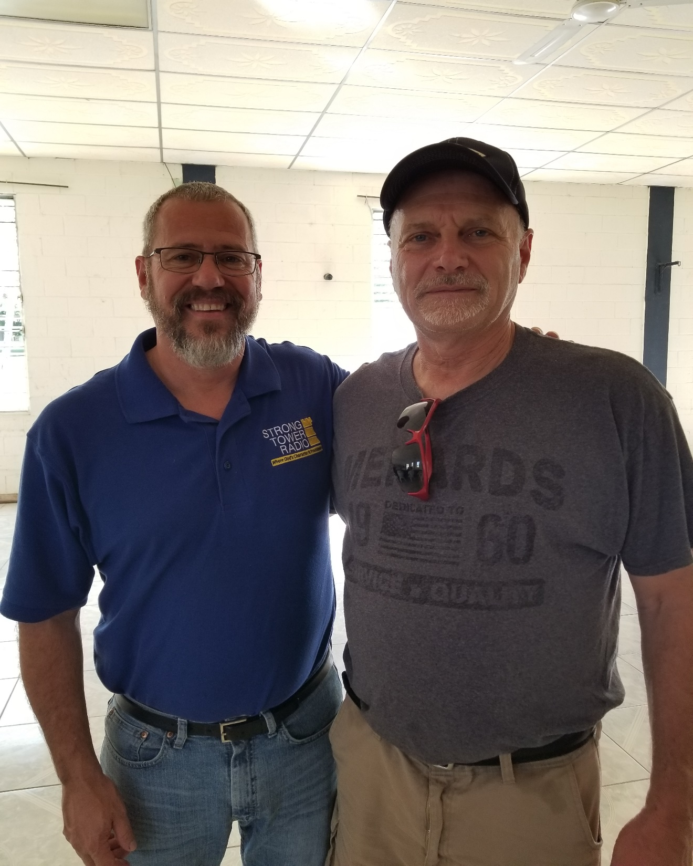
Two
Faithful
Spies
Notes:
Went to El Salvador
But we weren’t the only ones

Slide 7
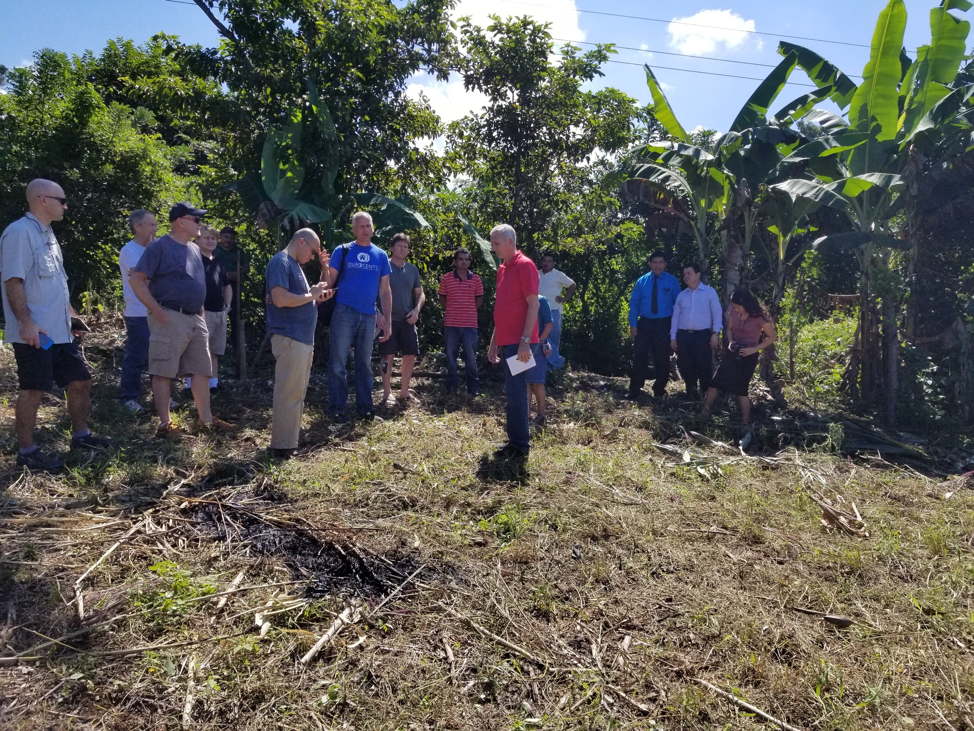
Notes:
Pastor Ron Kelly and one of his elders John from the Village church in Barrien Springs
Pastor Ariel Roldan and one of his elders Steve from the Oakwood church in Detroit
Pastor Alex Rybochek and one of his elders Lyle from the Gobbels church
And of course Mark and I
4 teams from Michigan

Slide 8
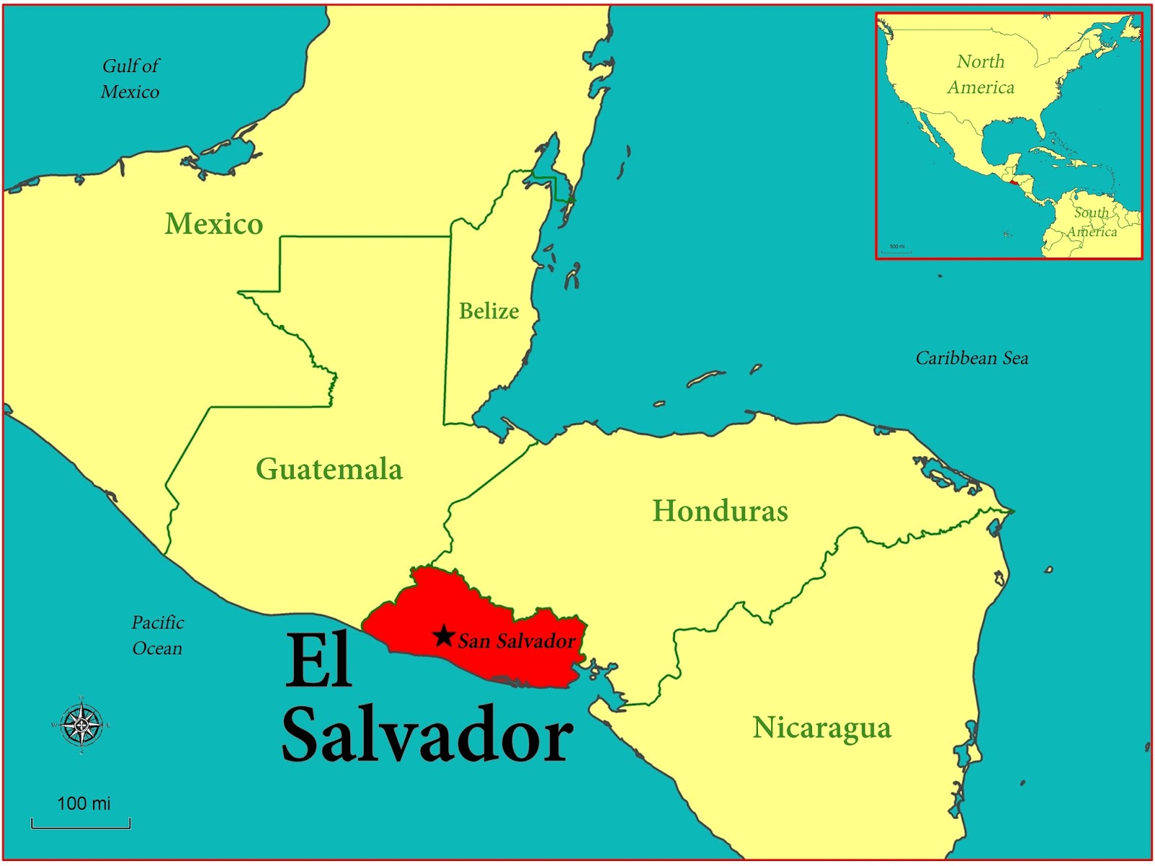
Notes:
As you can see from this map, El Salvador is the smallest country in Central America. But what this map doesn’t show is that El Salvador – even though it is the smallest, it is the mostly densely populated country. As of 2016 there were 6.34 million people living in this country
If you want to get an idea of the size of El Salvador – it is slightly smaller than the state of Massachusetts
Massachusetts has roughly the same number of inhabitants (6.9 Million) average monthly income $6,274.75 (as of 2016)
El Salvador average monthly income is $661 (as of 2012)
And yet every thing in El Salvador costs the same or more
Notice that there gas

Slide 9
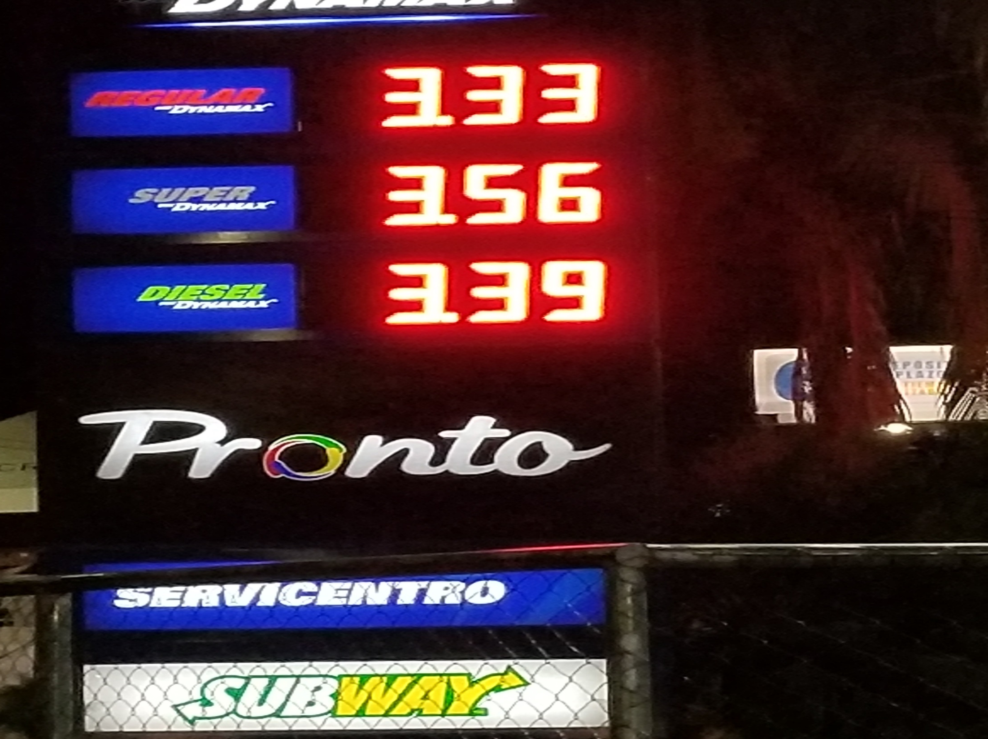
Notes:
Costs $3.33 per gallon
A small piece of land about 100 x 300 costs about $15,000 - out in the country. That same size piece in the city of San Salvador (capital) could cost you $100,000.00
Just so you get an idea of the cost, a few years ago I bought some land up in Kalkaska and I paid less than $2,000 per acre.
So what we are talking about here is hyper inflation.
In 2001 the El Salvador government adopted the US dollar as their currency to try and get this in check but it hasn’t worked.
In the communities that we saw one of the best paying jobs that the poor people could get, was harvesting coffee. In that job you could make $12 for an 11 hour day
So we went around looking at sites to build a church. The requirement was that the church/conference had to already own the land

Slide 10
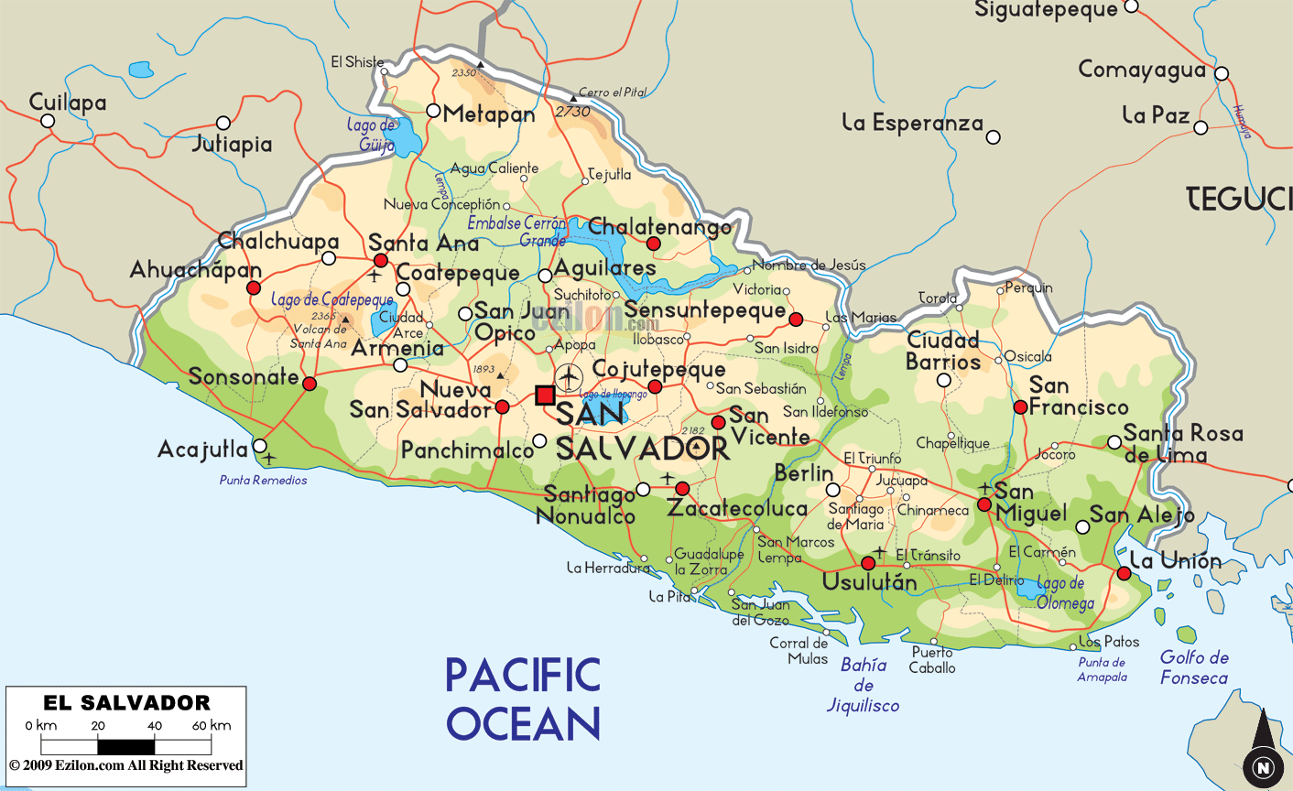
Notes:
Point out the airport and San Juan Opico where the school is
The first place that we went to was in Horcones which is a part of this area by Santa Ana

Slide 11
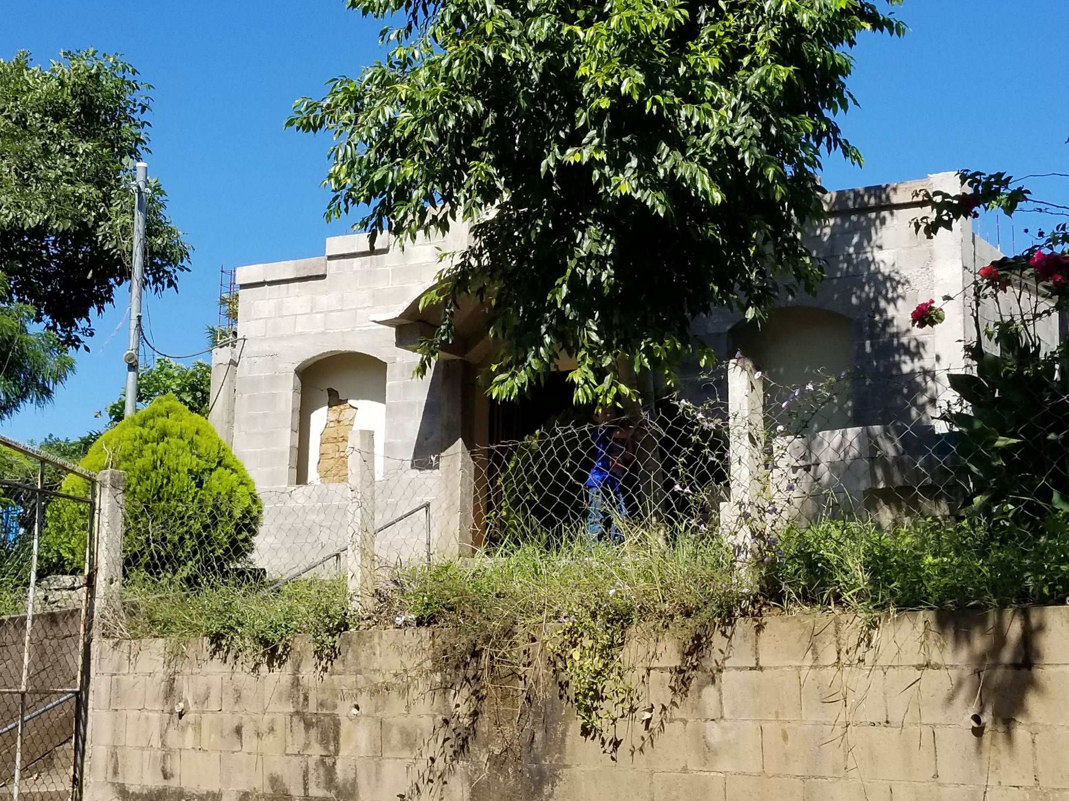
Notes:
In this location we saw this church
What’s unique about this church is that it was already built, but they had an earth quake that damaged the building. So they started to build a new building on the outside of it.

Slide 12
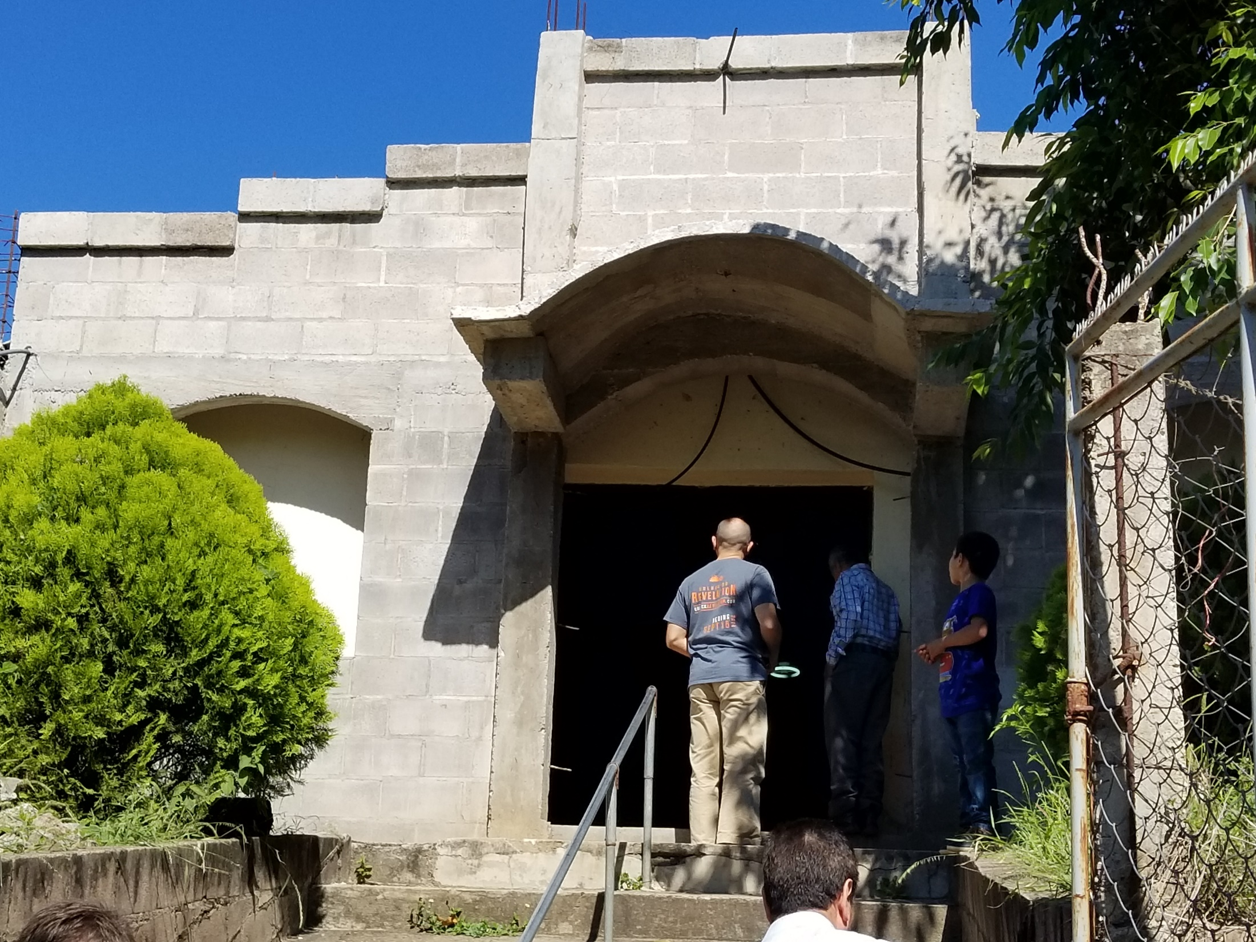
Notes:
Look at the window on the left and the square door frame

Slide 13
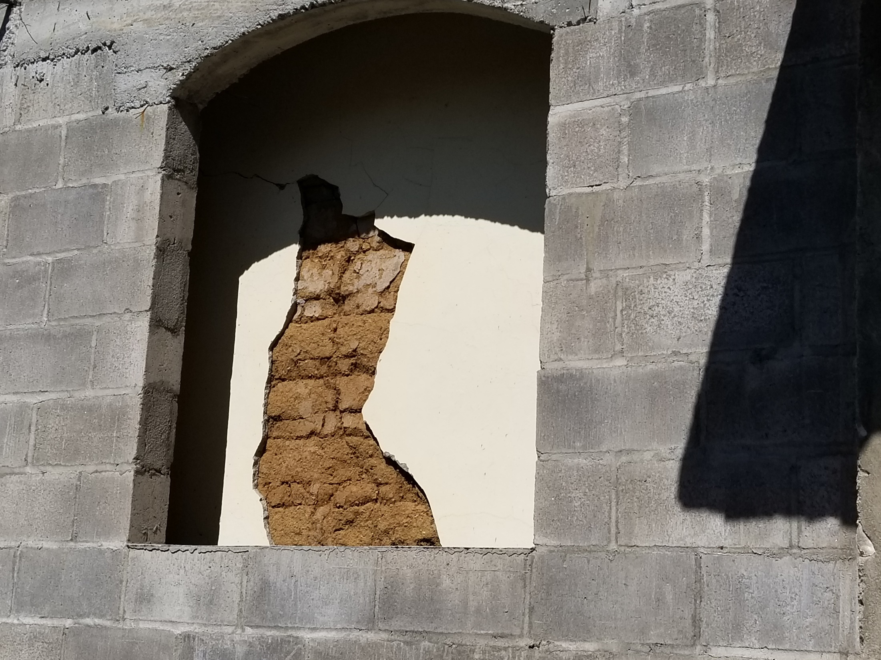
Notes:
A closer view of the front window

Slide 14
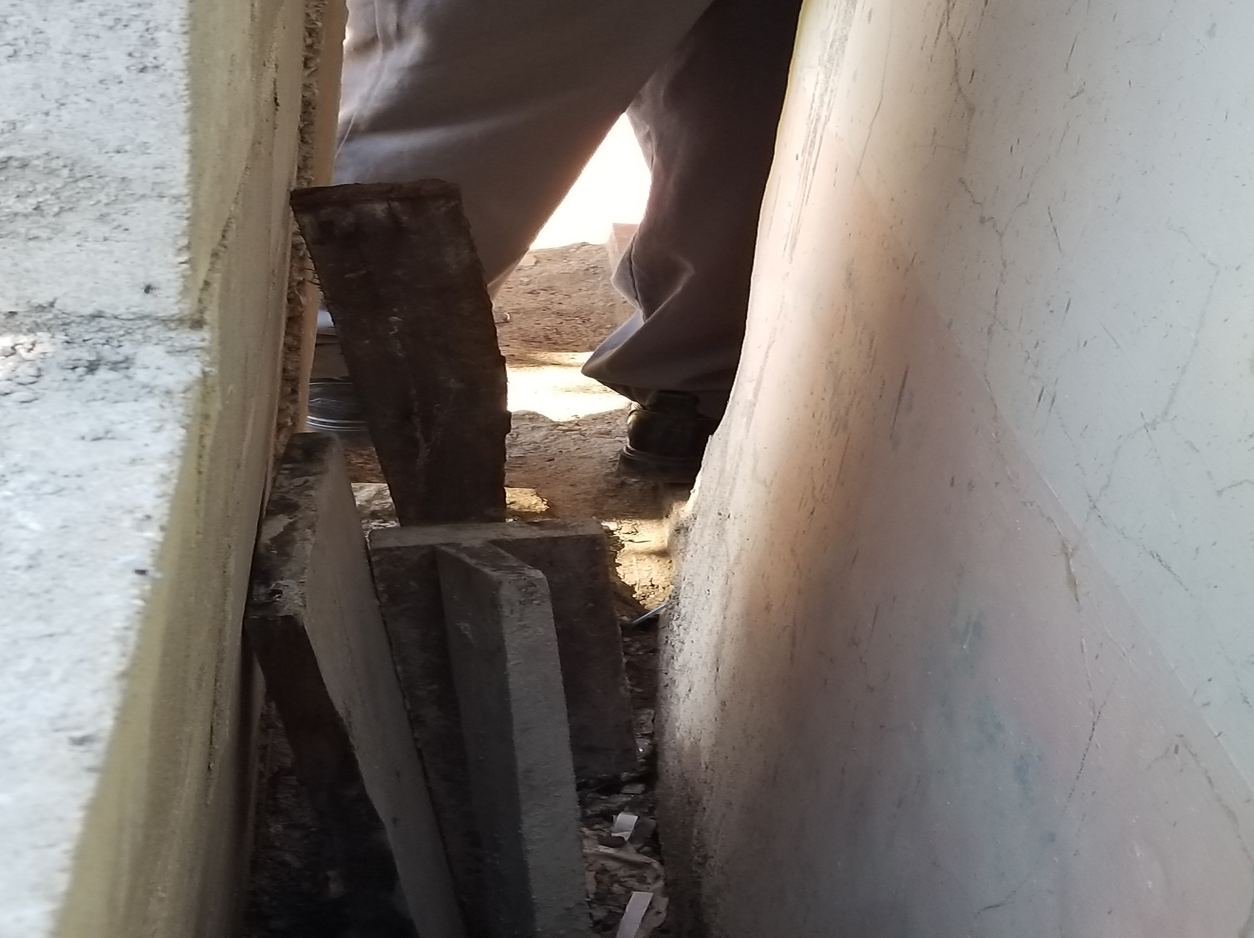
Notes:
Side view

Slide 15
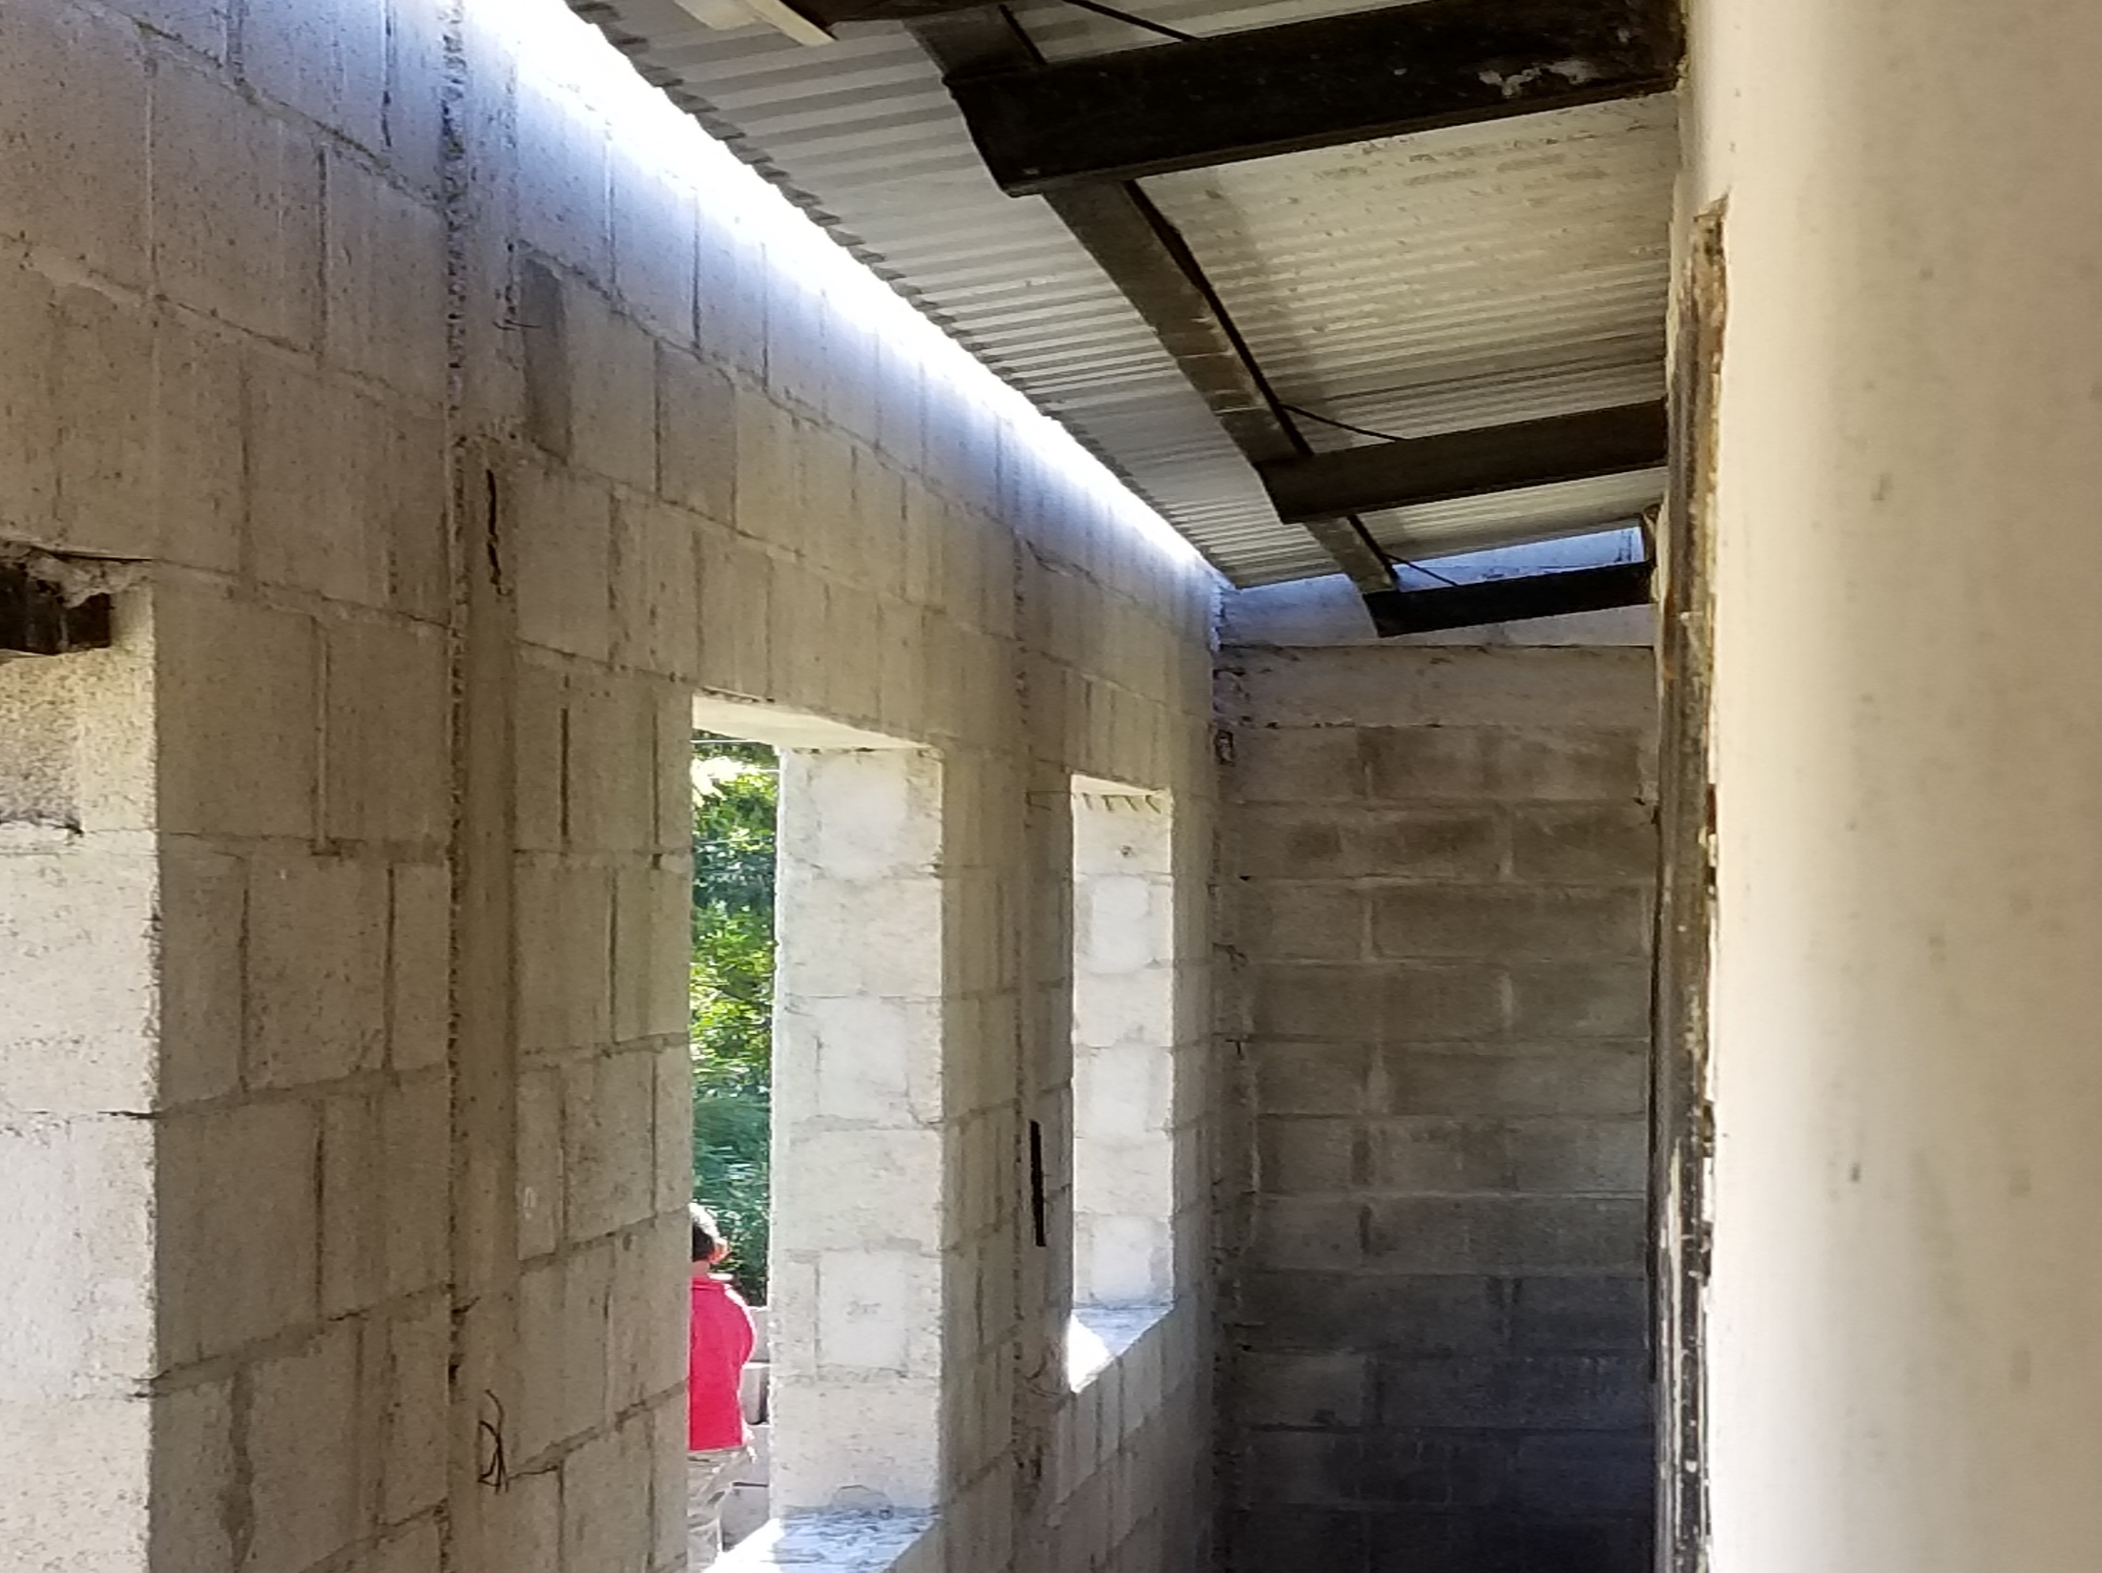
Notes:
But they ran out of money and are not able to finish. So they are looking for help to be able to do that.
The next place we went to was Atehuesilla near Ahuahapan

Slide 16
Notes:
Atehuesilla near Ahuachapan Near Guatemala

Slide 17
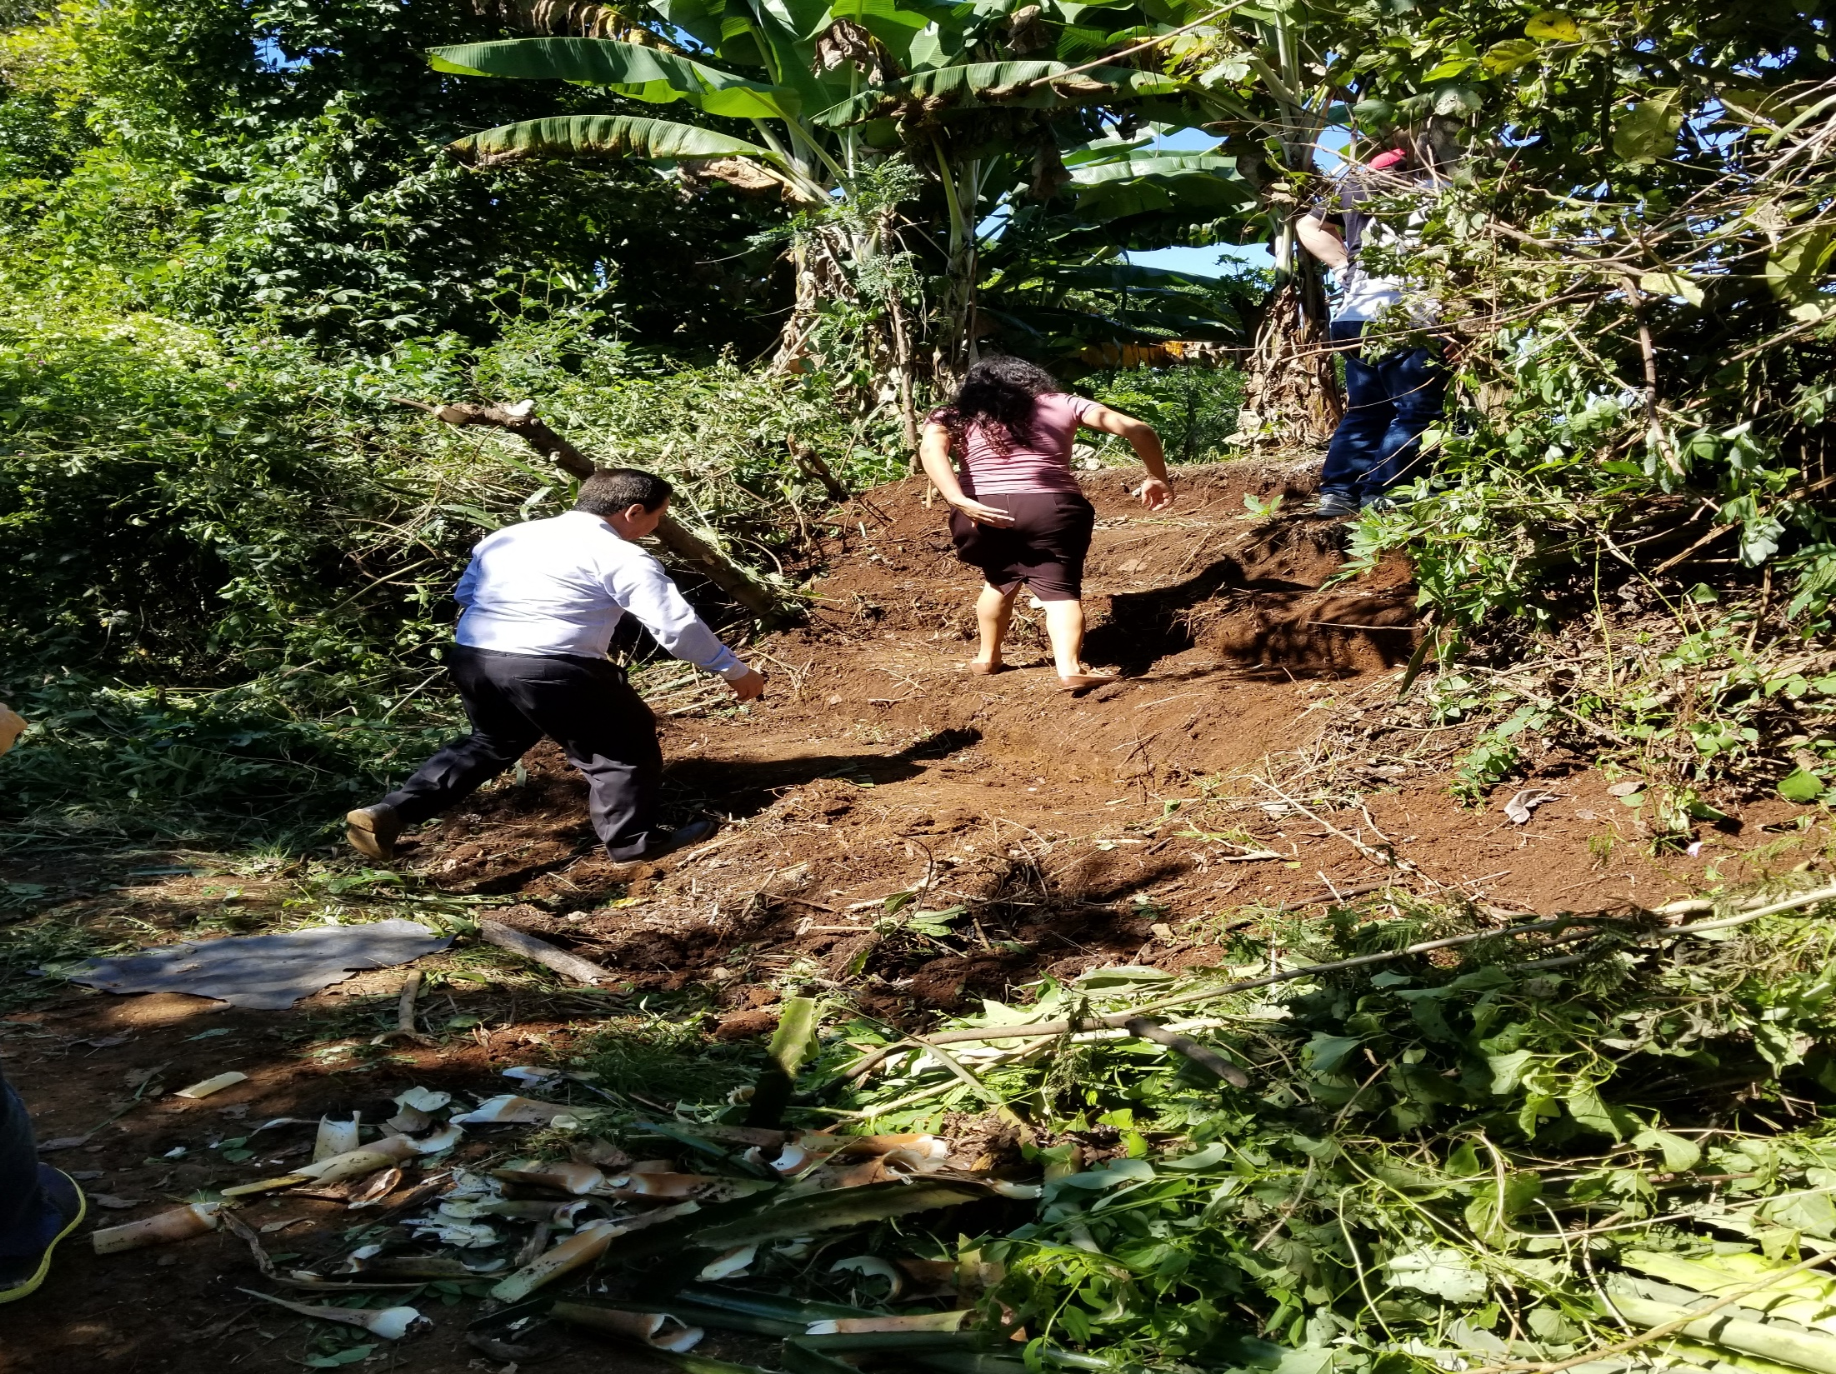
Notes:
Where we saw this piece of Land
In this picture I am standing on the road and you can see where the church made a step up so that we could look at the land

Slide 18
Notes:
In this picture I am up top looking back at the entry way up (on the right)
Notice the guy in the back with the red shirt on. He started the church in this area with 15 people 5 months ago. They now have over 30 members and they purchased this land

Slide 19
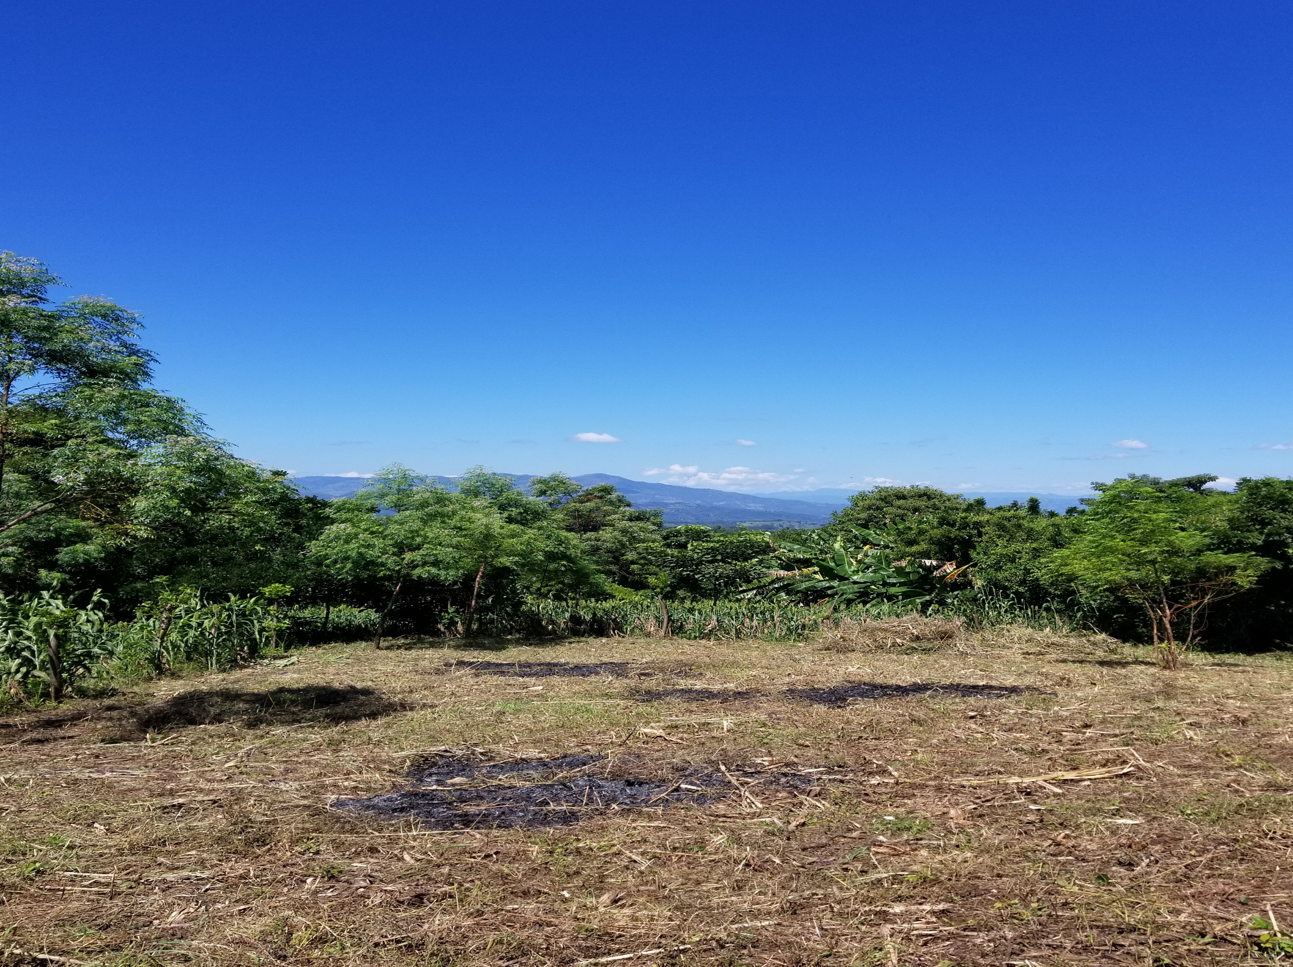
Notes:
You can see here that they already cleared the land and have already held worship services on the site
Point out the mountains of Guatemala in the back ground
They need $10,000.00 to build the church

Slide 20
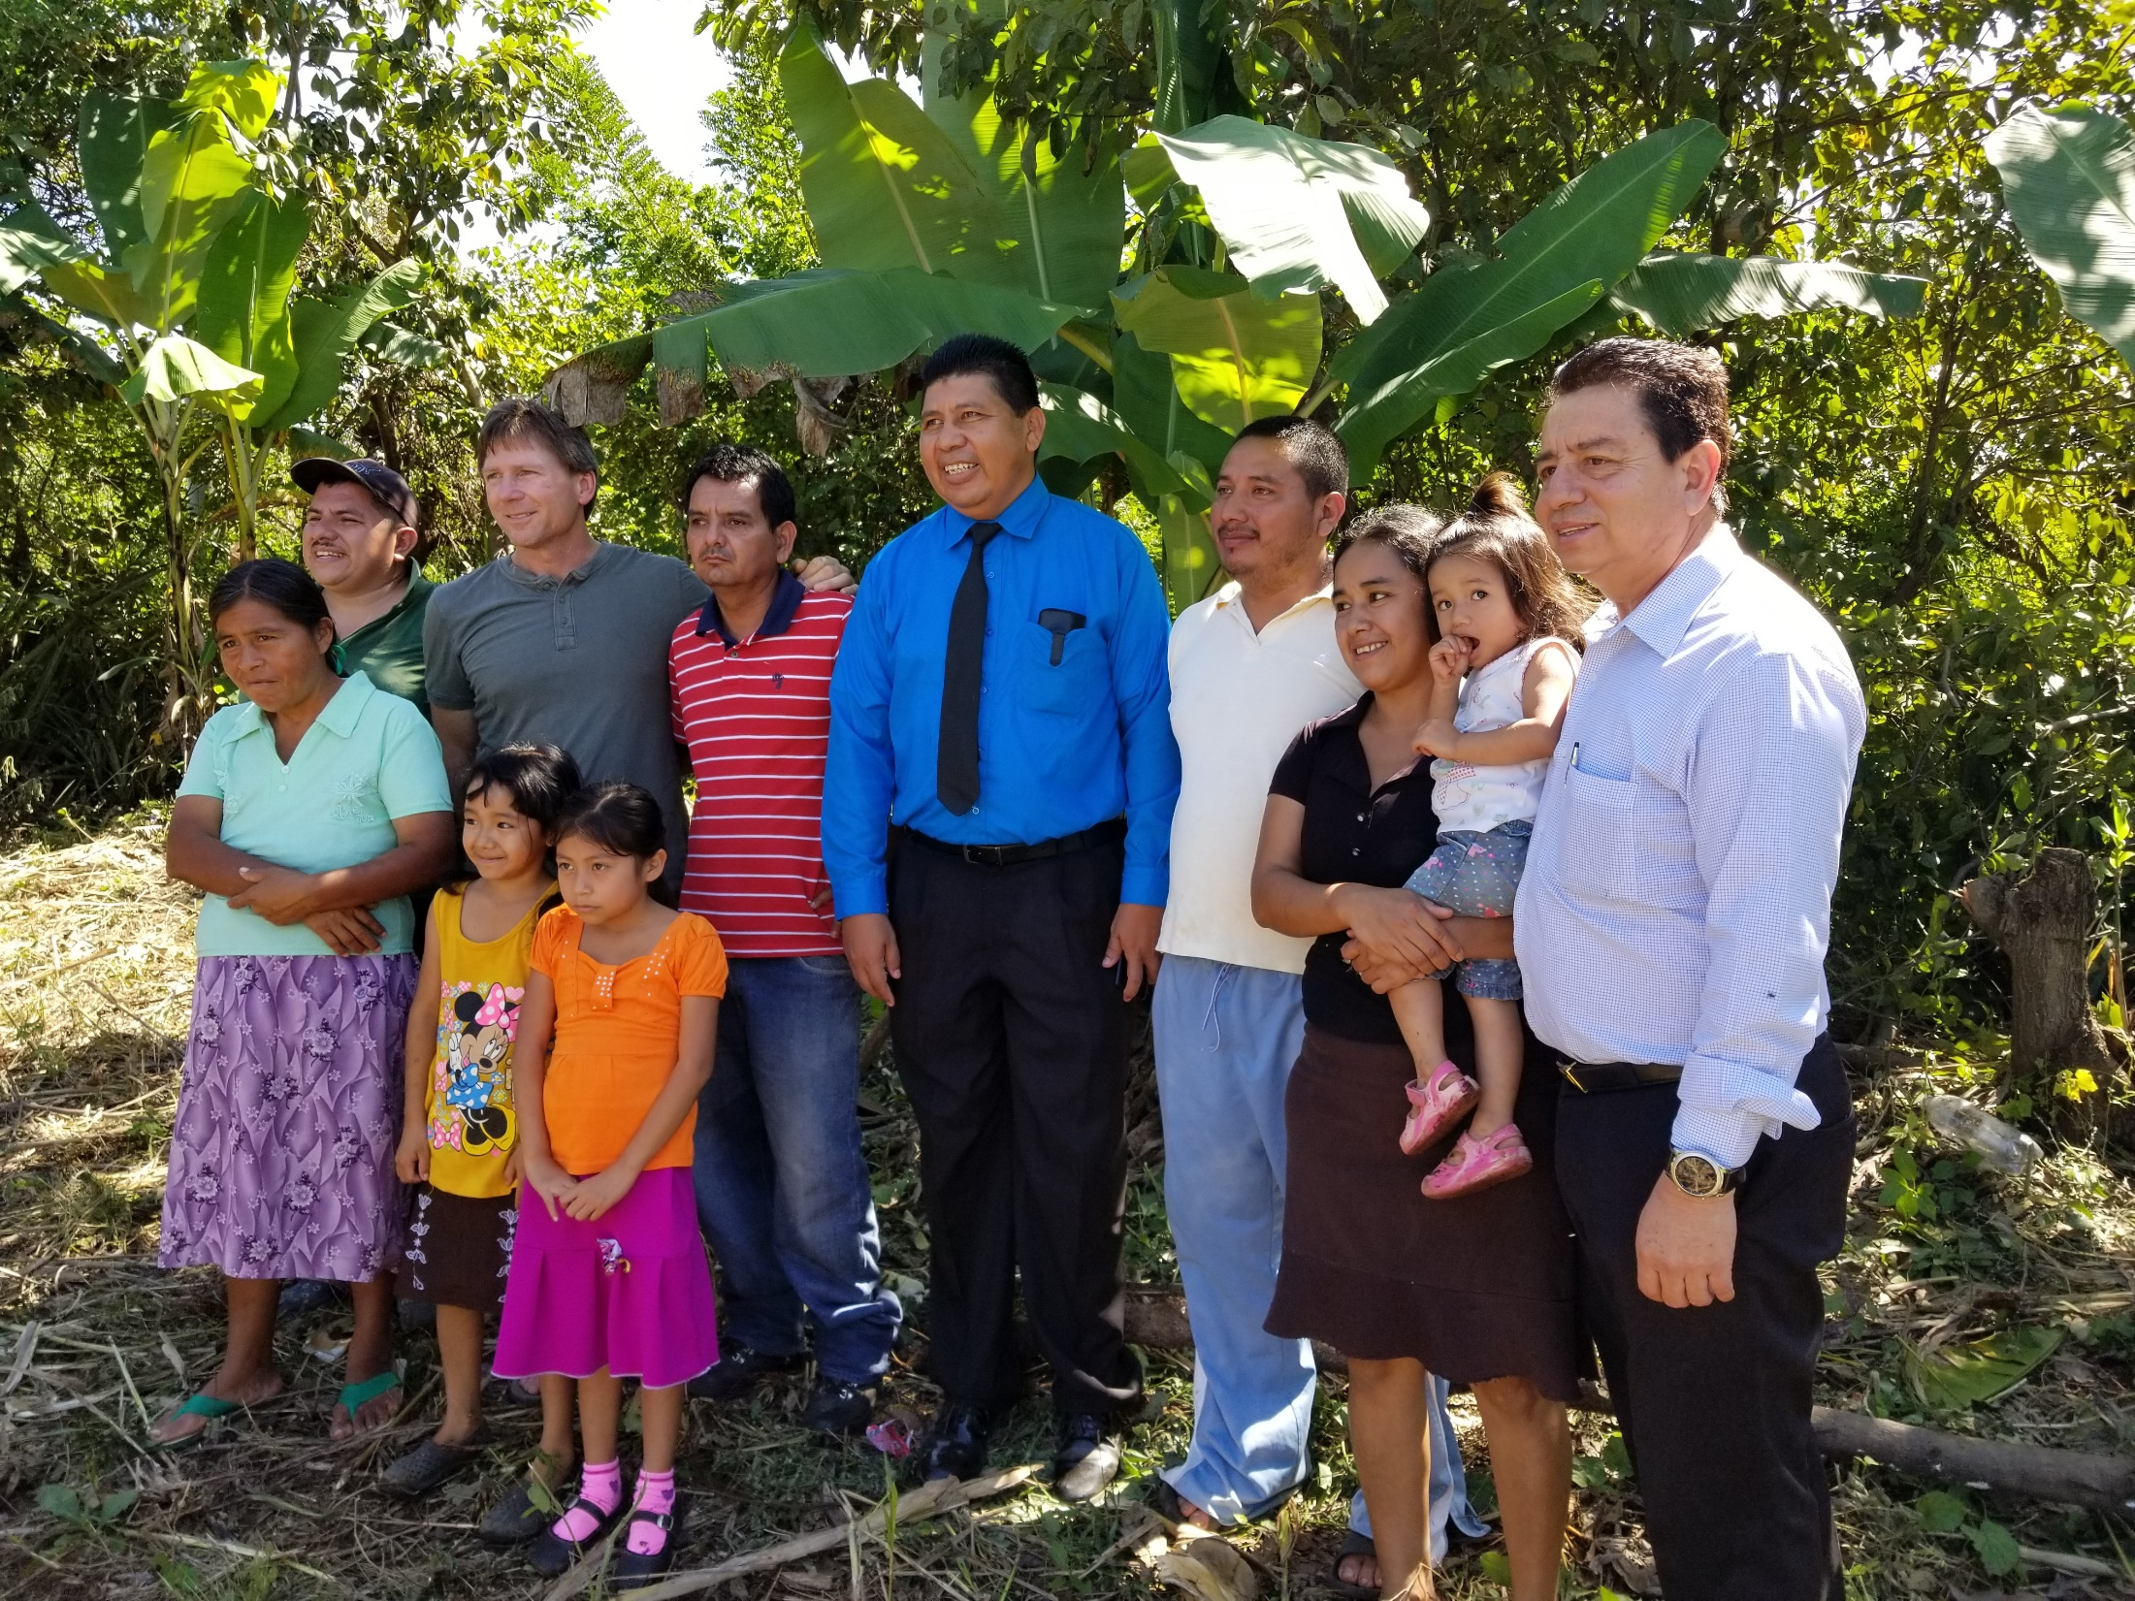
Notes:
While we were standing there Steve ( Oakwood church ) said that his family was going to give the money so they could build the church
The expectation is that it will be built by the time we go back in March so we will be able to dedicate the church while we are there.
Fidel – Treasurer of the Union
Guy in blue is the pastor (every Pastor in El Salvador has between 10-20 churches) The rest of the people were some of the church members
From there we went to

Slide 21
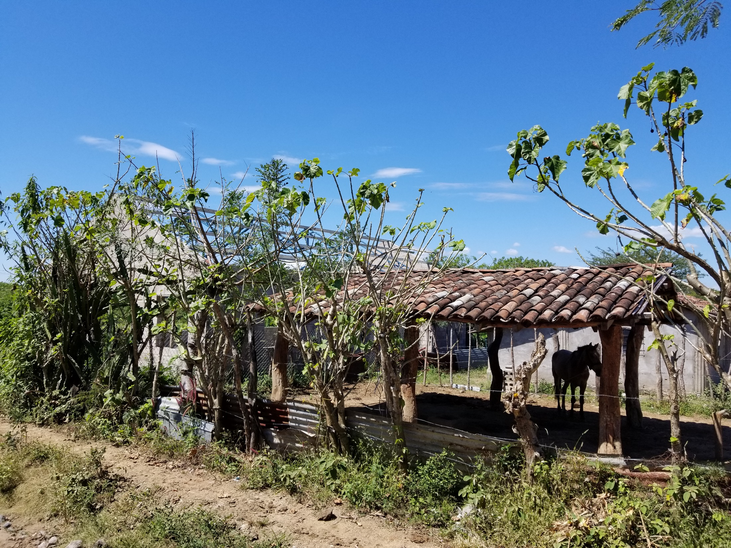
Notes:
This place in Chanama
Guy donated the land – He is not an Adventist
His house to the right – out of country - he is letting them hold the services in his house

Slide 22
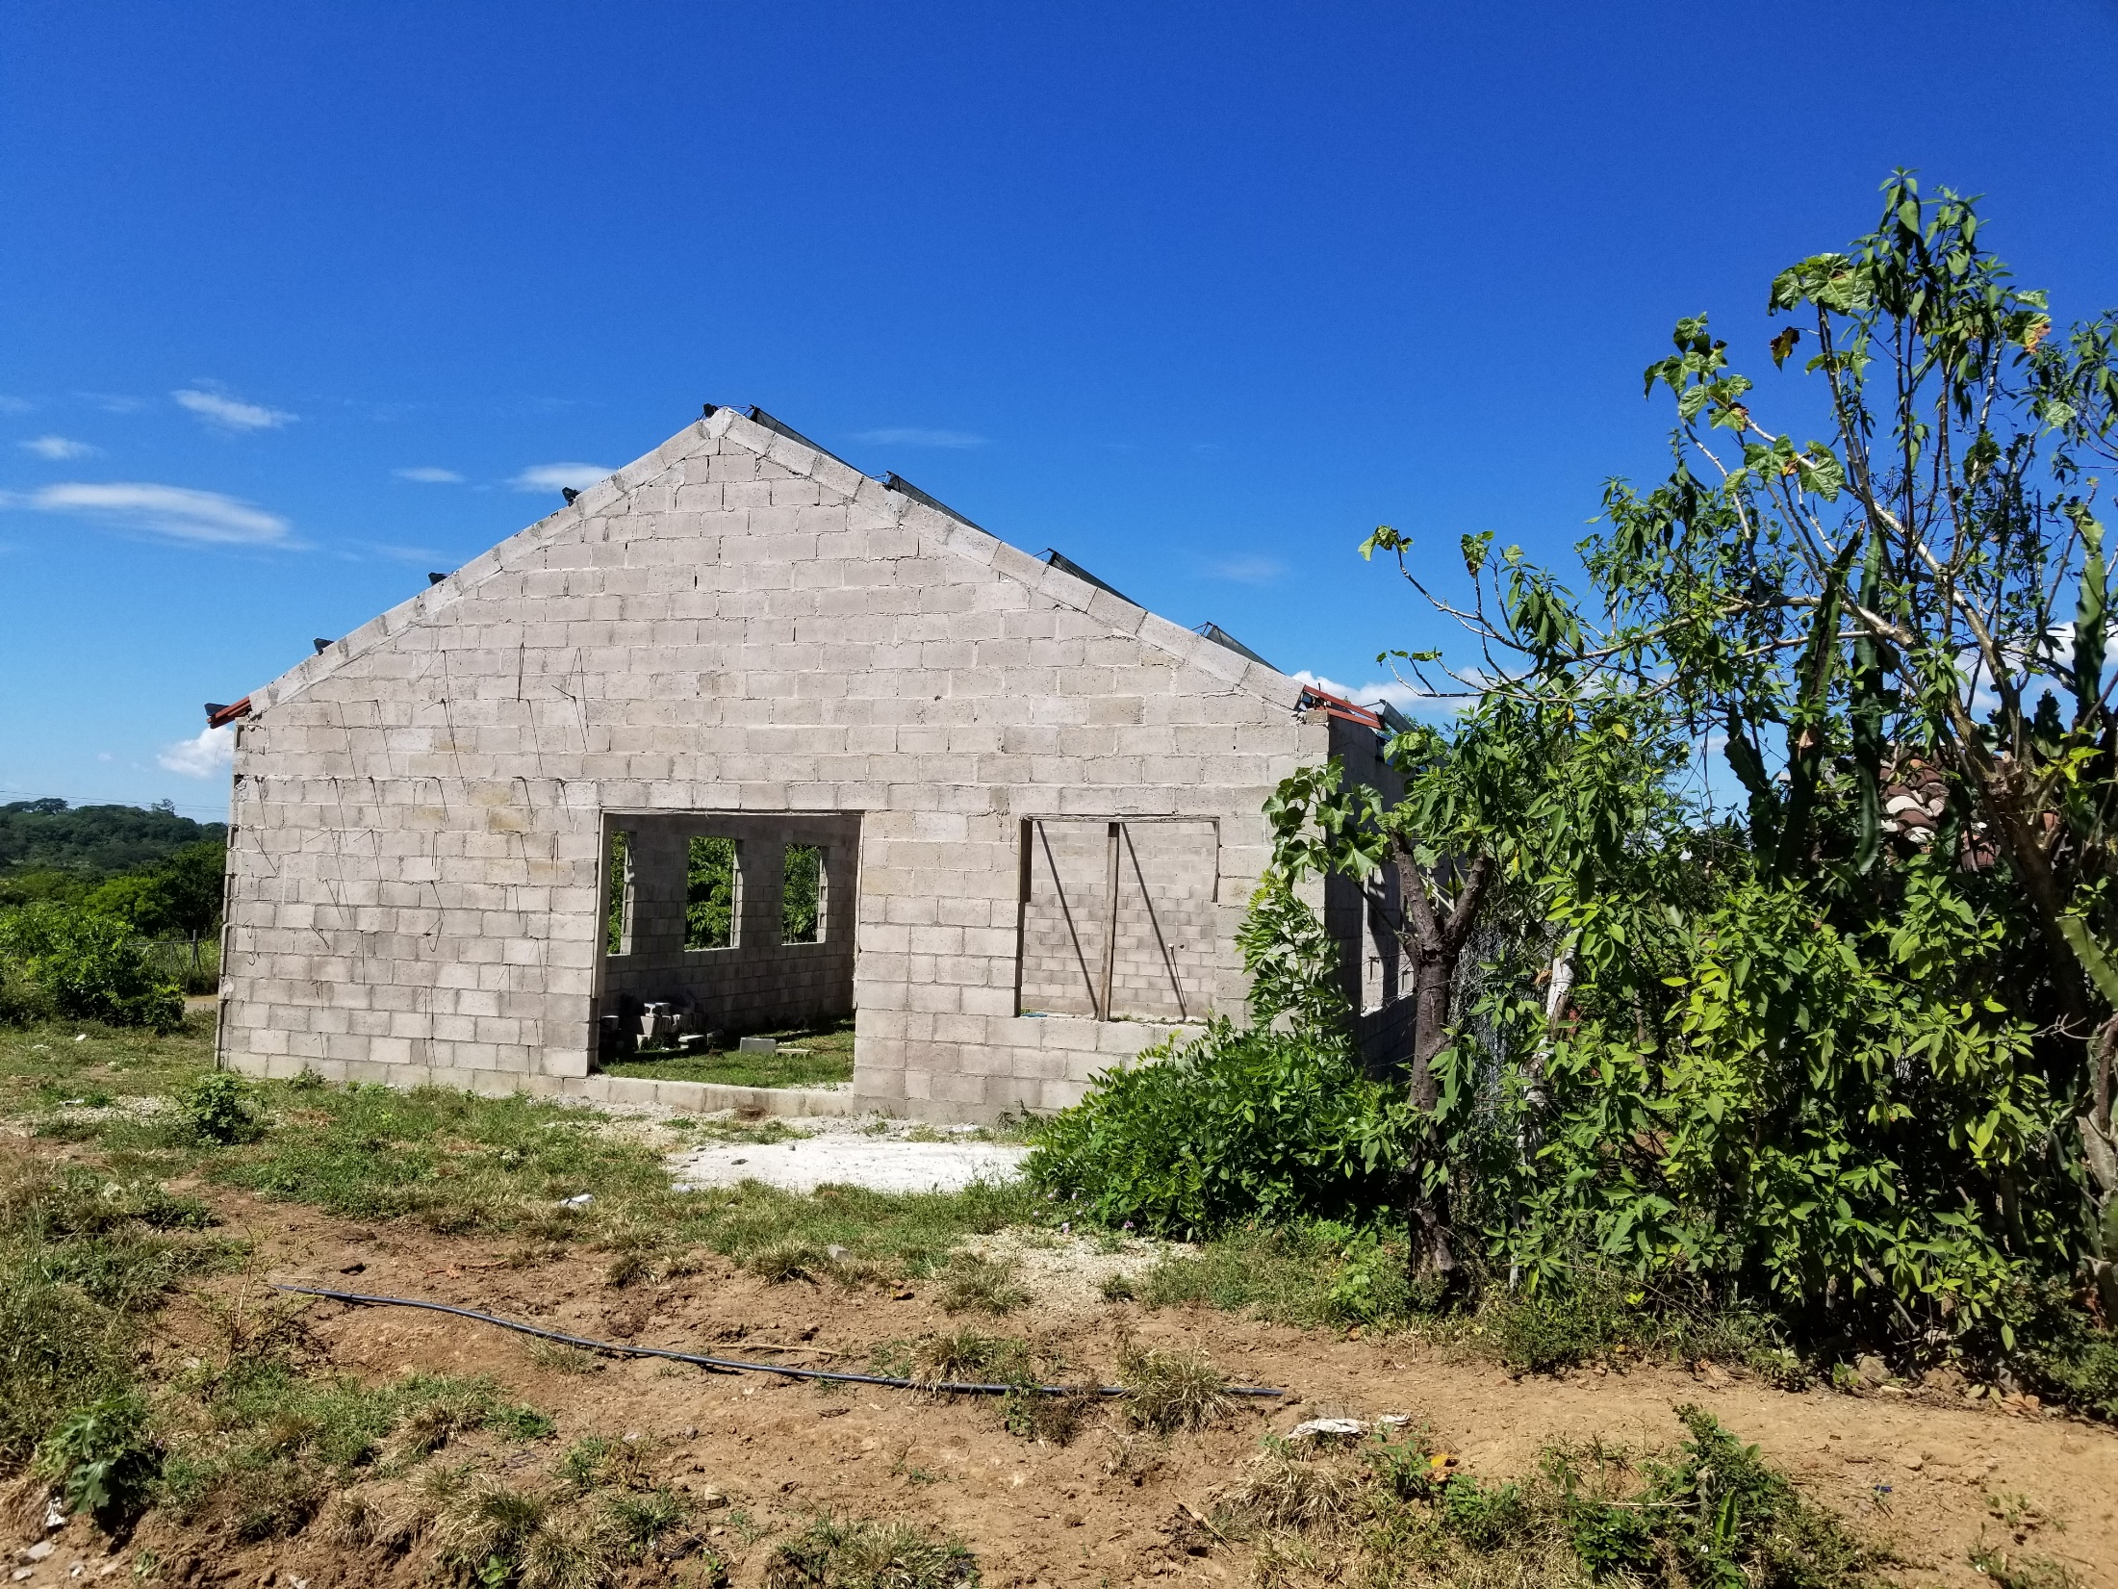
Notes:
They started to build the church
Everything there was donated
Mayor gave them access to his property on the other side of the road to park there cars
But they ran out of money

Slide 23
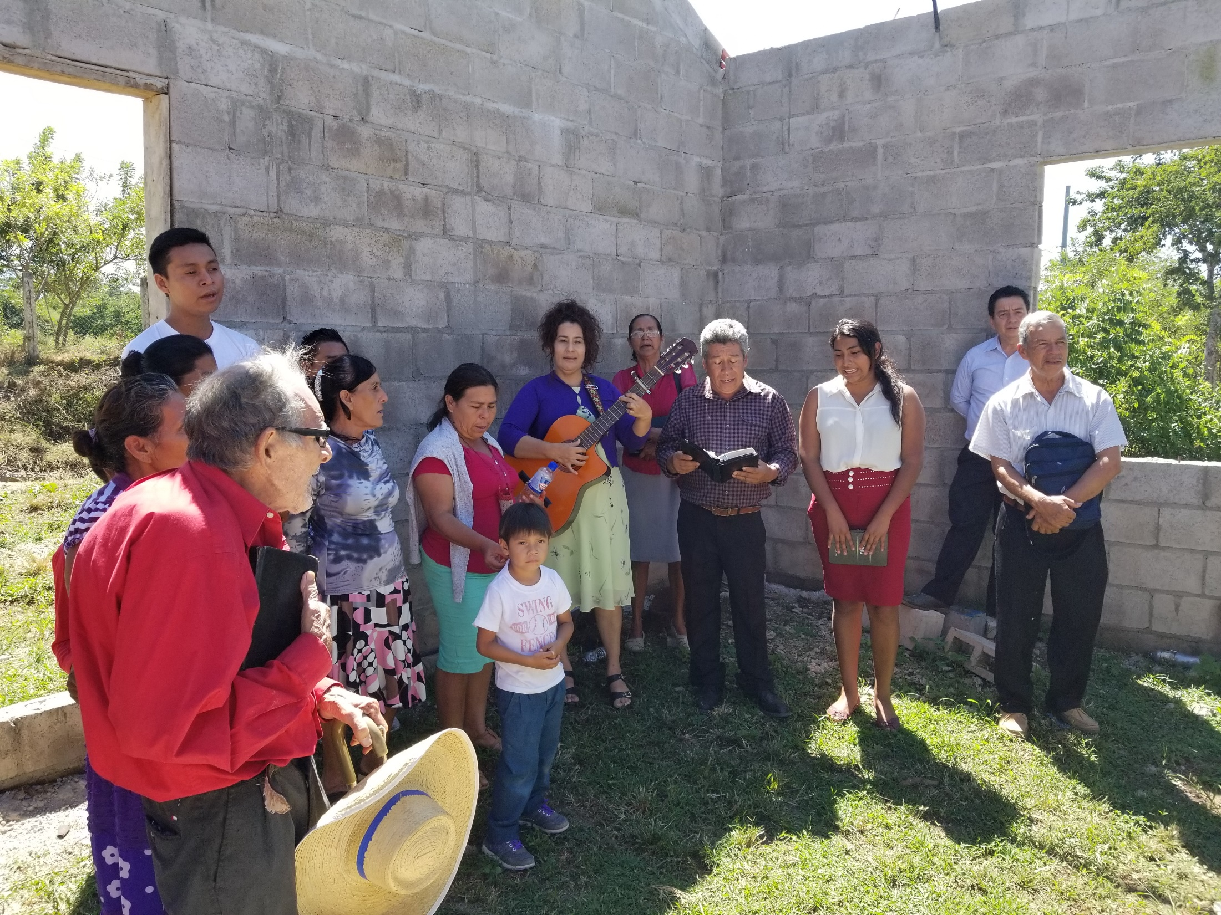
Notes:
Here is some members of the church who were singing to us.
Talk about Victor Emanuel and the gentleman who did most of the talking
Church started a year ago with 10 people – no have about 40 members
Church will double by 1 year after completed (every member evangelizing) go door to door inviting others
Pastor Alex and Lyle (led to pay for church and build classrooms
$7,500.00
That evening (November 8th)
We went to

Slide 24
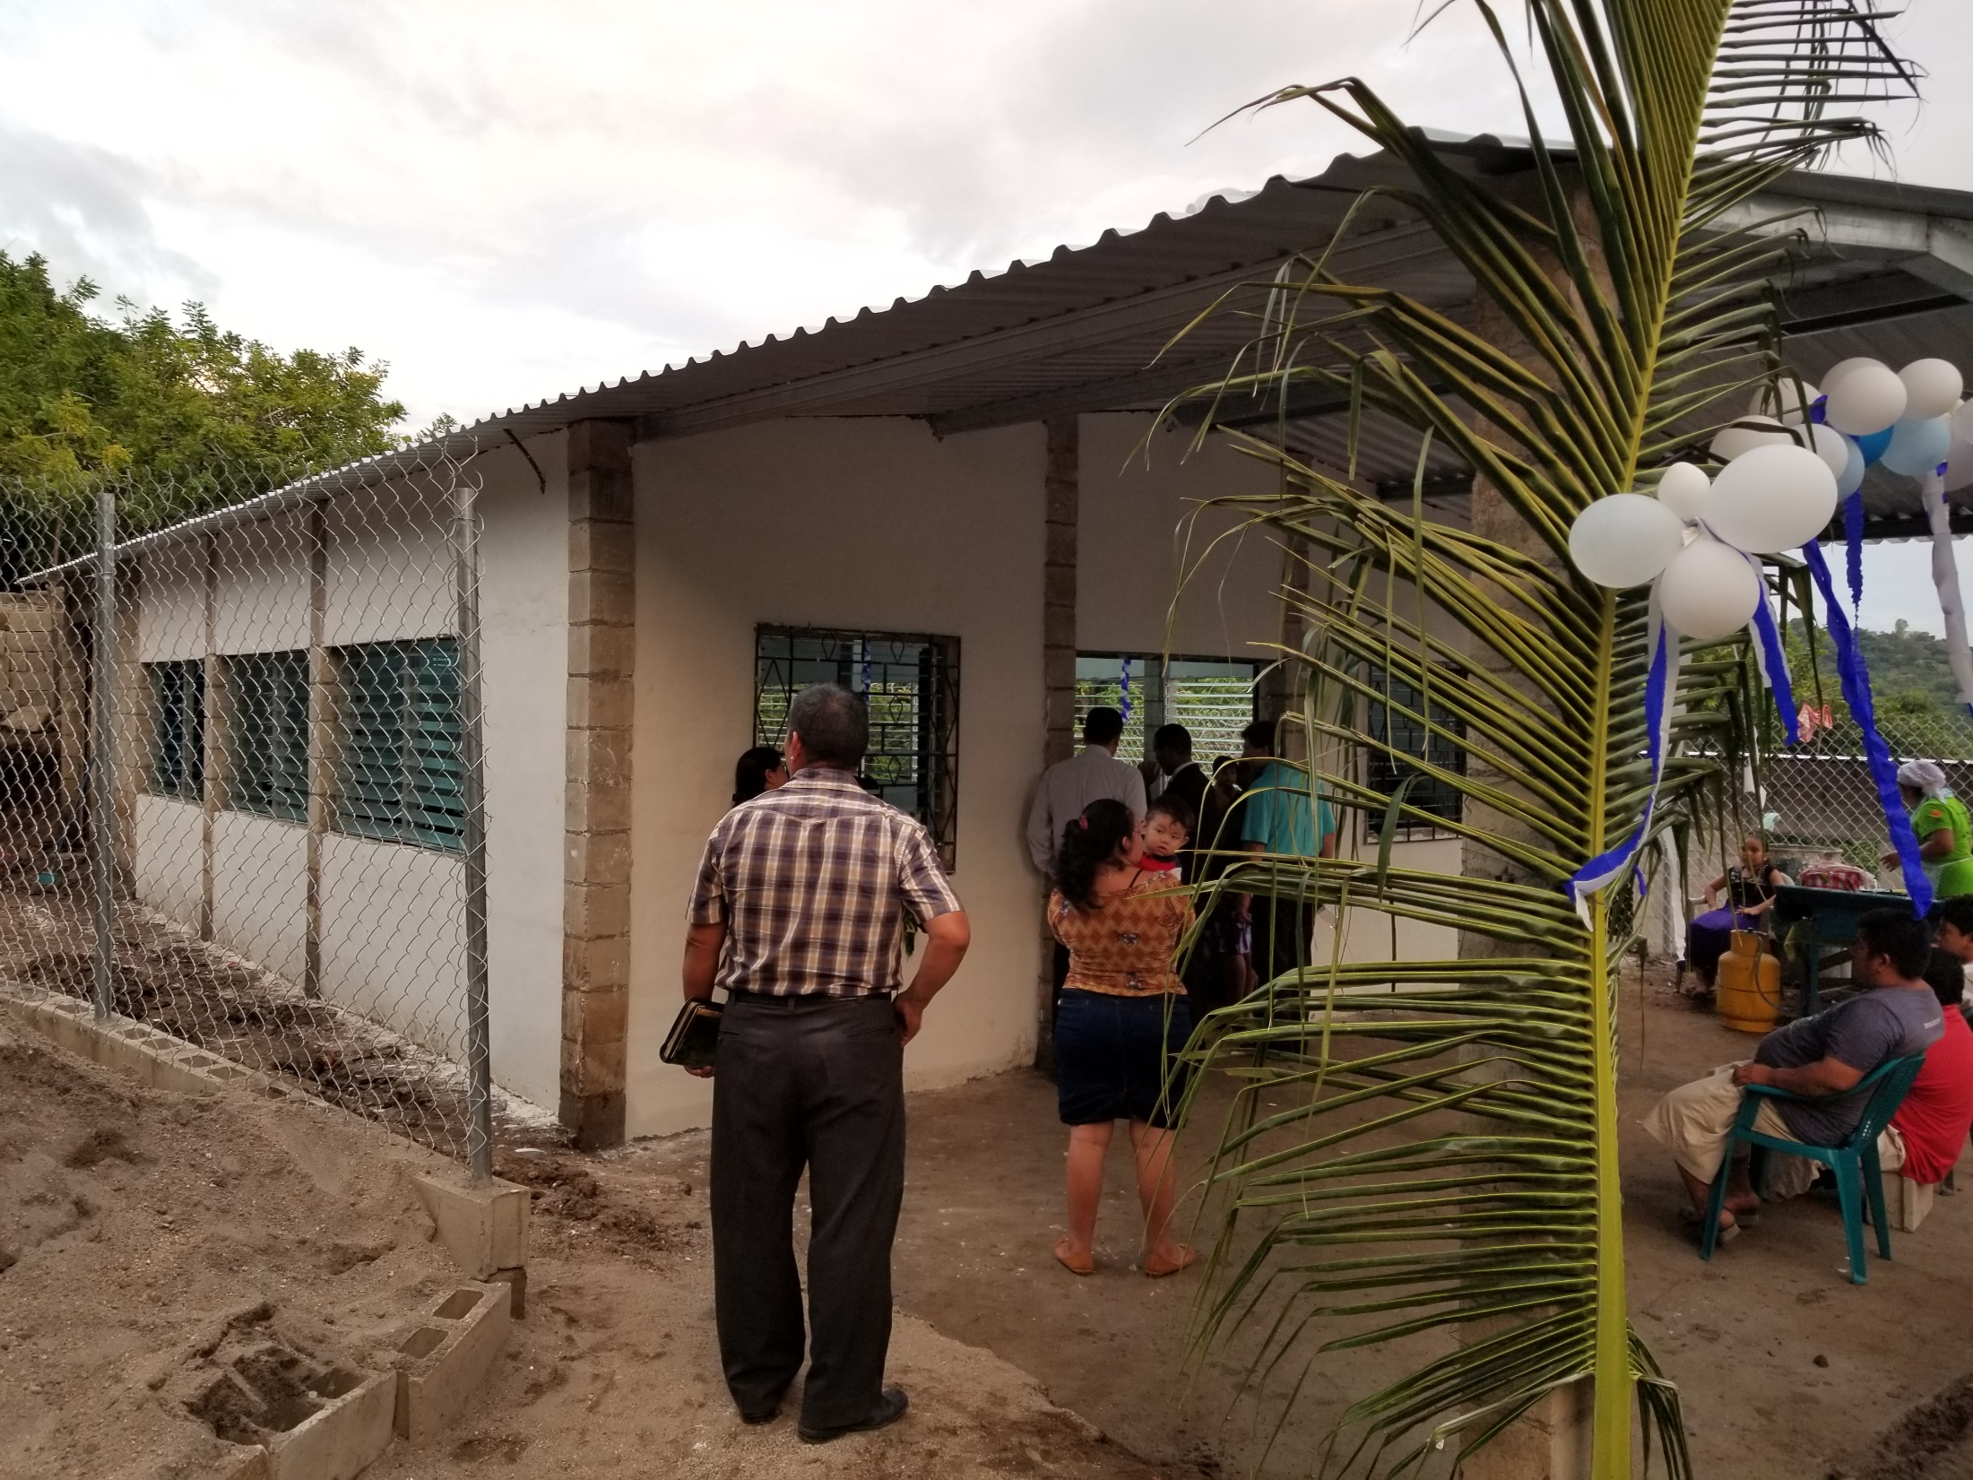
Notes:
This church in San Diemongo
This is a church that the Village church in Berrien Springs provided the $10,000 to build
Concrete slab, footings, walls, roof, and windows
Church members provided all of the labor

Slide 25
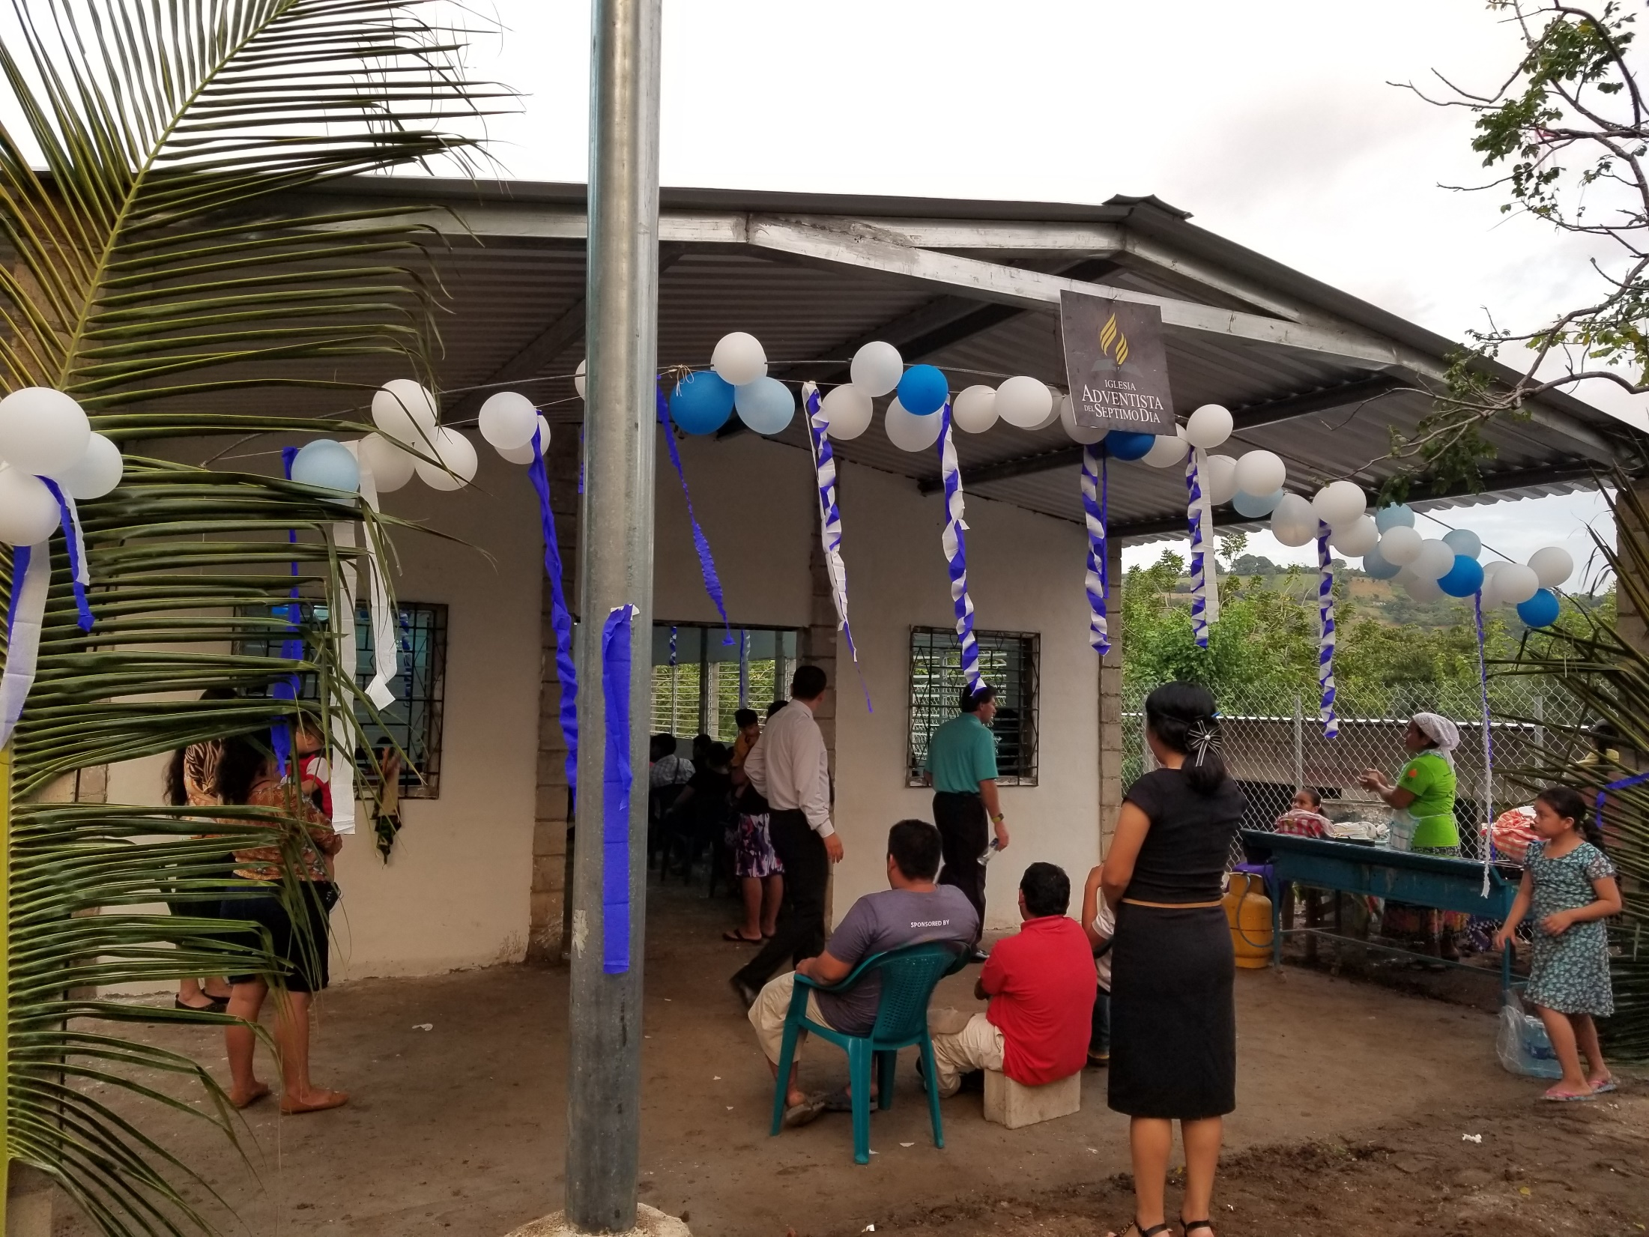

Slide 26
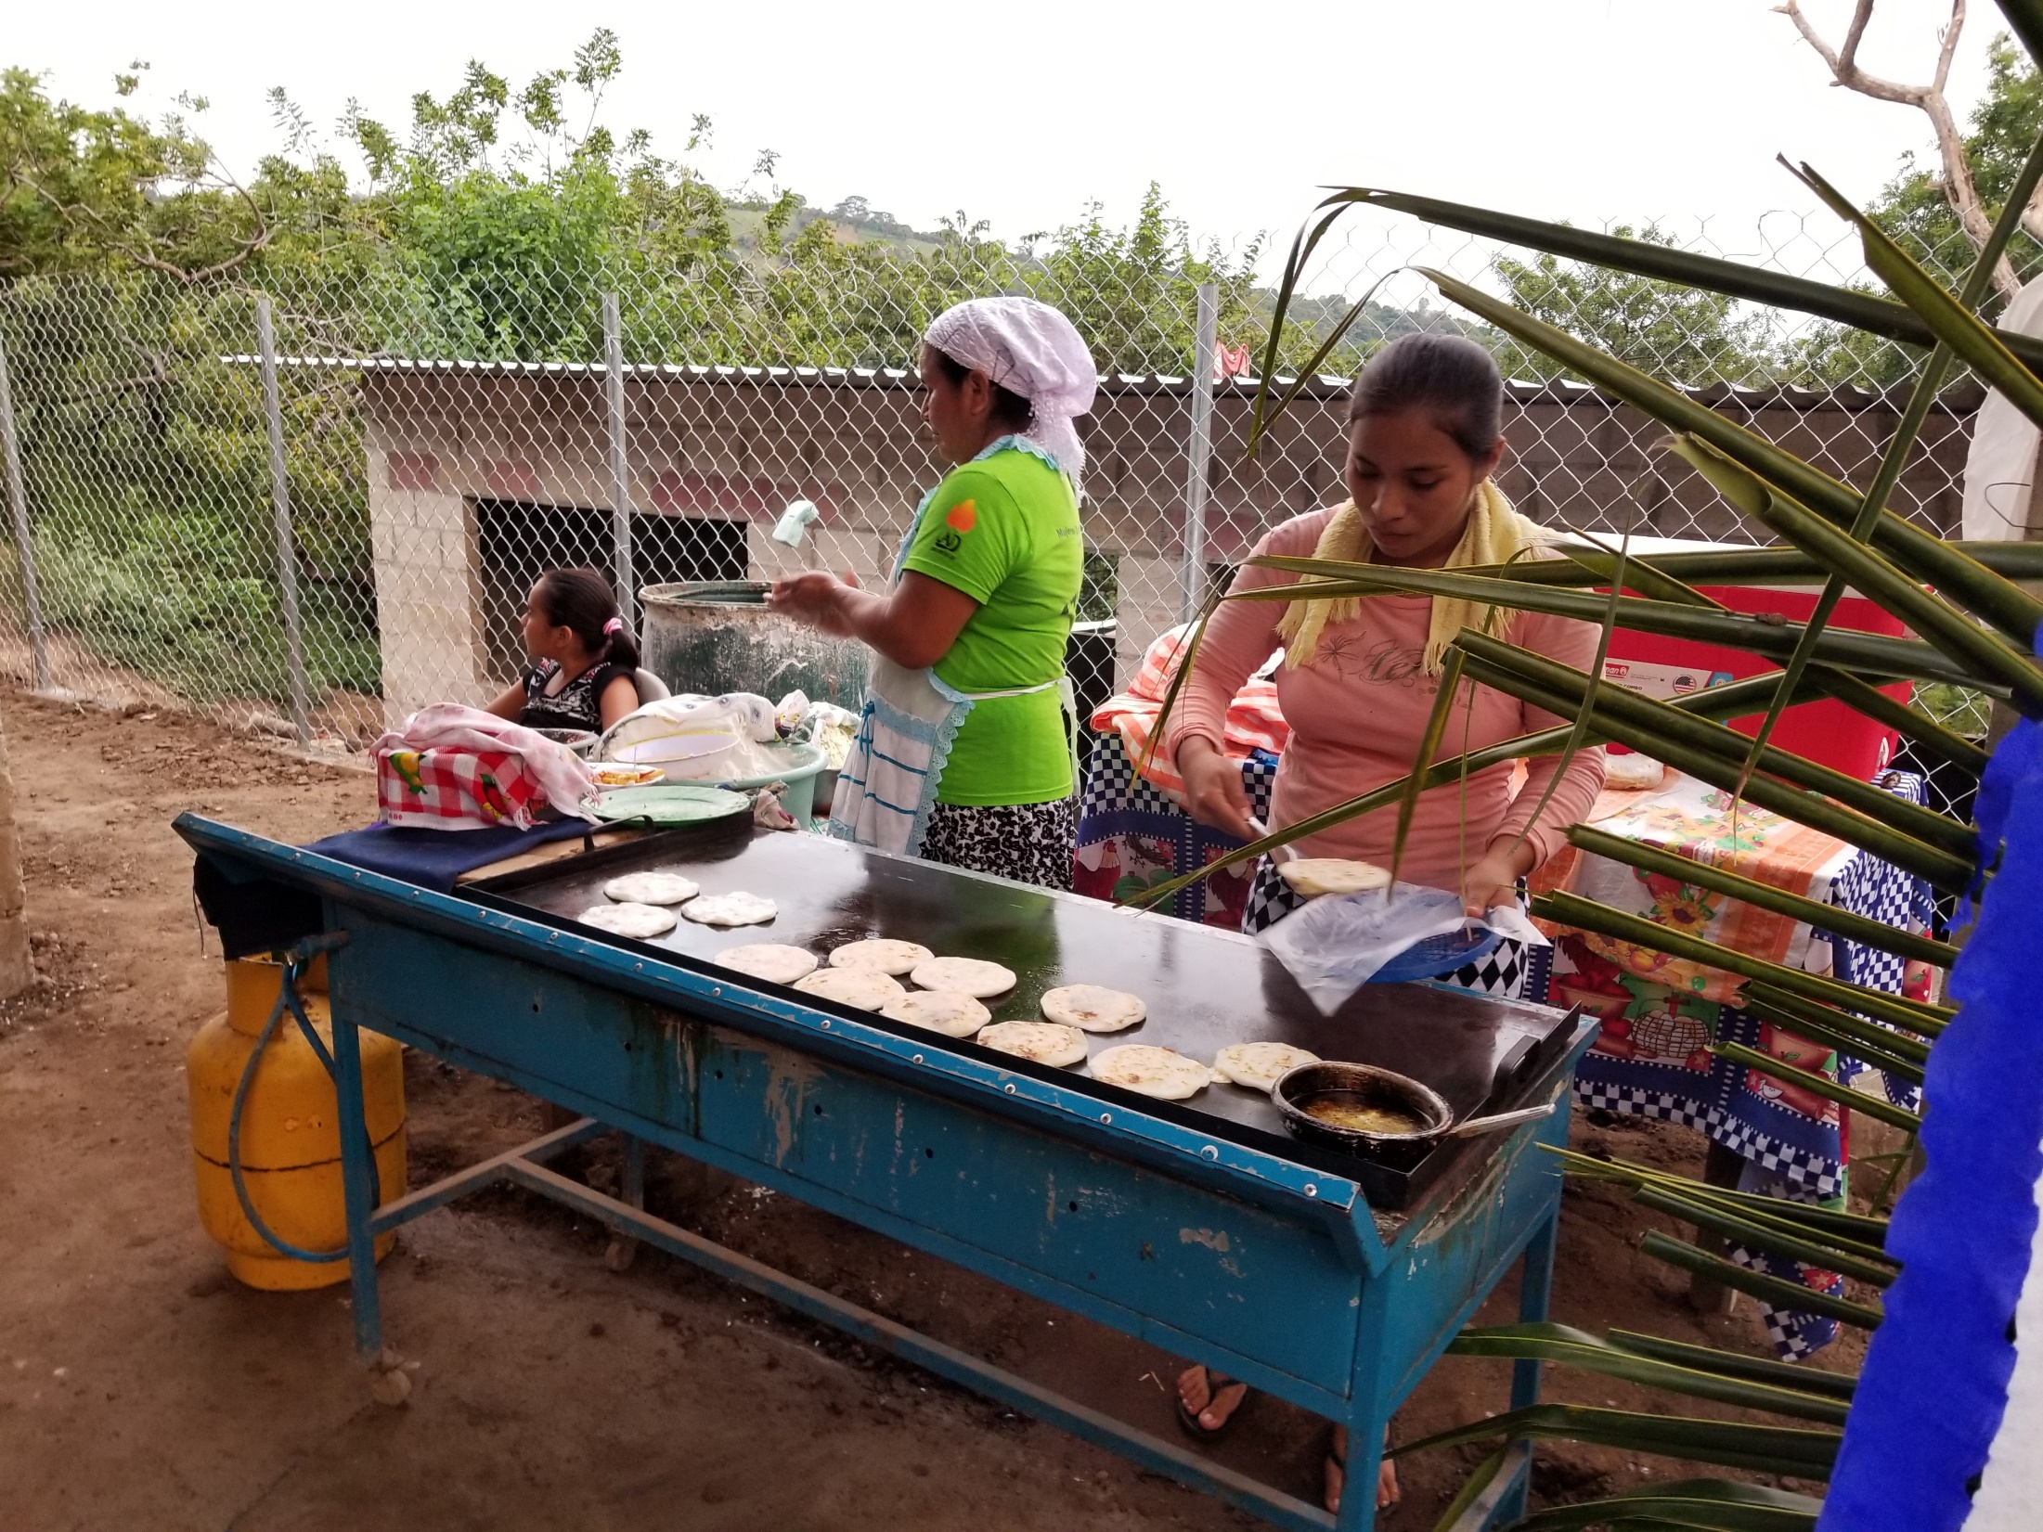
Notes:
Ladies cooking
Provided us dinner
Papusa’s

Slide 27
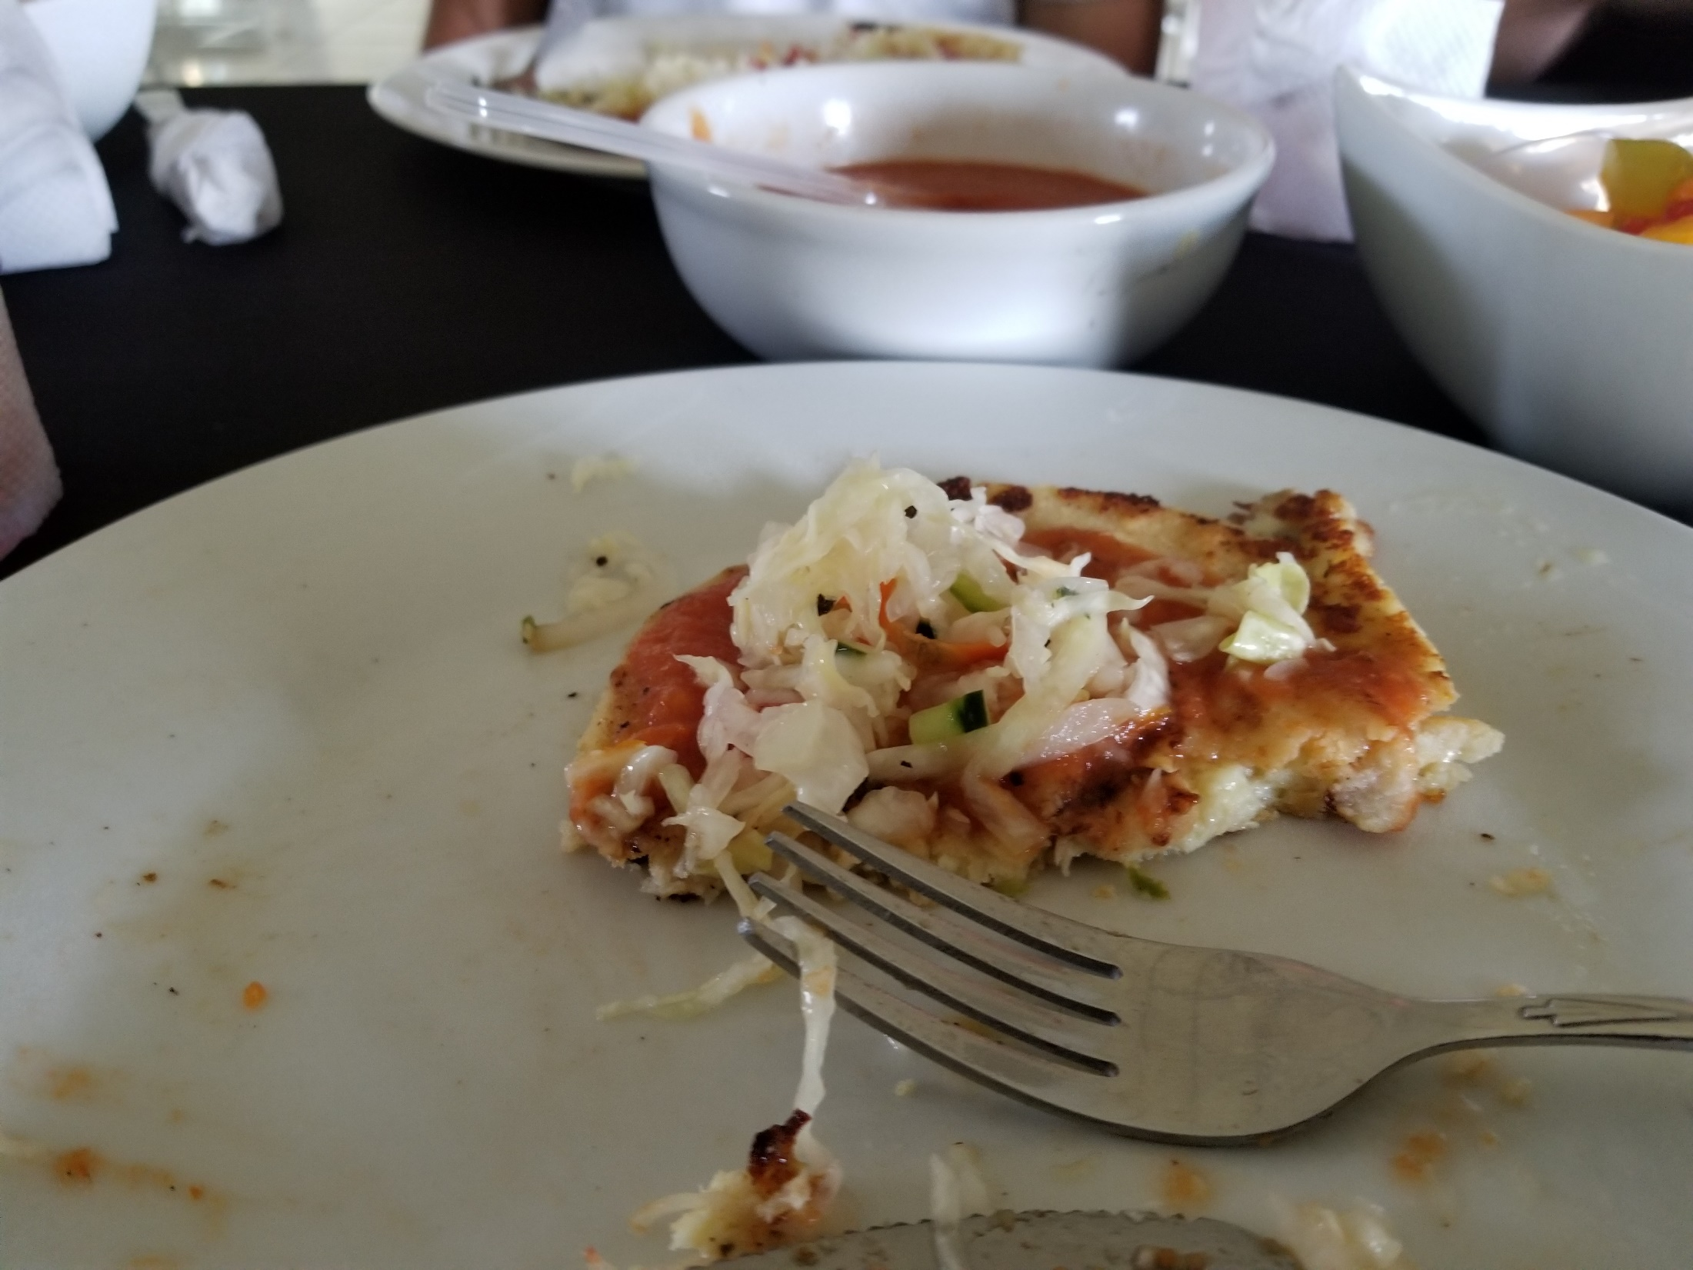
Notes:
Made out of corn flour
Stuffed in side with refried beans, cheese, jalapeno
Tomato sauce up at the top
Cabbage, cucumber and tomato

Slide 28
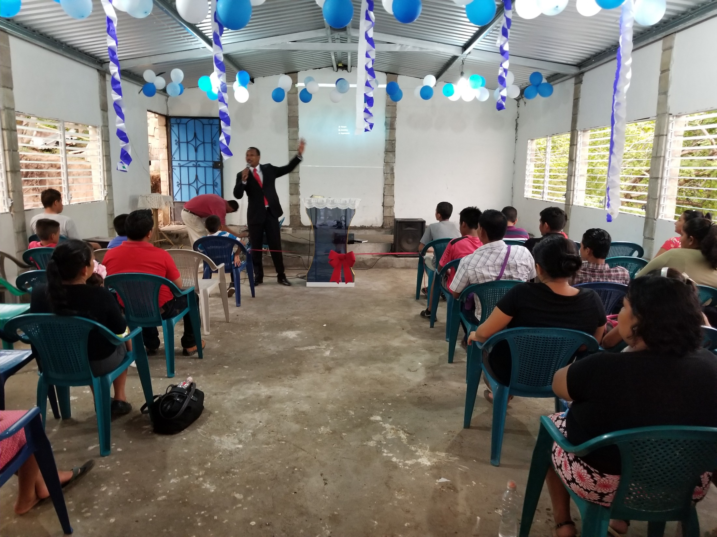
Notes:
Here is the inside of the church
Pastor speaking
Look how basic it is
Baptistery in the floor
Walls, ceiling, floor, lights
Chairs were full by the time we started the dedication service. (Notice those plastic chairs)
Been a church for just over a year.
Guy in red shirt left his community, got saved, came back to his community and helped build this group up. Now have about 40 members
Planning there first evangelism meeting next month. But they already have 15 bible studies going since they finished the building a few weeks ago.

Slide 29
Notes:
Pastor Ron Kelly and Ariel Roldan during the dedication

Slide 30
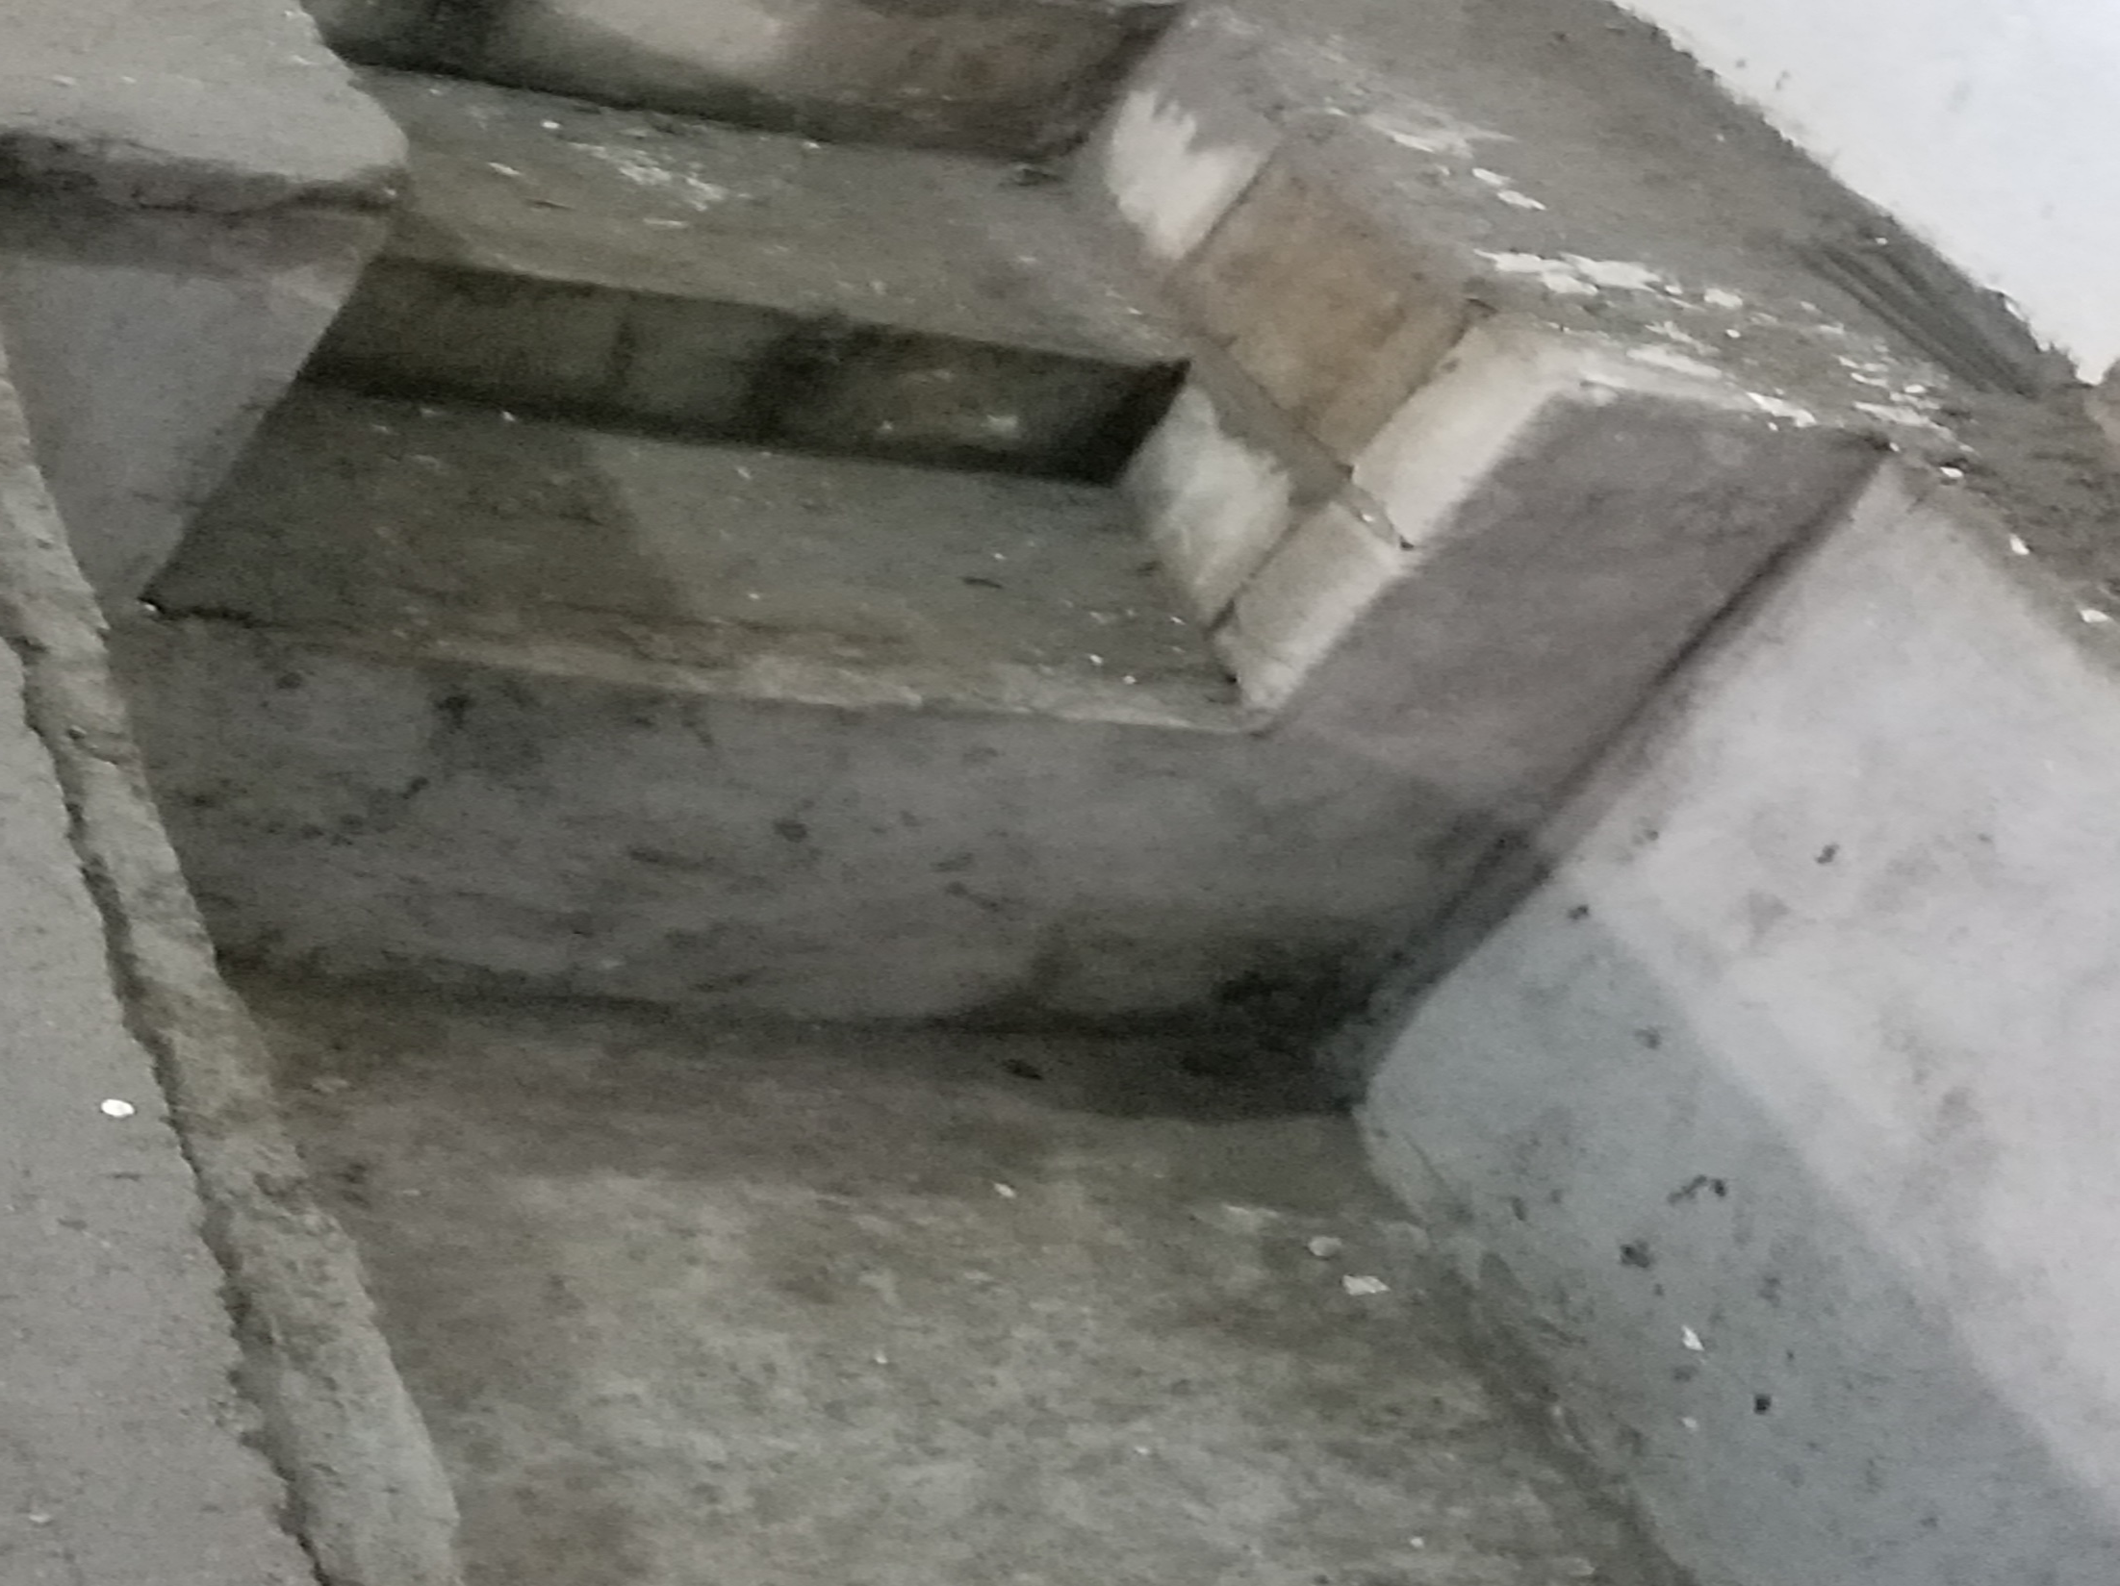
Notes:
Here is a picture of the baptitery

Slide 31
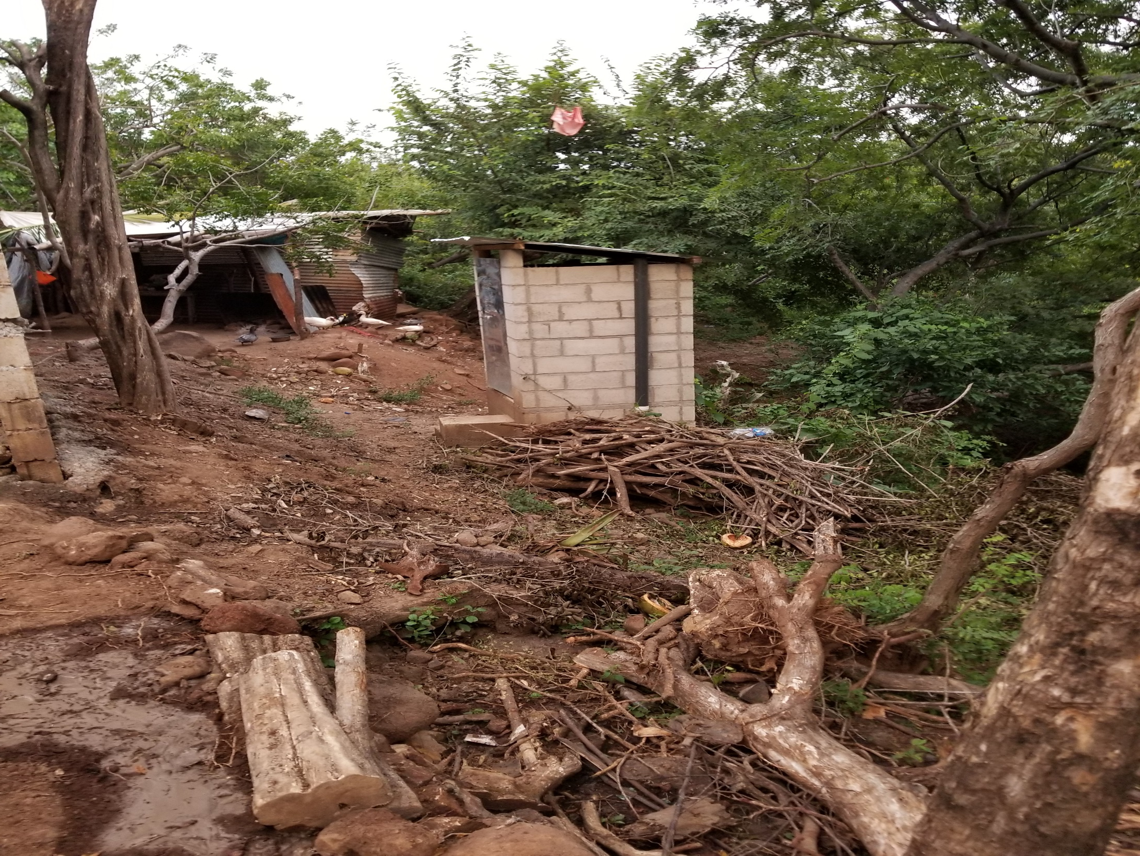
Notes:
And here is one of the bathroom out back

Slide 32
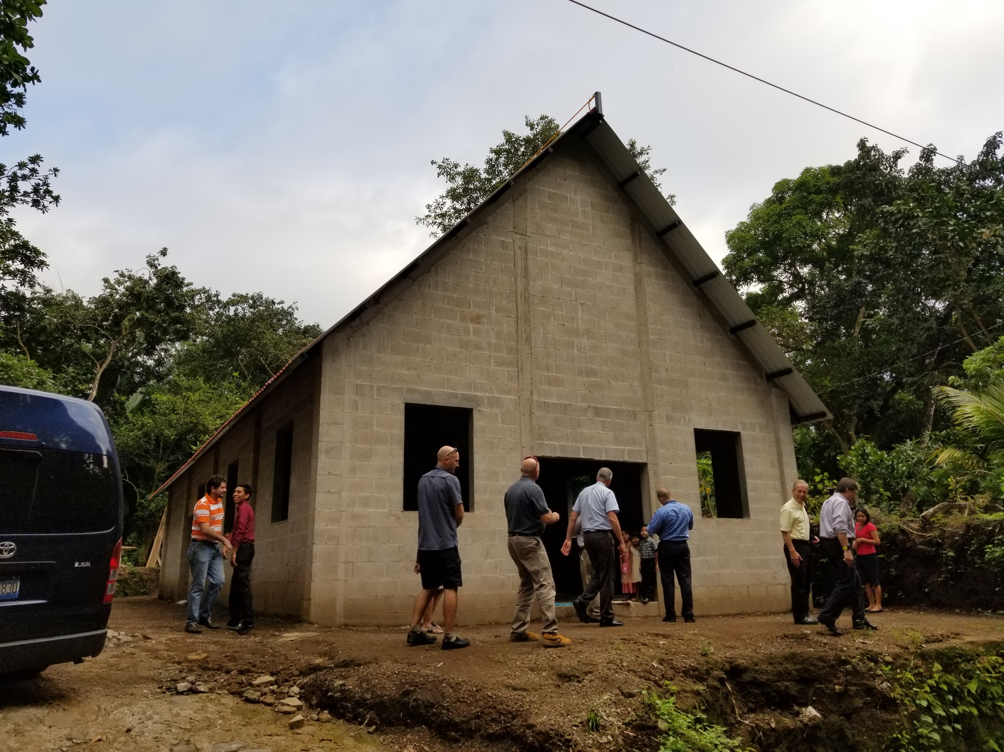
Notes:
The following day (Friday November 9th we looked at the facilities that we were staying at and will be again in March when we go back. I will talk more about that in a moment
But that afternoon we went to this church. This is another one that the Village church in Berrien Springs provided the money for to build.

Slide 33
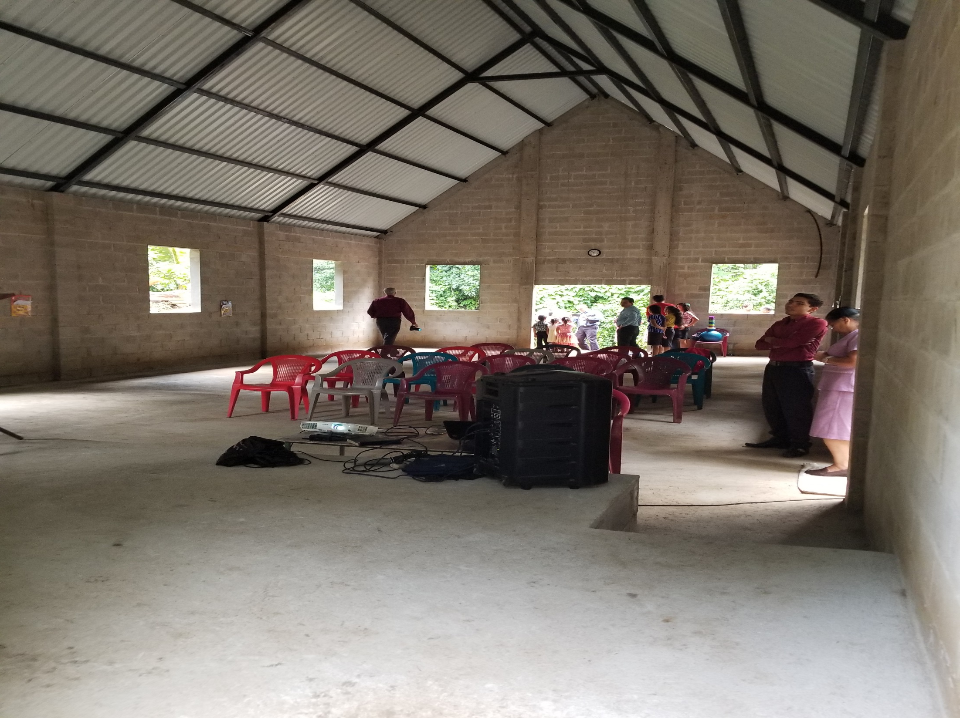
Notes:
Here is a picture of the inside
Not quite ready to be dedicated yet. No windows, doors or lights
But they are already holding services here

Slide 34
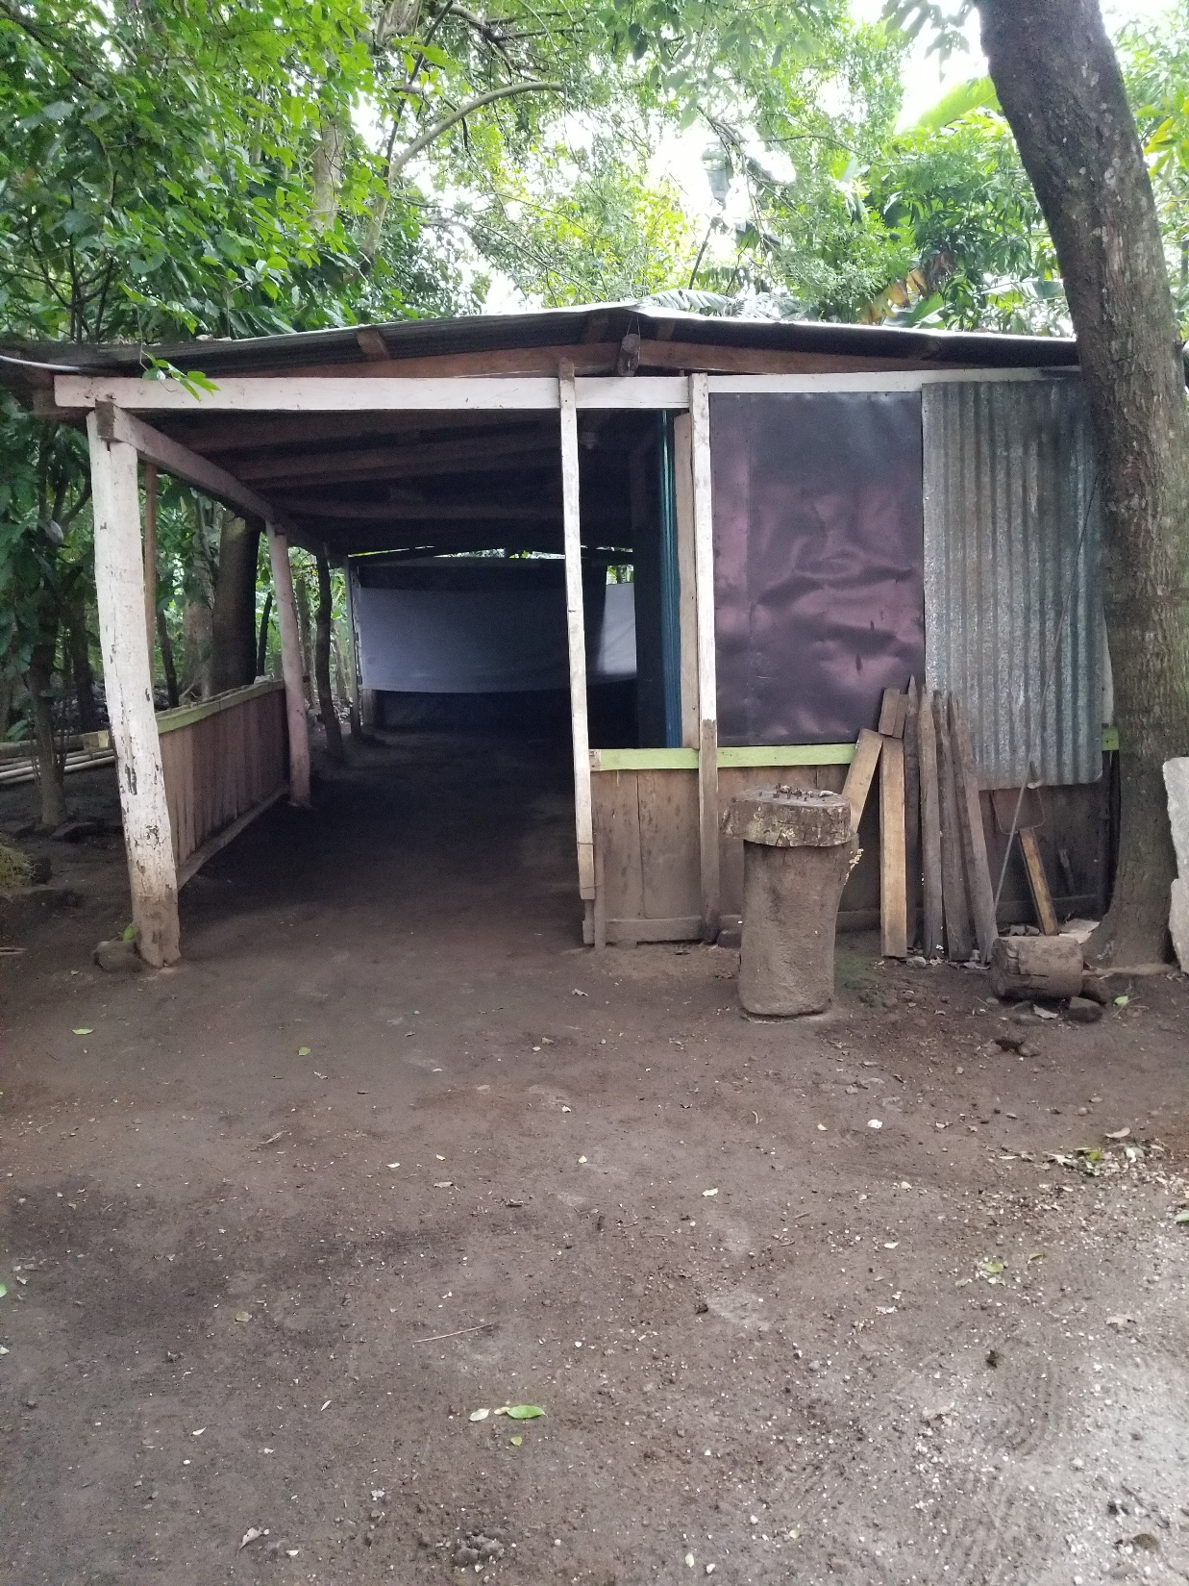
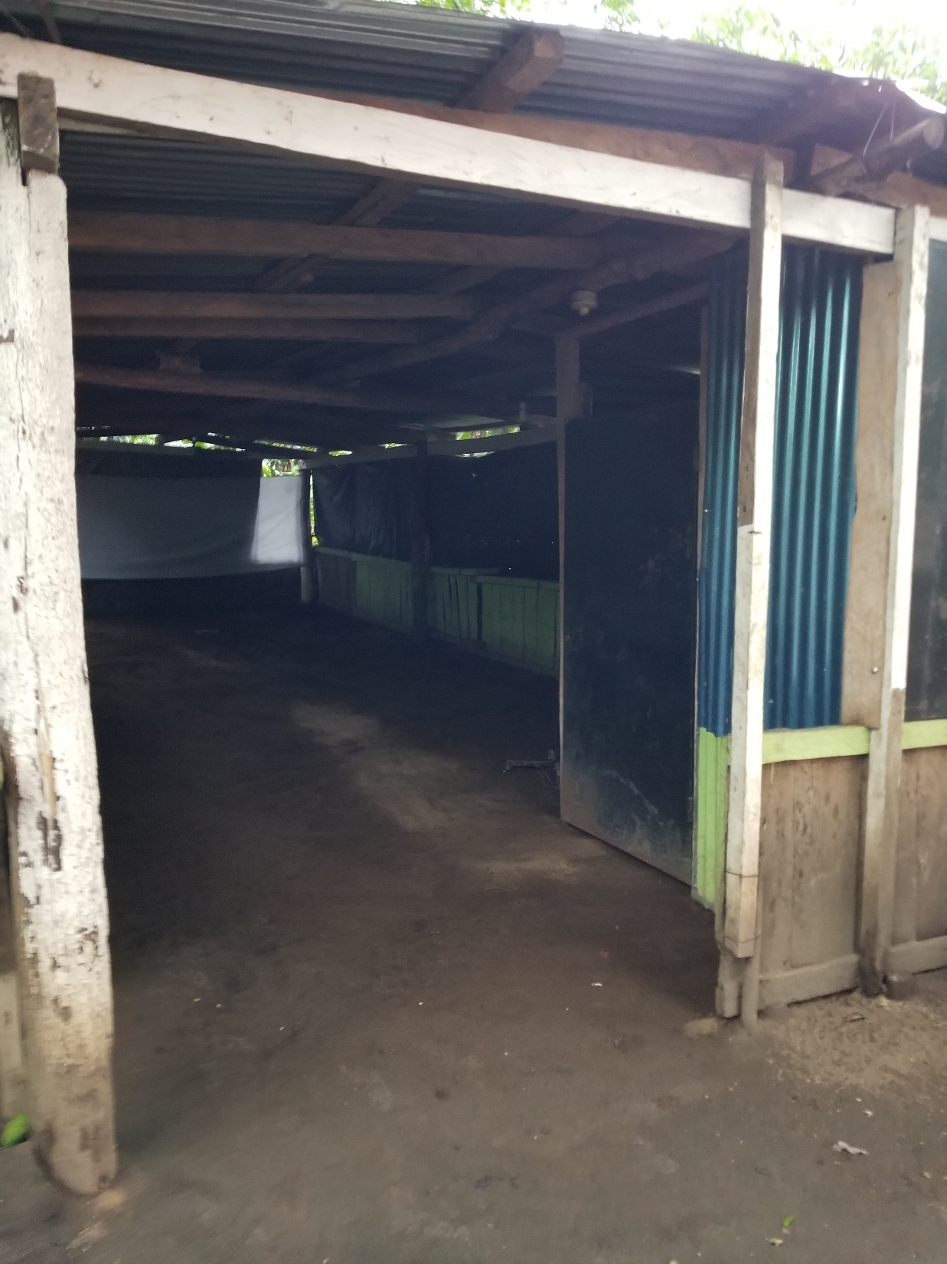
Notes:
Right next door is the building that they have been holding worship in for over a year
By the way – every church that we went to – we asked them how often they meet. Every single one said 3-5 days per week

Slide 35
Notes:
Friday evening we went to Culuco (Part of Sonsonate district ) Lower left
To this church

Slide 36
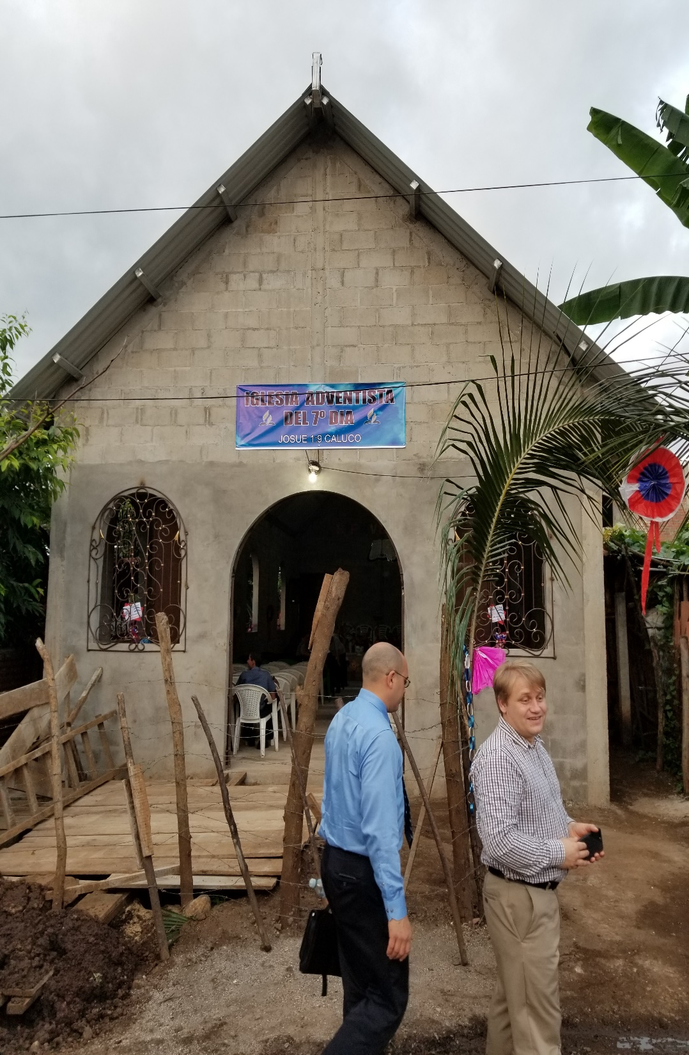
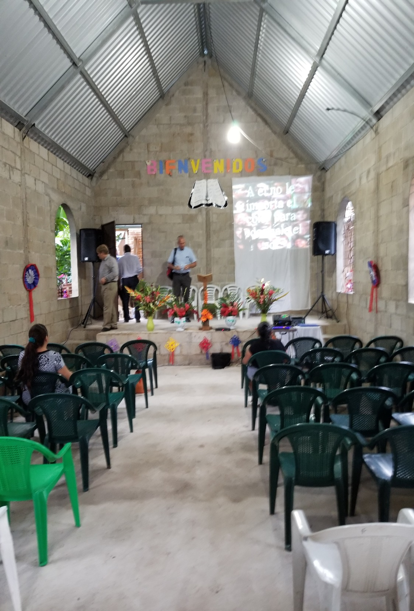
Notes:
For the dedication. Another one that the village church paid for. They have about 30 members in this church, but what was interesting was that they had 100 chairs set up and they were all full.
They had 30 people from the community there. 15 of them they are having bible studies with.
Did you catch what I said 30 people in the church and 15 bible studies. Half the church is already giving a bible study
If you look at the left side of the stage you will see a door going out the back.
If you go out there you will see

Slide 37
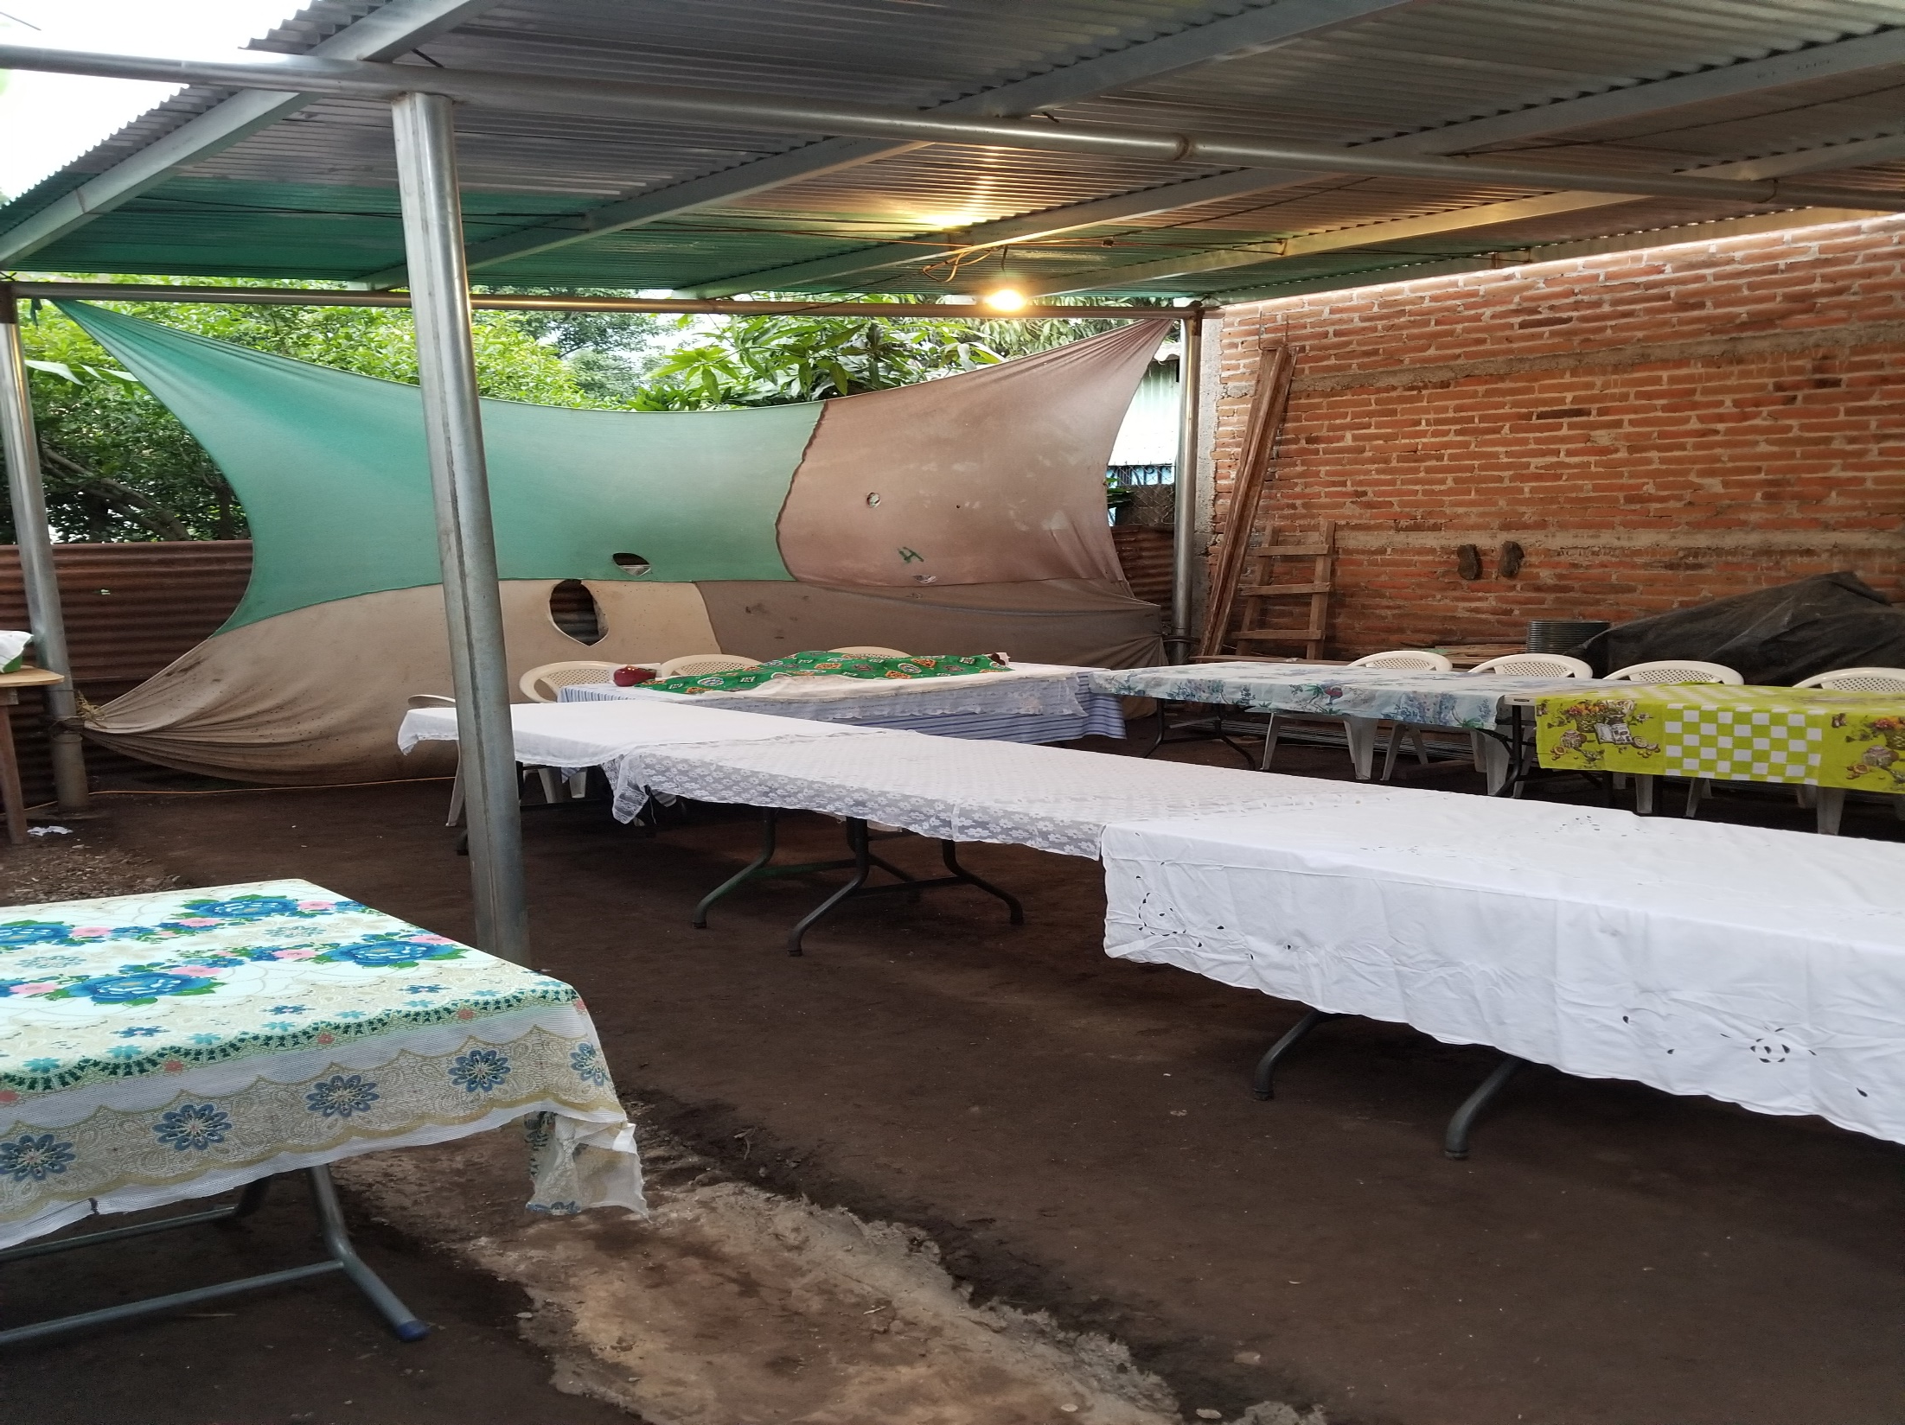
Notes:
This covered area where they have been holding their services for over a year.
Saturday morning, before we went to worship we went to

Slide 38
Notes:
Apopa – Just north of San Salvador

Slide 39
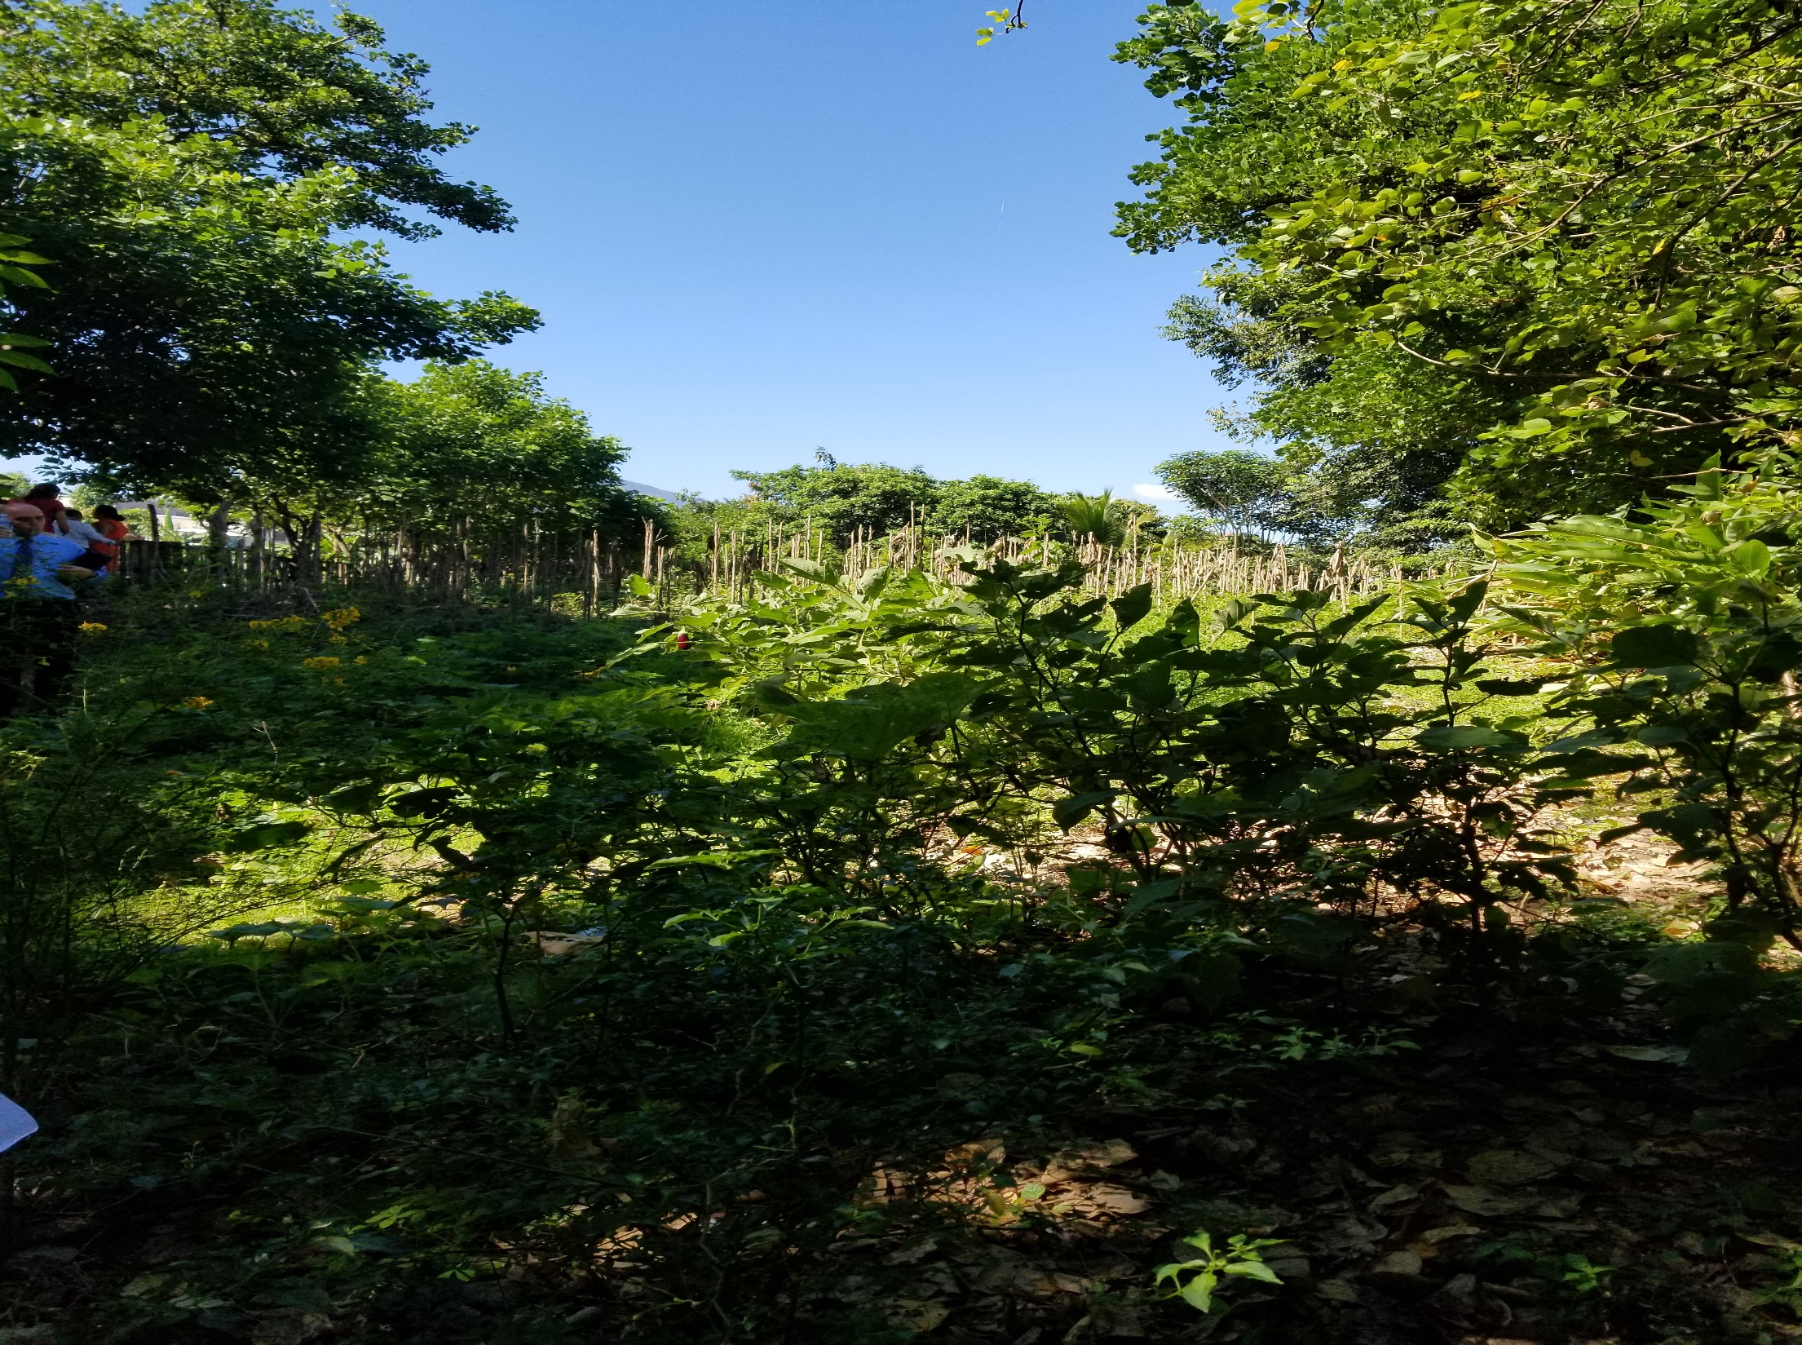
Notes:
To this site

Slide 40
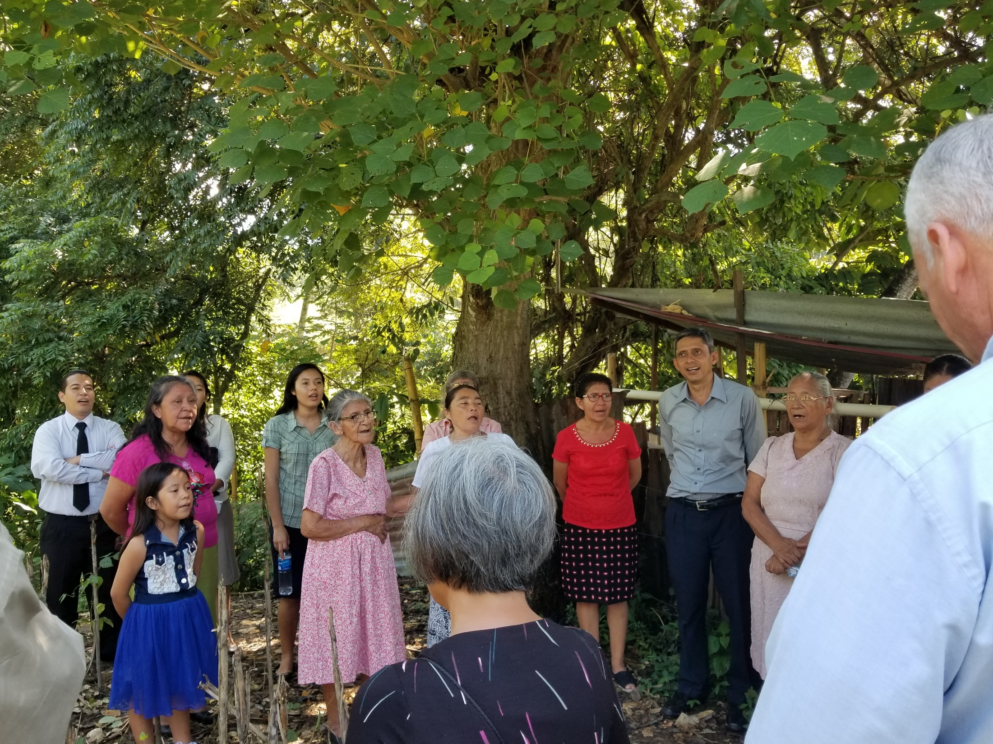
Notes:
The lady in red sold the church this property for $3,000
Remember how much land is worth in the country ($15,000). And this piece is bigger than any of the others that we looked at
This lady, who is dying of cancer, has been a member of this church for 10 years, and she has been praying for a building that whole time

Slide 41
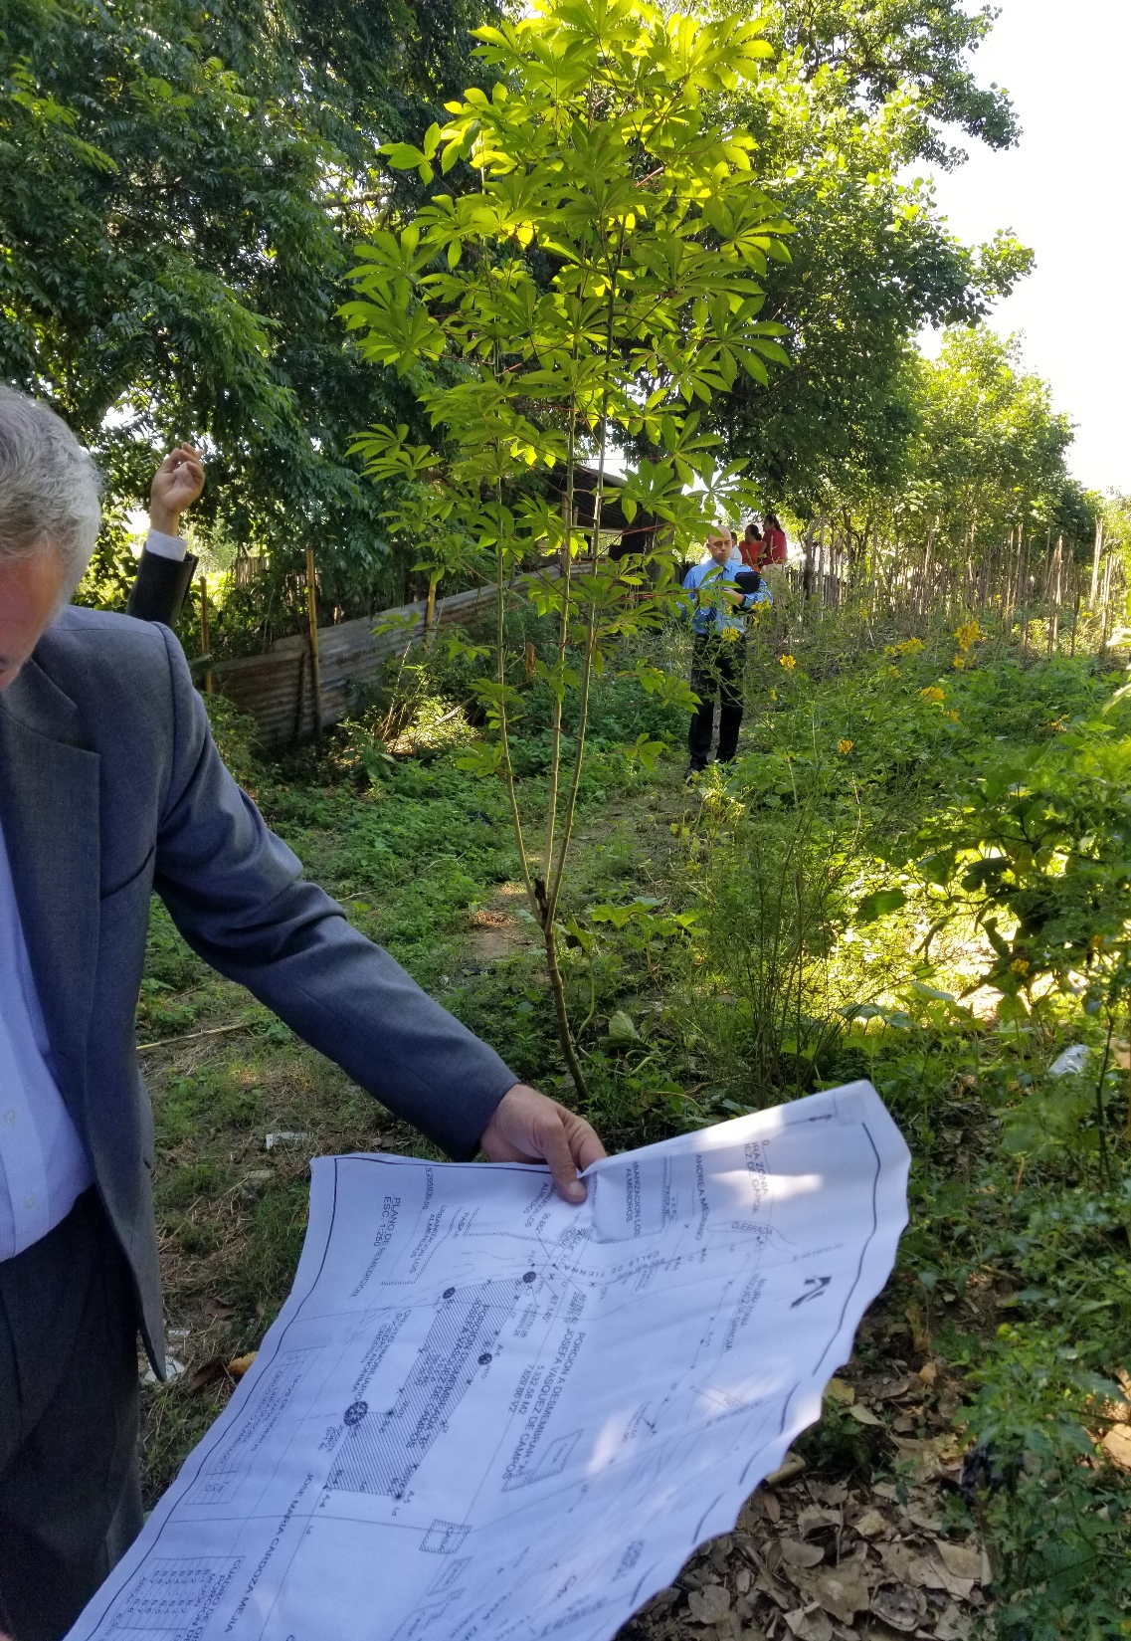
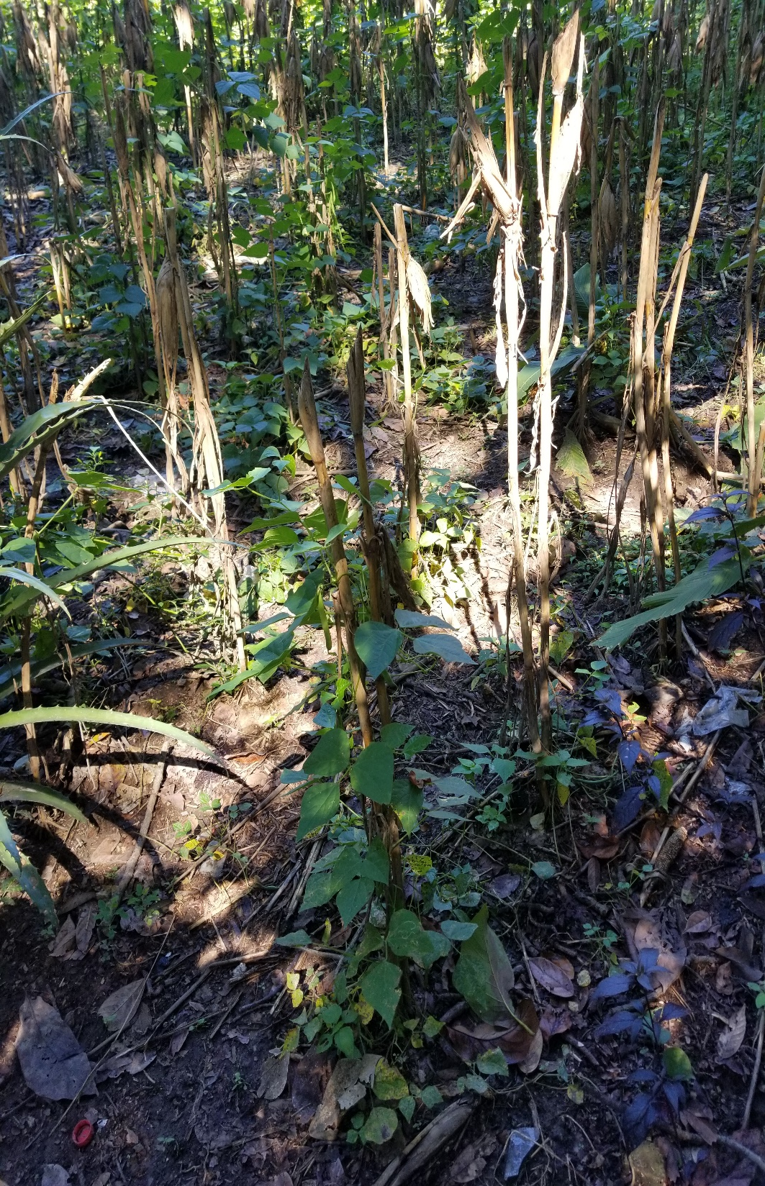
Notes:
Here are a few more pictures from this site

Slide 42
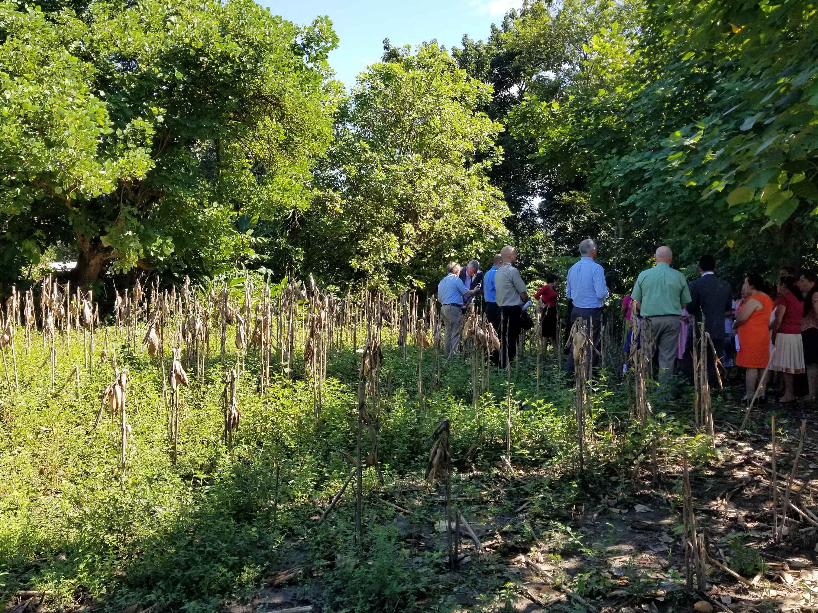

Slide 43
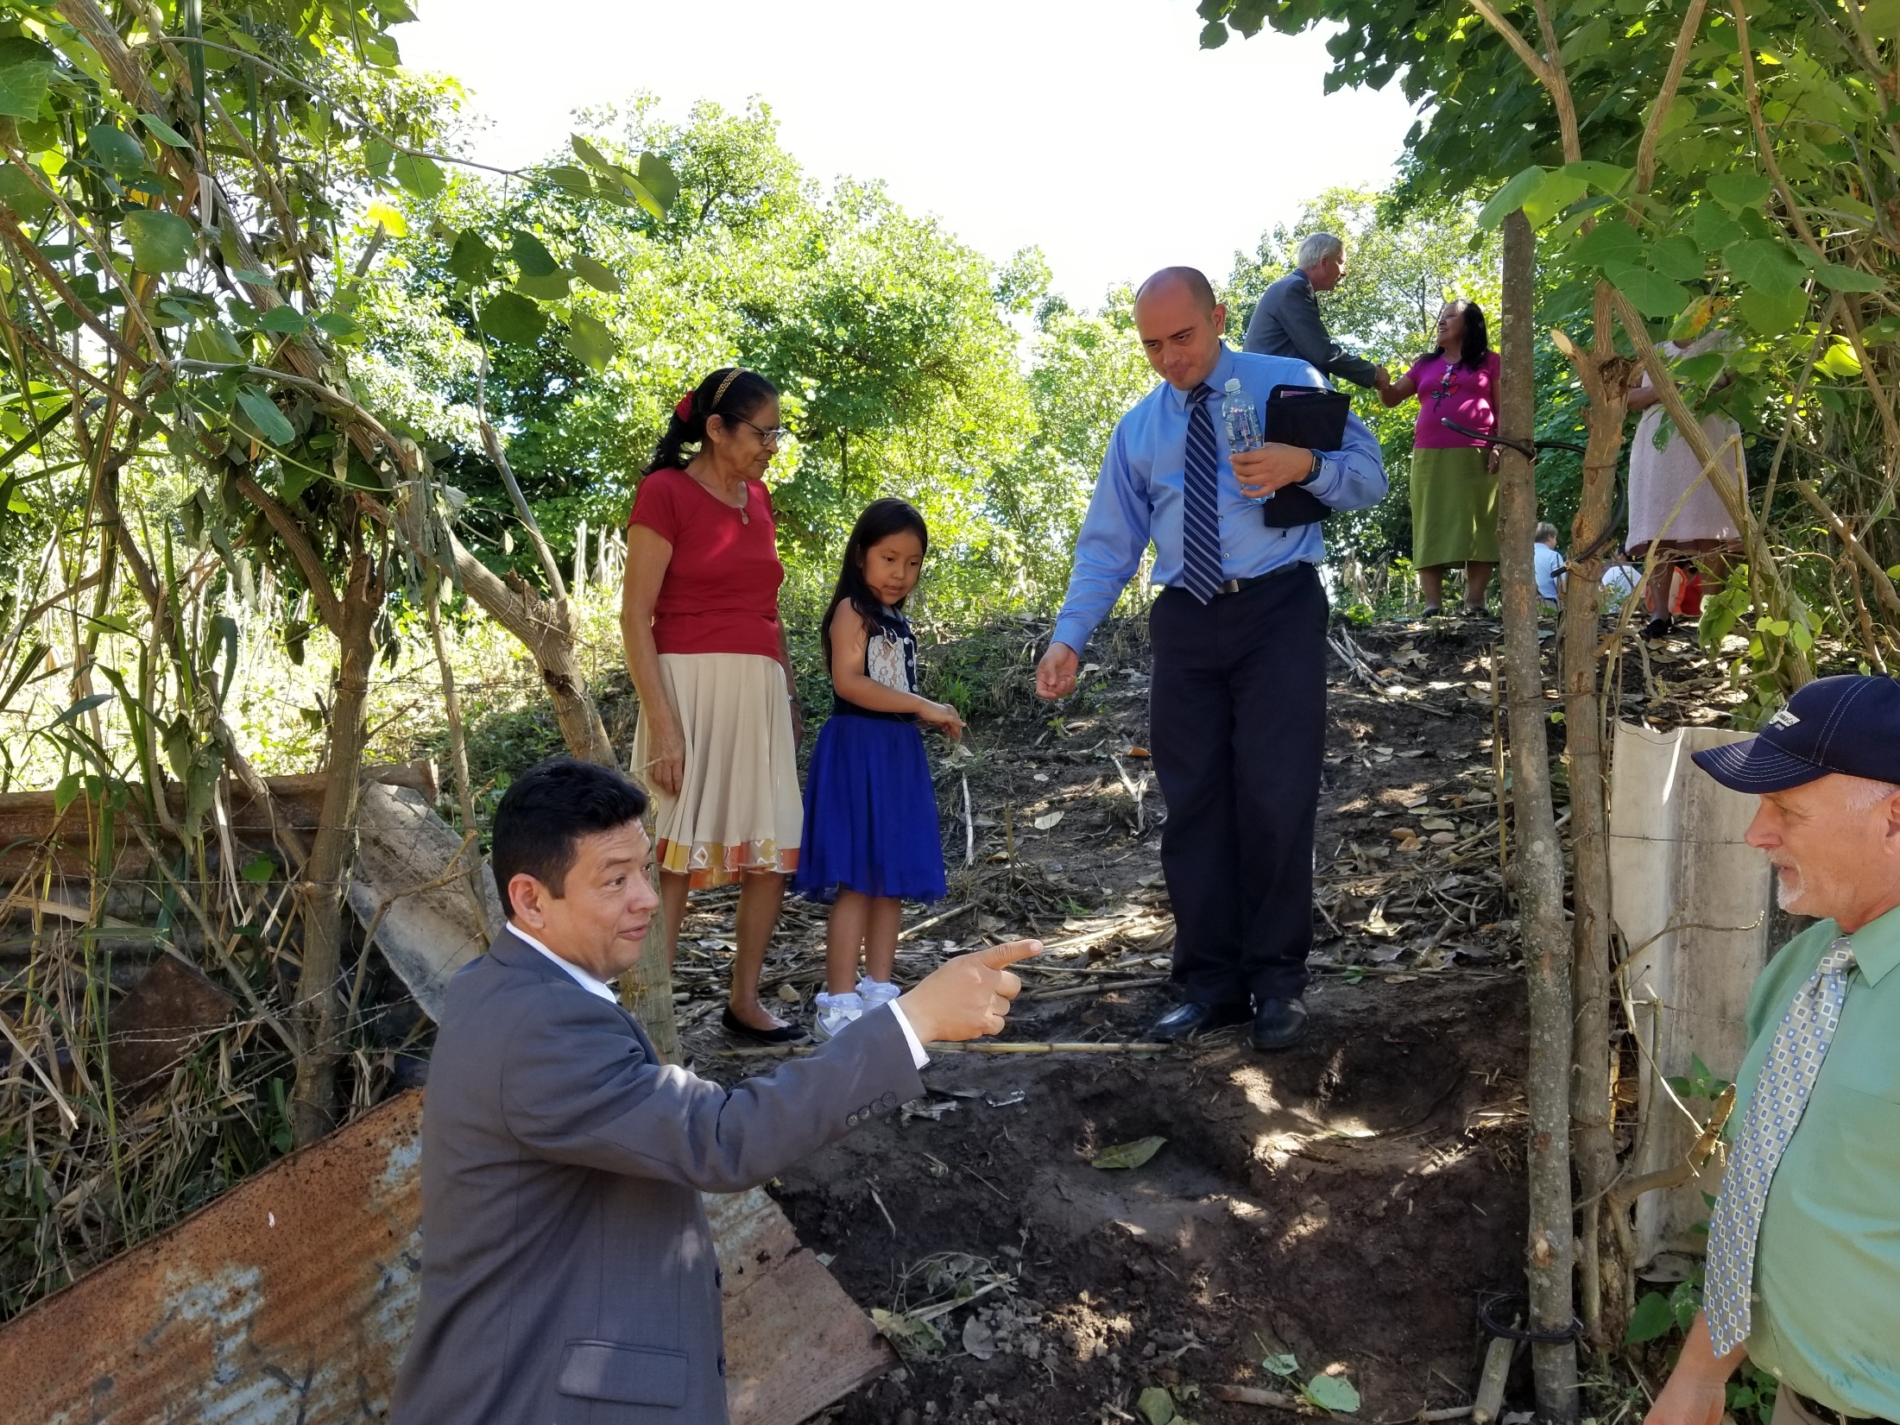
Notes:
Here everyone is coming back down to the road

Slide 44
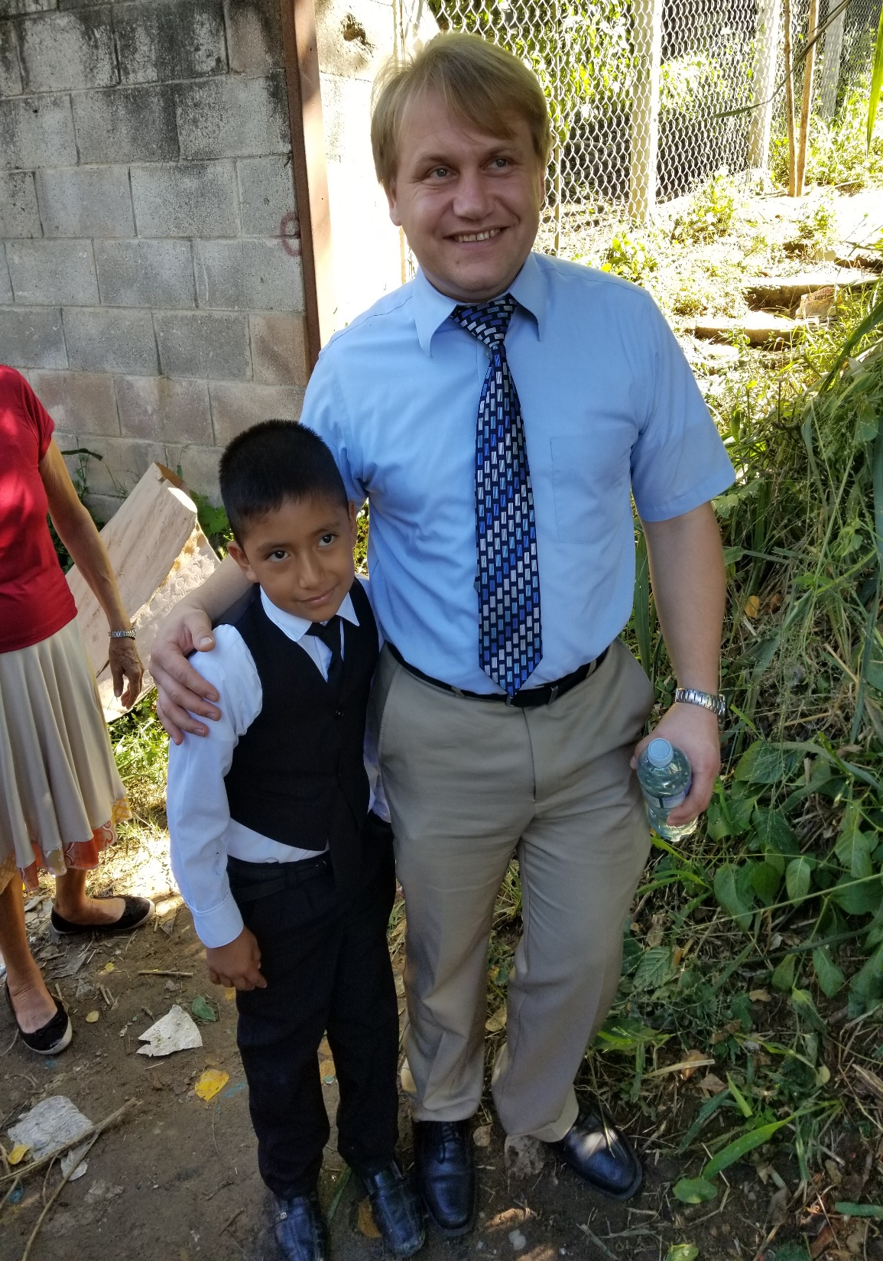
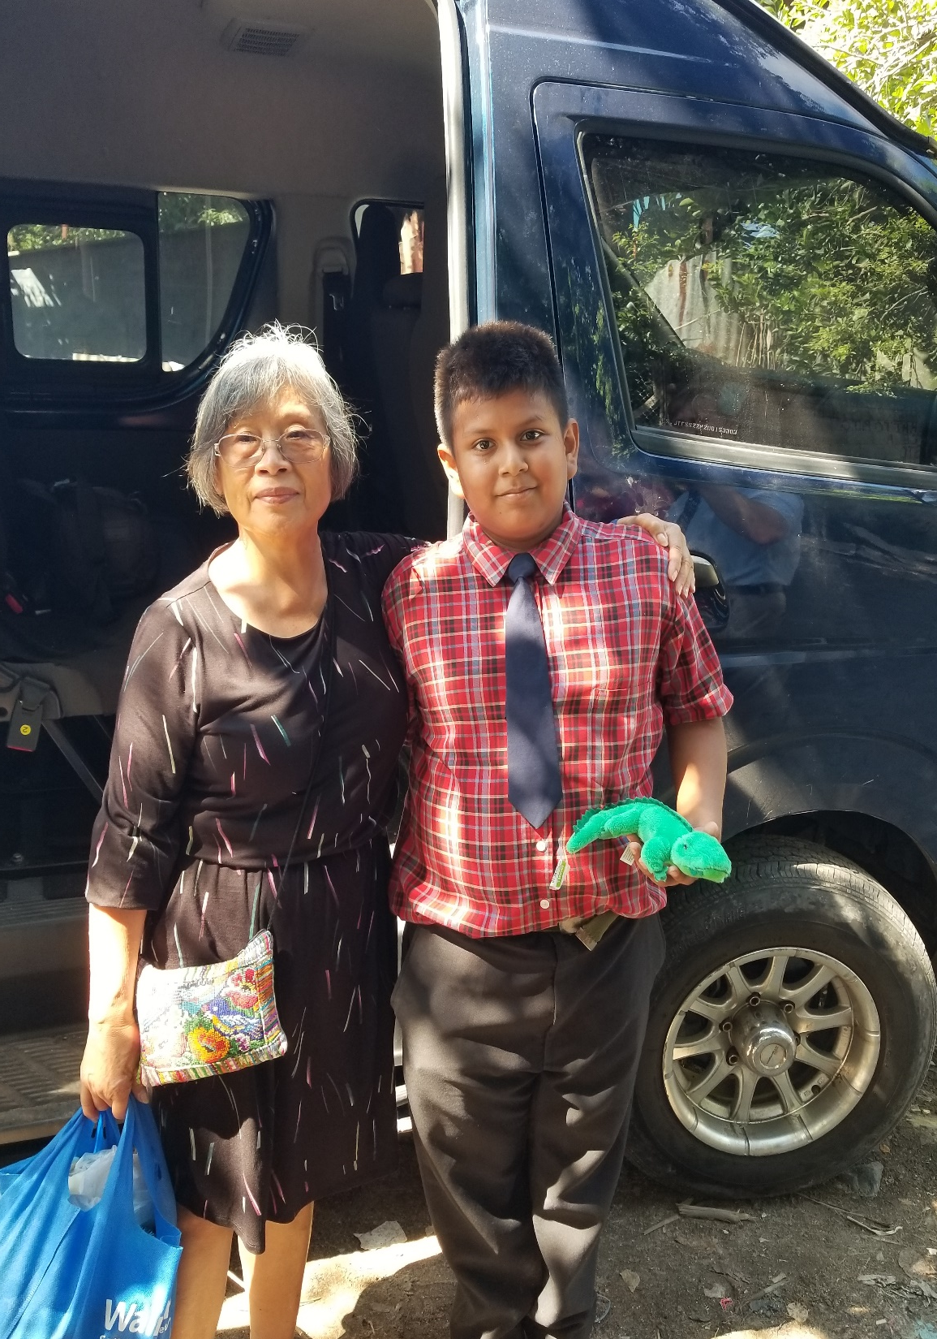
Notes:
On the left standing next to Pastor Alex is Moses. Moses is a sharp young man. The first child I saw wearing a suite. And Moses has been studying his bible
Moses is just 8 years old. But he is a baptized member of the church and he is one of the deacons
The young man on the right is also a deacon in this church at Apopa
Brothers and sisters – when Mark and I left this site we were both convicted that we (Mt Pleasant / Midland) need to provide the money to help this congregation build a church.
I believe the Lord is calling us to do it.
Remember our scripture reading (Deuteronomy 19:15)
By the mouth of two or three witnesses the matter shall be established
We are faithful witnesses

Slide 45
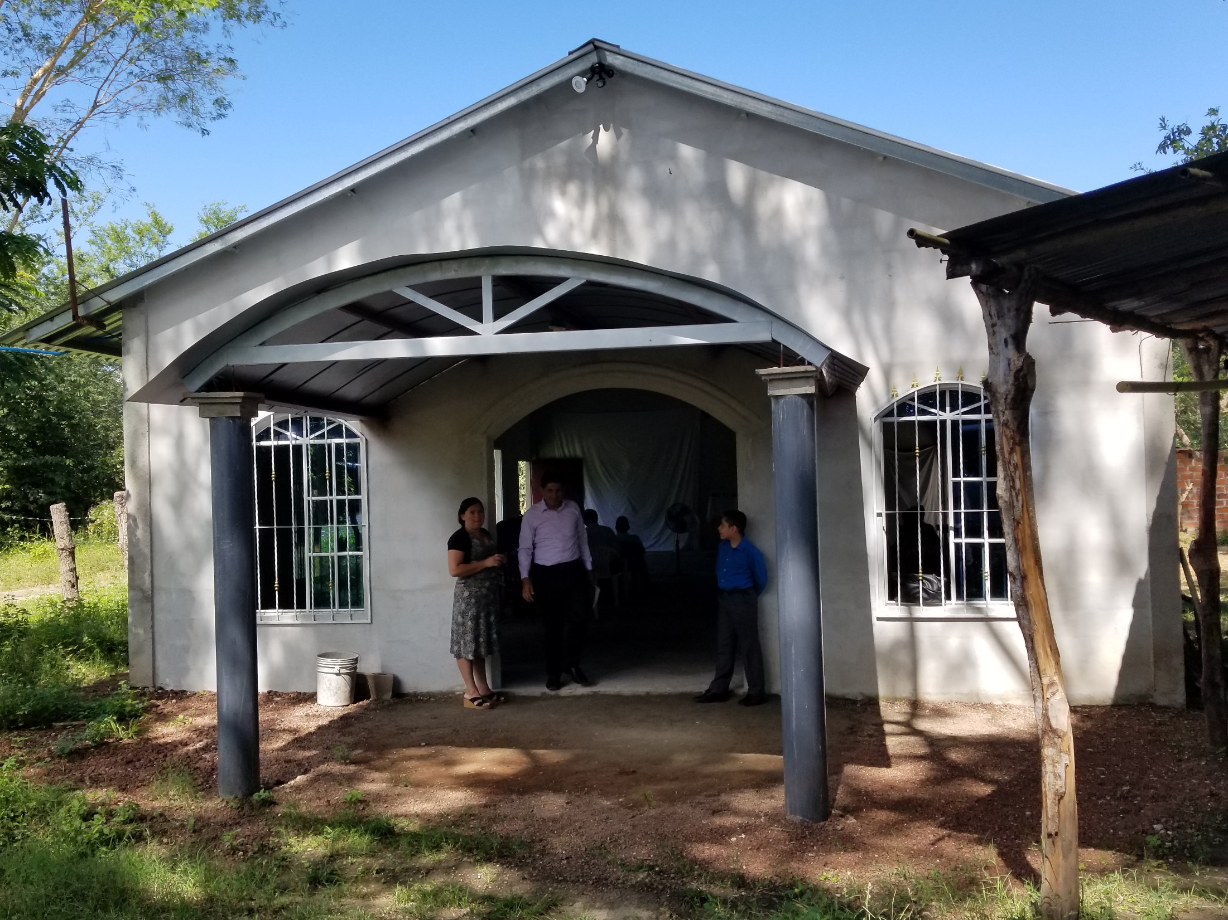
Notes:
When we left there we came to this church in El Paisnal Chaparral near San Salvador. This is were we had our worship service and once again Pastor Kelly dedicated the building and the congregation
But we weren’t done there. Later that afternoon we went to this building

Slide 46
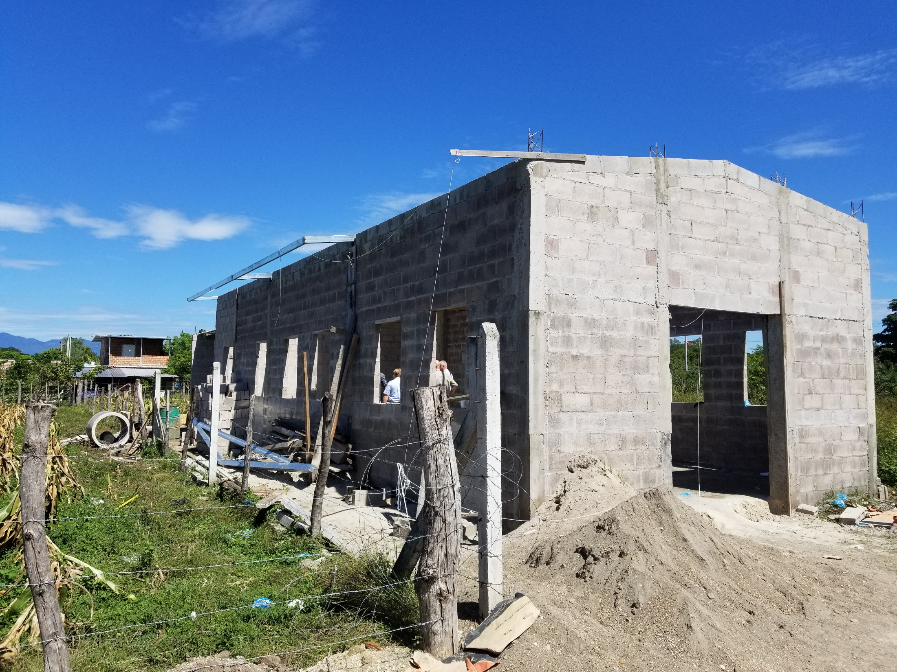
Notes:
That the village church is paying for
Classrooms in the back
And Sabbath evening we went to

Slide 47
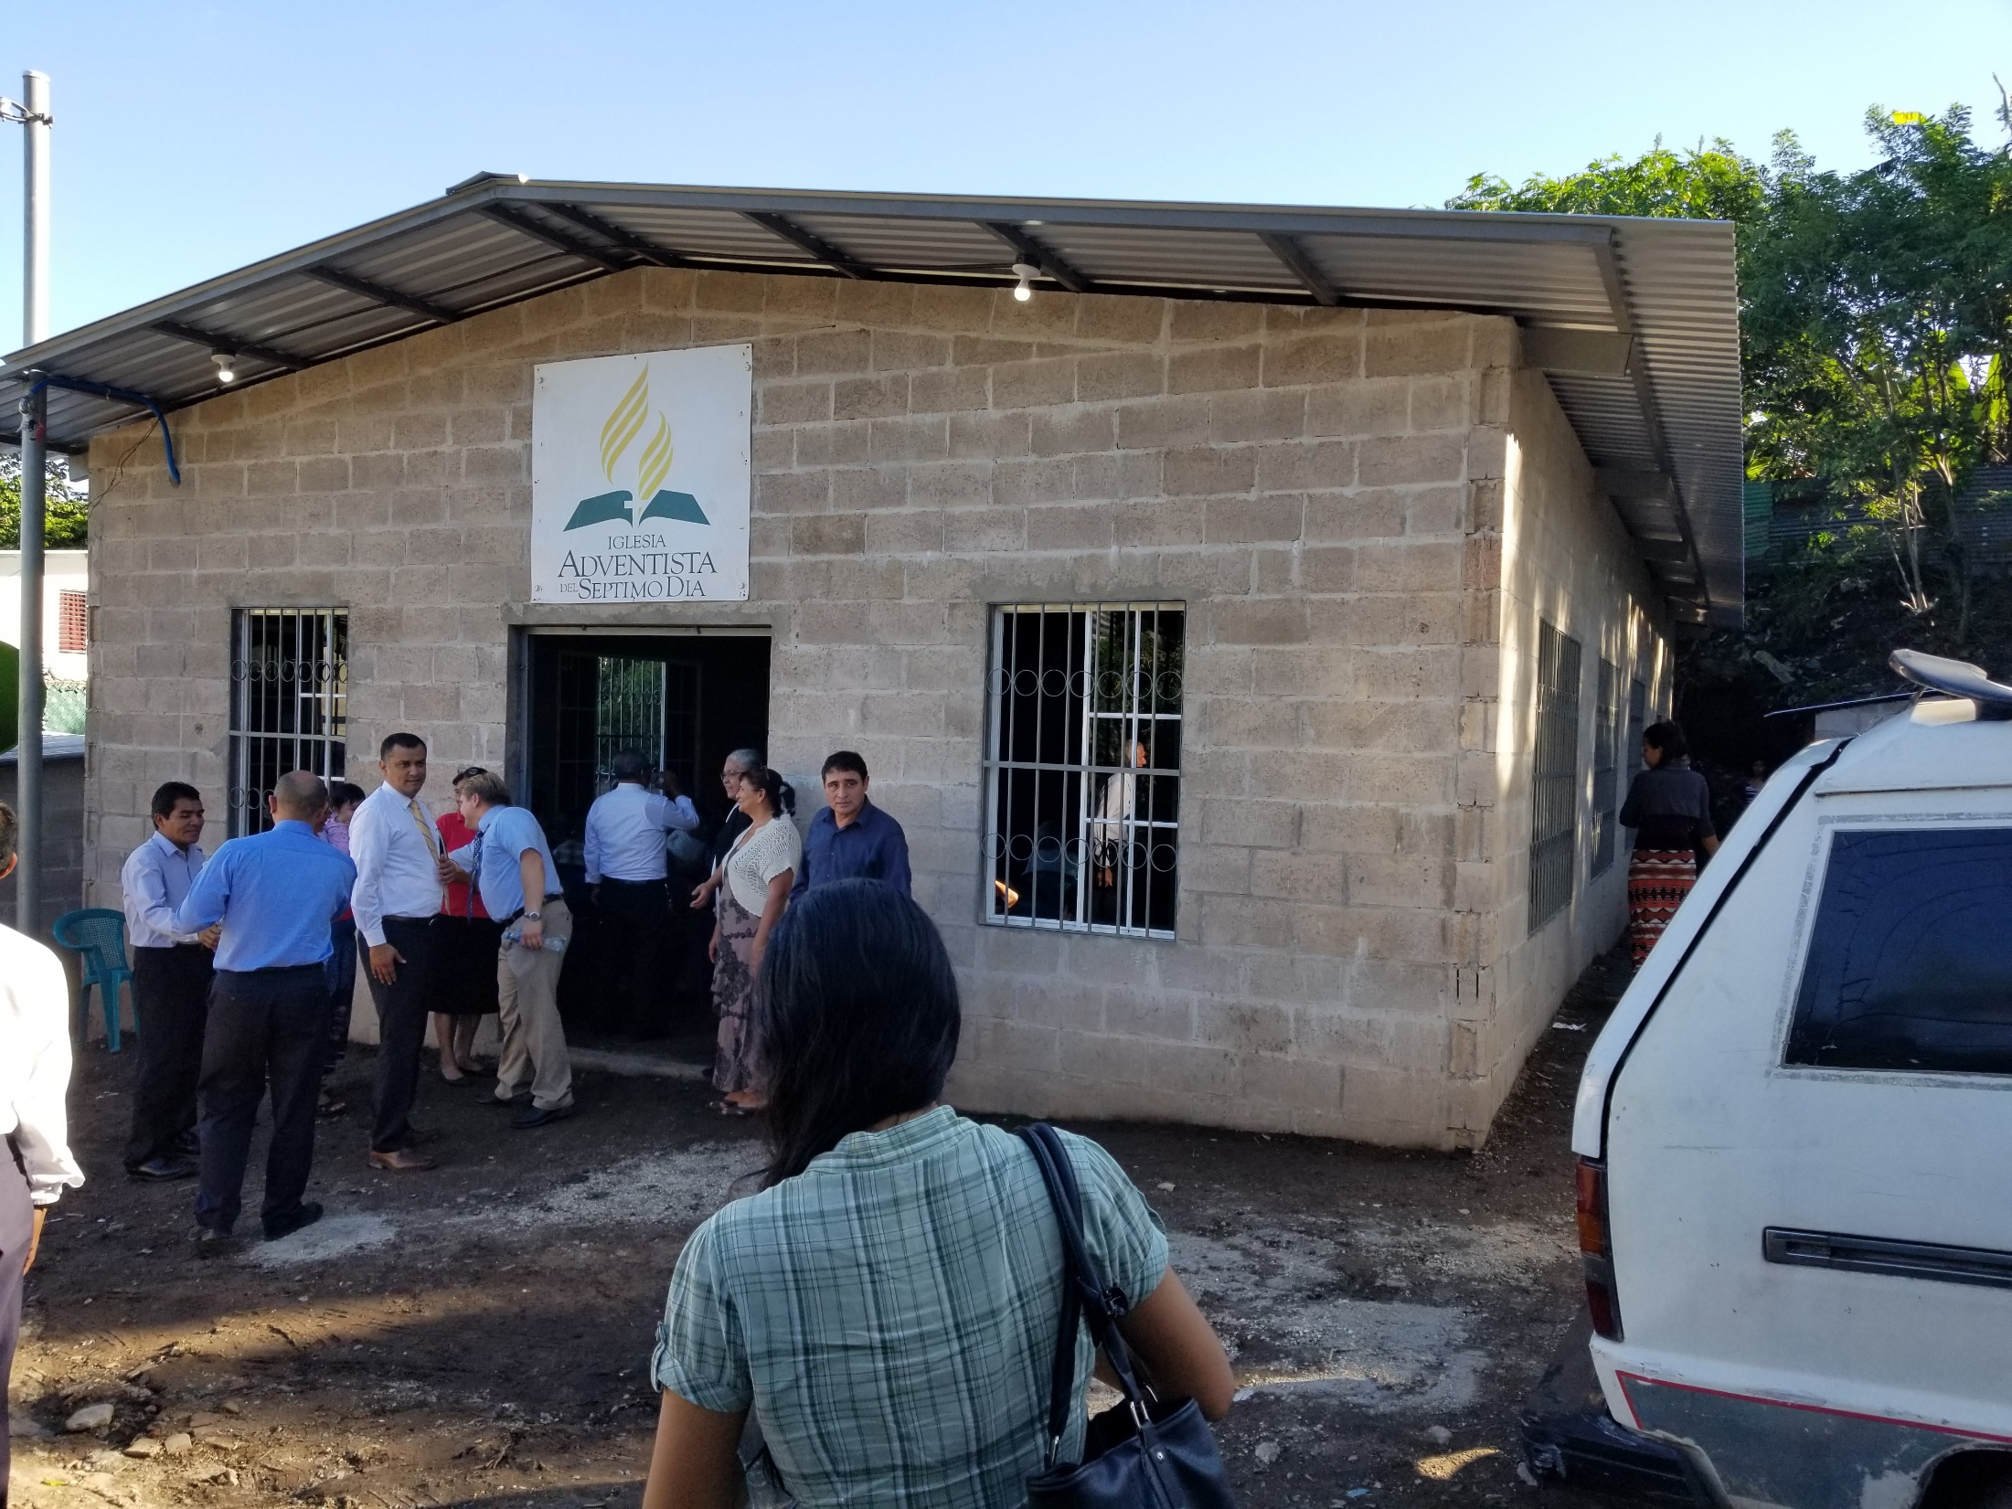
Notes:
The Village church of San Salvador which the village church of Berrien Springs provided the money to build and we dedicated the building and congregation

Slide 48
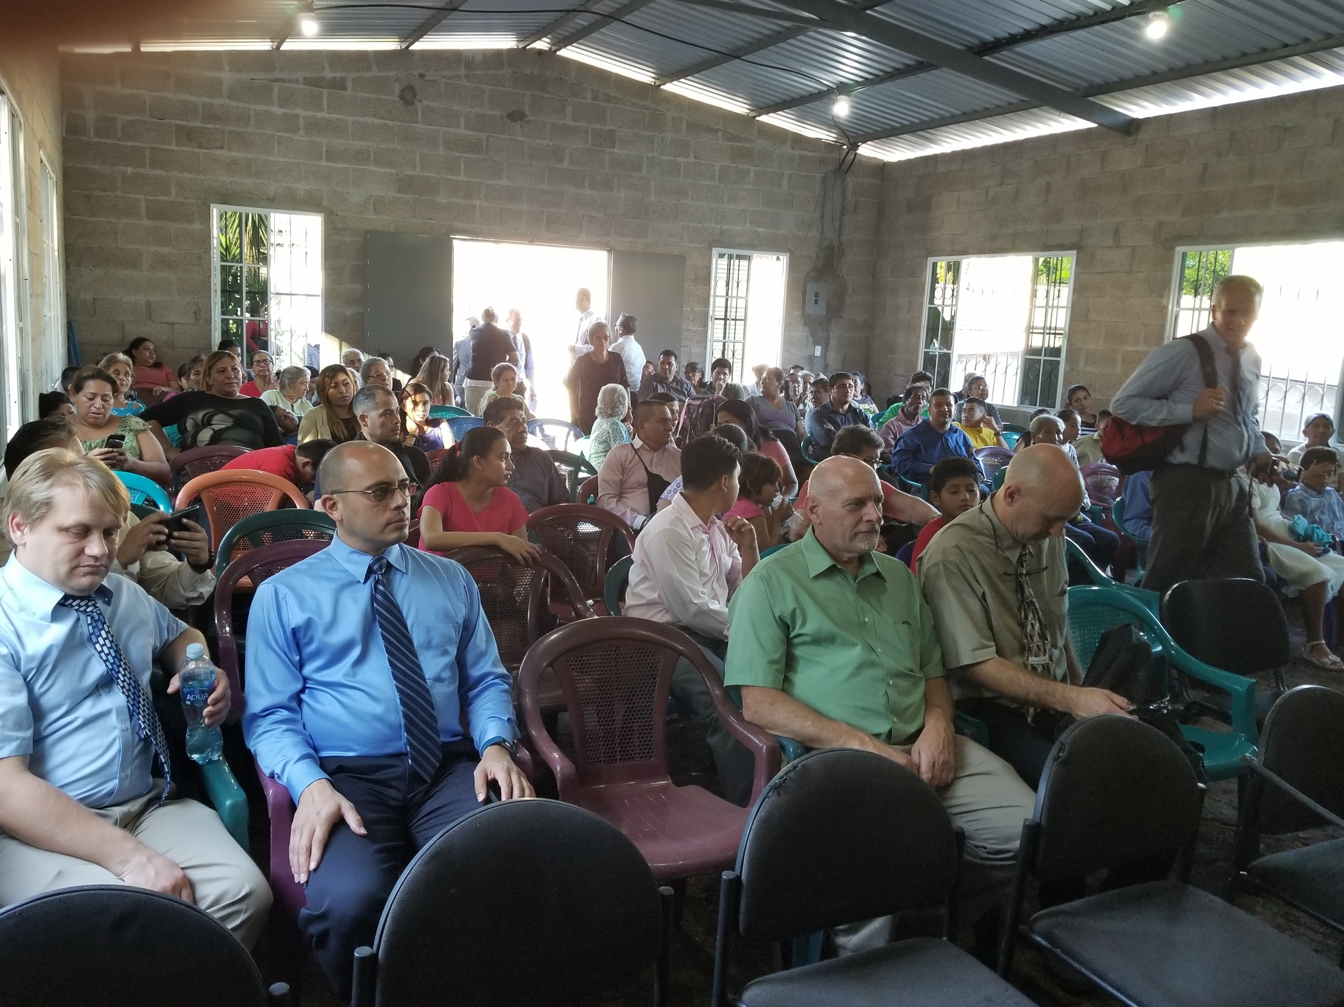
Notes:
This church is yet another example of how quickly churches are growing in El Salvador.
They started of with 7 people from the mother church who planted another church in this area. They go door to door, house to house and invite people to be a part of there group. When they got to 30 they were officially recognized as a church. When this building was finished (not finished by our standards) the held an evangelism meeting and they currently have 30 bible studies going (How many? – 30 members – so bible studies)
Within 1 year ( the current statistics – based on every where else) the expectation is that they will be up to 60 or more
When they get to 100 they then become the mother church that plants other churches
At the dedication every seat was full. They had 16 people from 8 other churches that helped them along the way
So why am I telling you all of this?
Because I am looking for two things

Slide 49
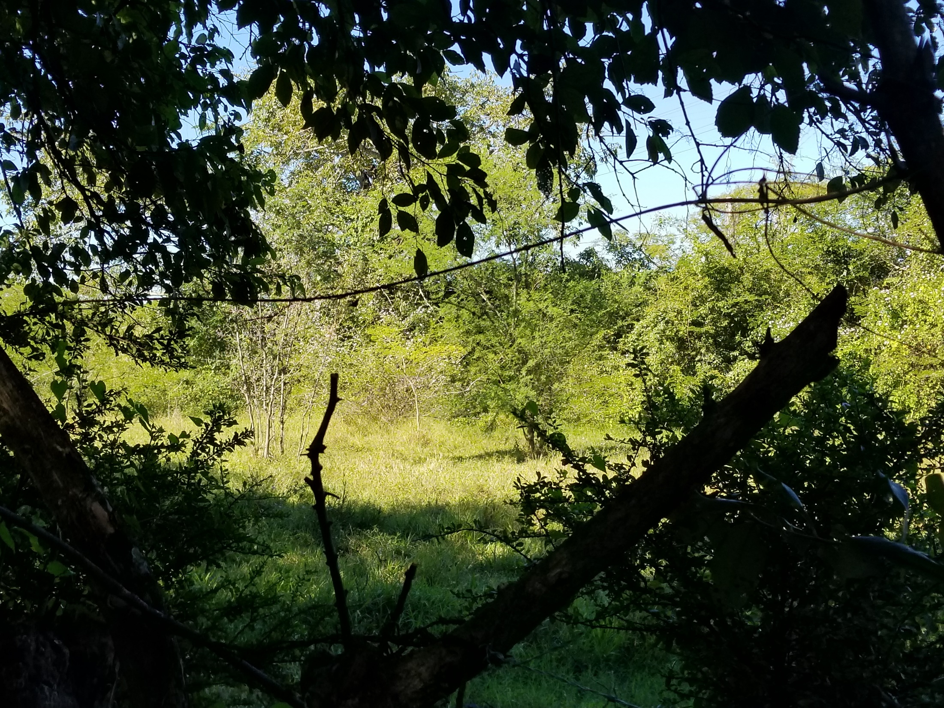
Notes:
Sunday morning before we left to come back home, we went to this site
This is the location of a new church that will be built in March. And Mark and I are wondering how many of you would like to come along with us to build a simple block temple for the local people to worship in
It costs $1300 per person to go on this trip. That includes your airfare, a place to sleep and all your meals. That is a really good price and I want to encourage everyone to prayerfully consider going
I have heard people say that everyone needs to go on a mission trip because it will change you. I can promise you that it has already changed me, and I suspect Mark as well. It can open your eyes to things that you can’t otherwise imagine or understand. I can show you the pictures but they don’t really do justice to the great need that is here.
Many people won’t be a part of a church in someone's house or a field. But once they have a building they grow exponentially ( their history proves it)
Applications are available. You need to get them to me along with a $200 non-refundable deposit by the end of November. Then you can divide the remaining $1100 up over the next 4 months and pay some on it each month.
And here is the great value of it all. Not only are you building up a treasure in heaven, but you are bonding with those around you as you work and play together.
So please prayerfully consider it

Slide 50
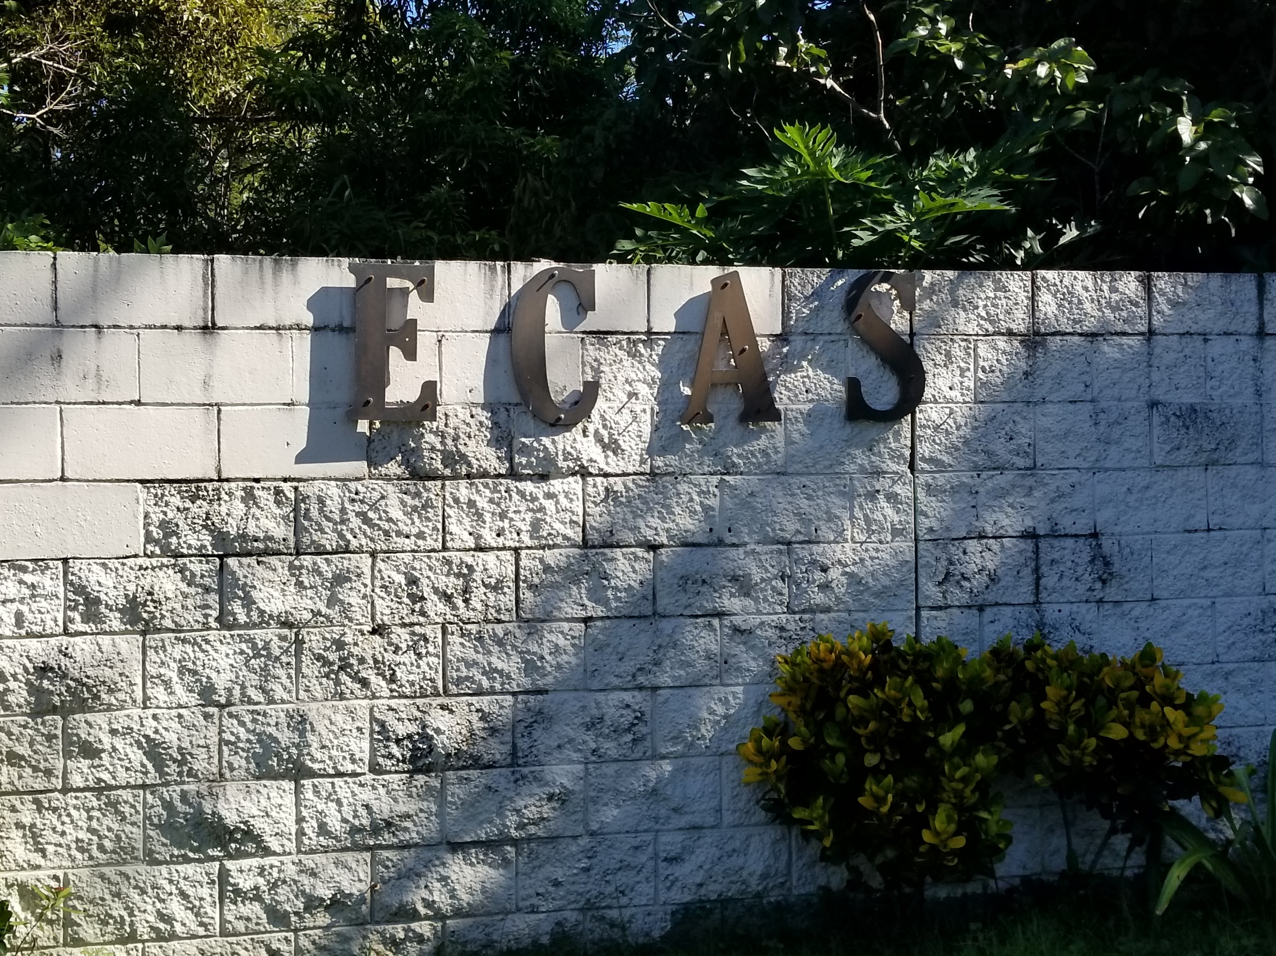
Notes:
If you do want to come, we will be staying at the Educational Center for Adventist youth in San Salvador

Slide 51
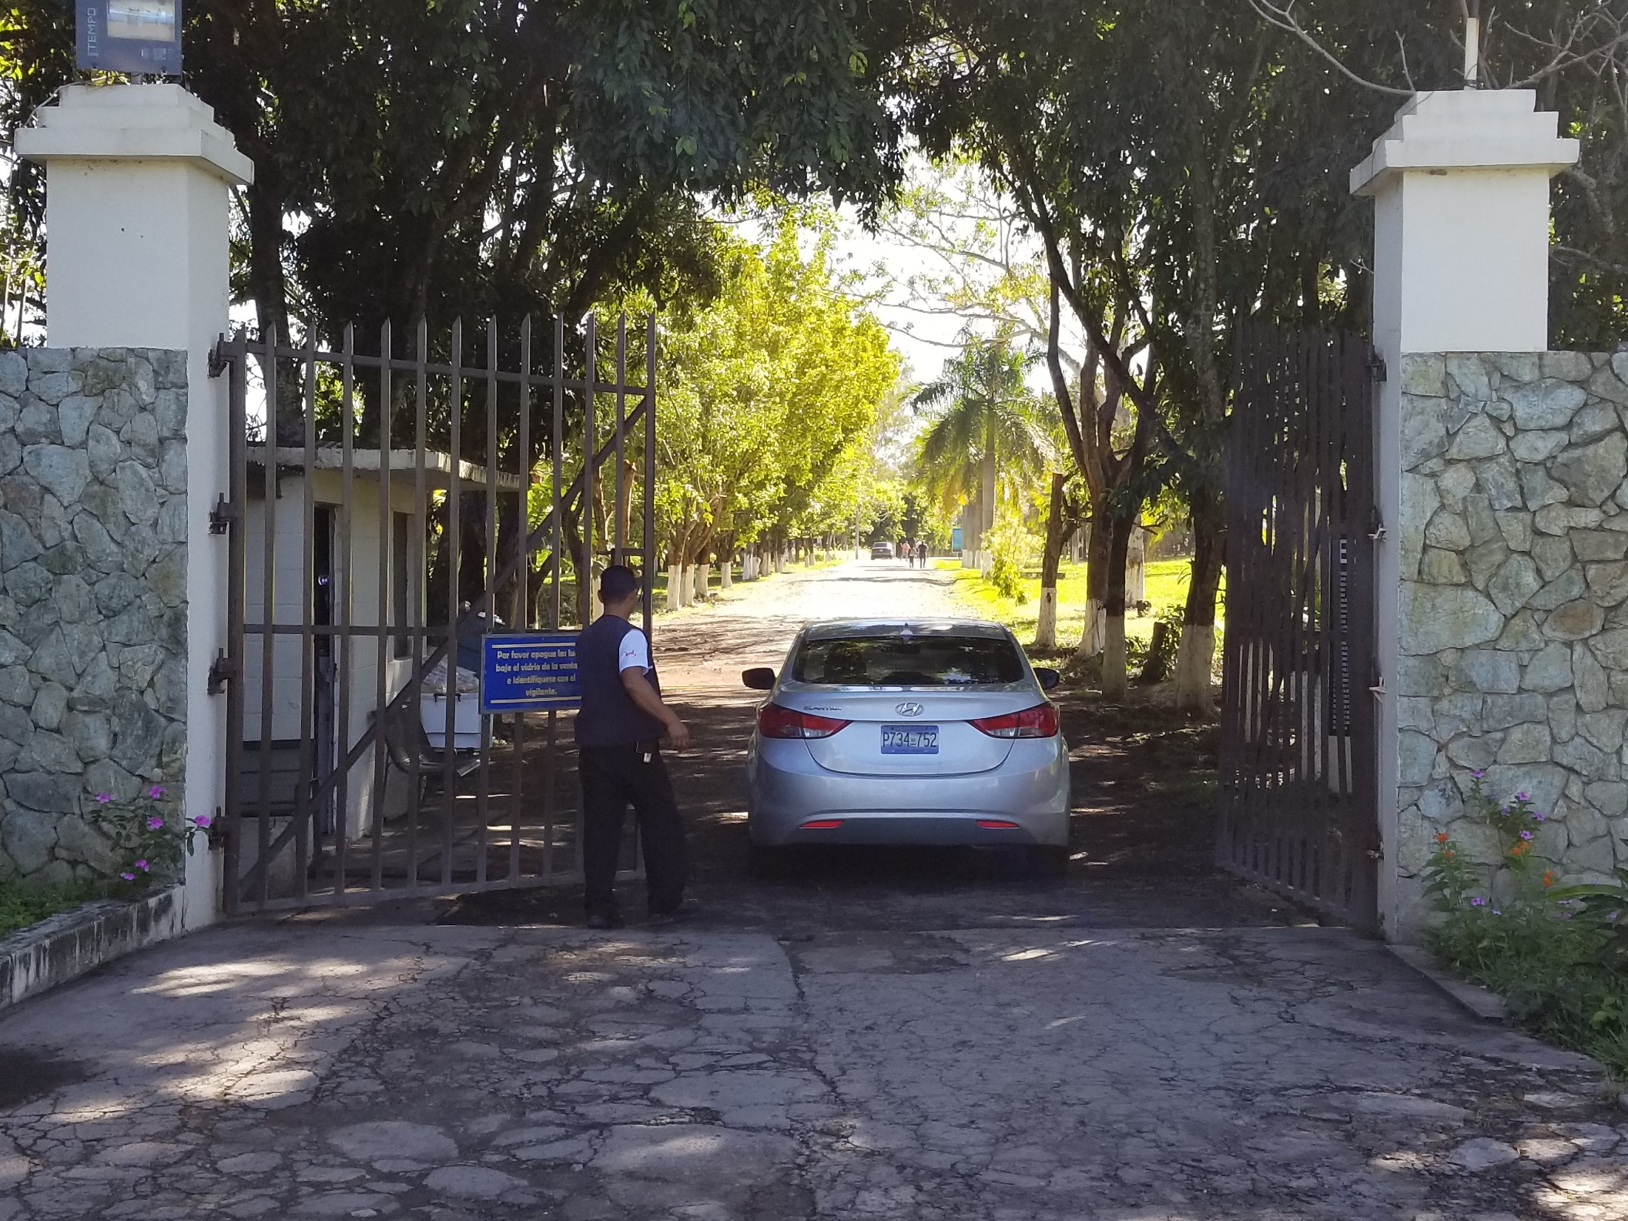
Notes:
Compared to the living conditions of the local people it is far above the standard
As you go in the gate one of the first things you see on the left is the

Slide 52
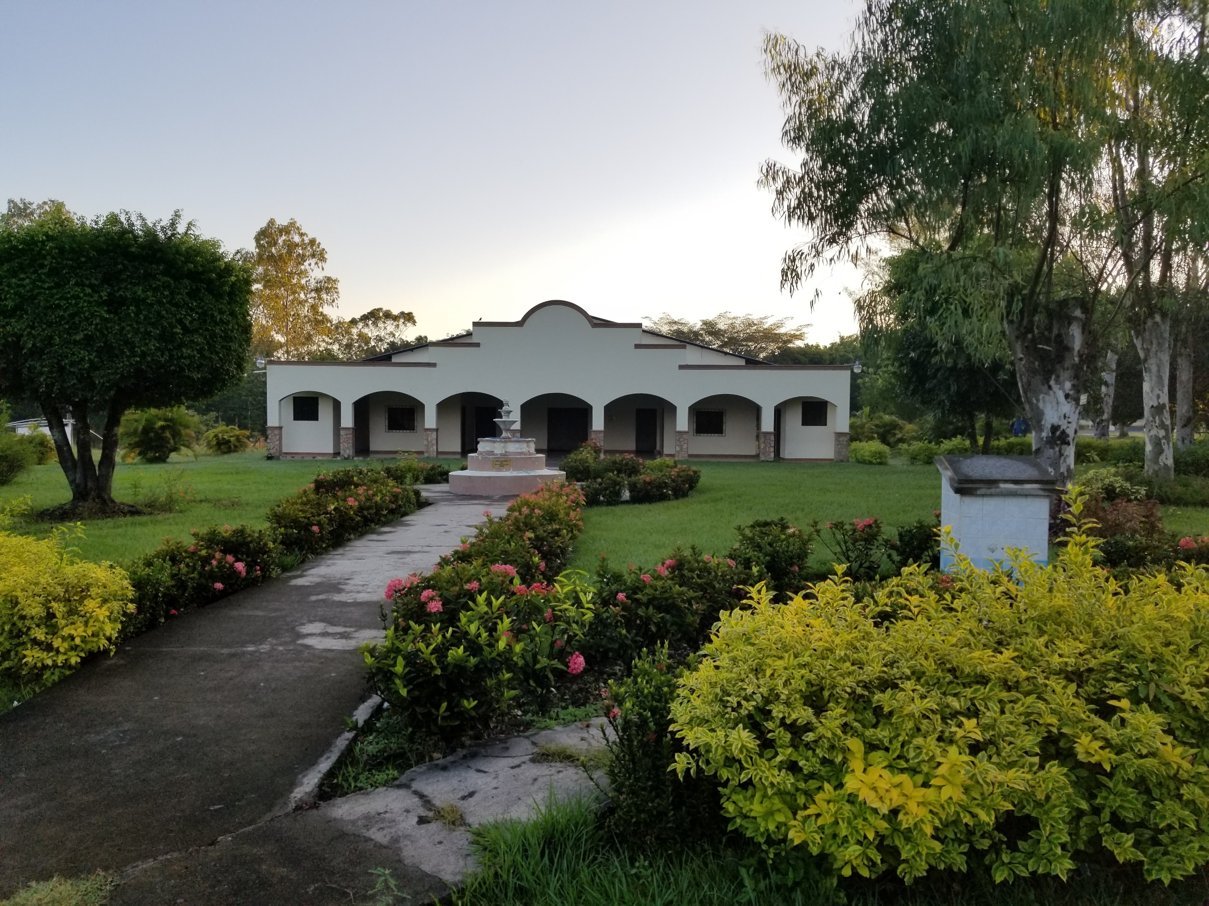
Notes:
The church

Slide 53
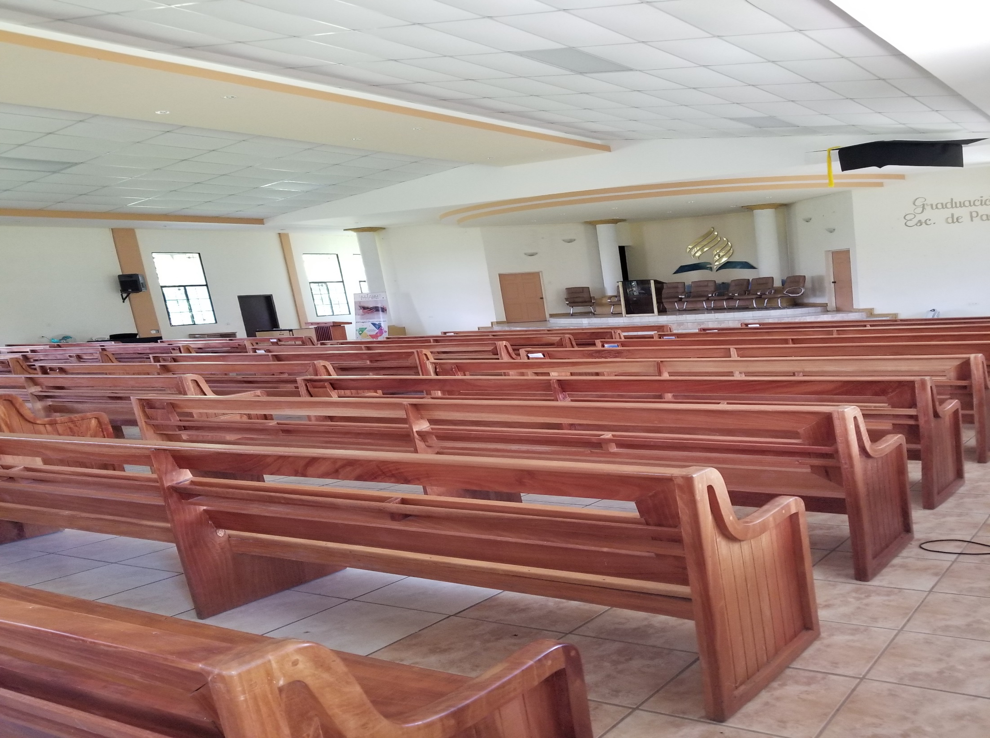
Notes:
It is one of the nicest you will find in El Salvador

Slide 54
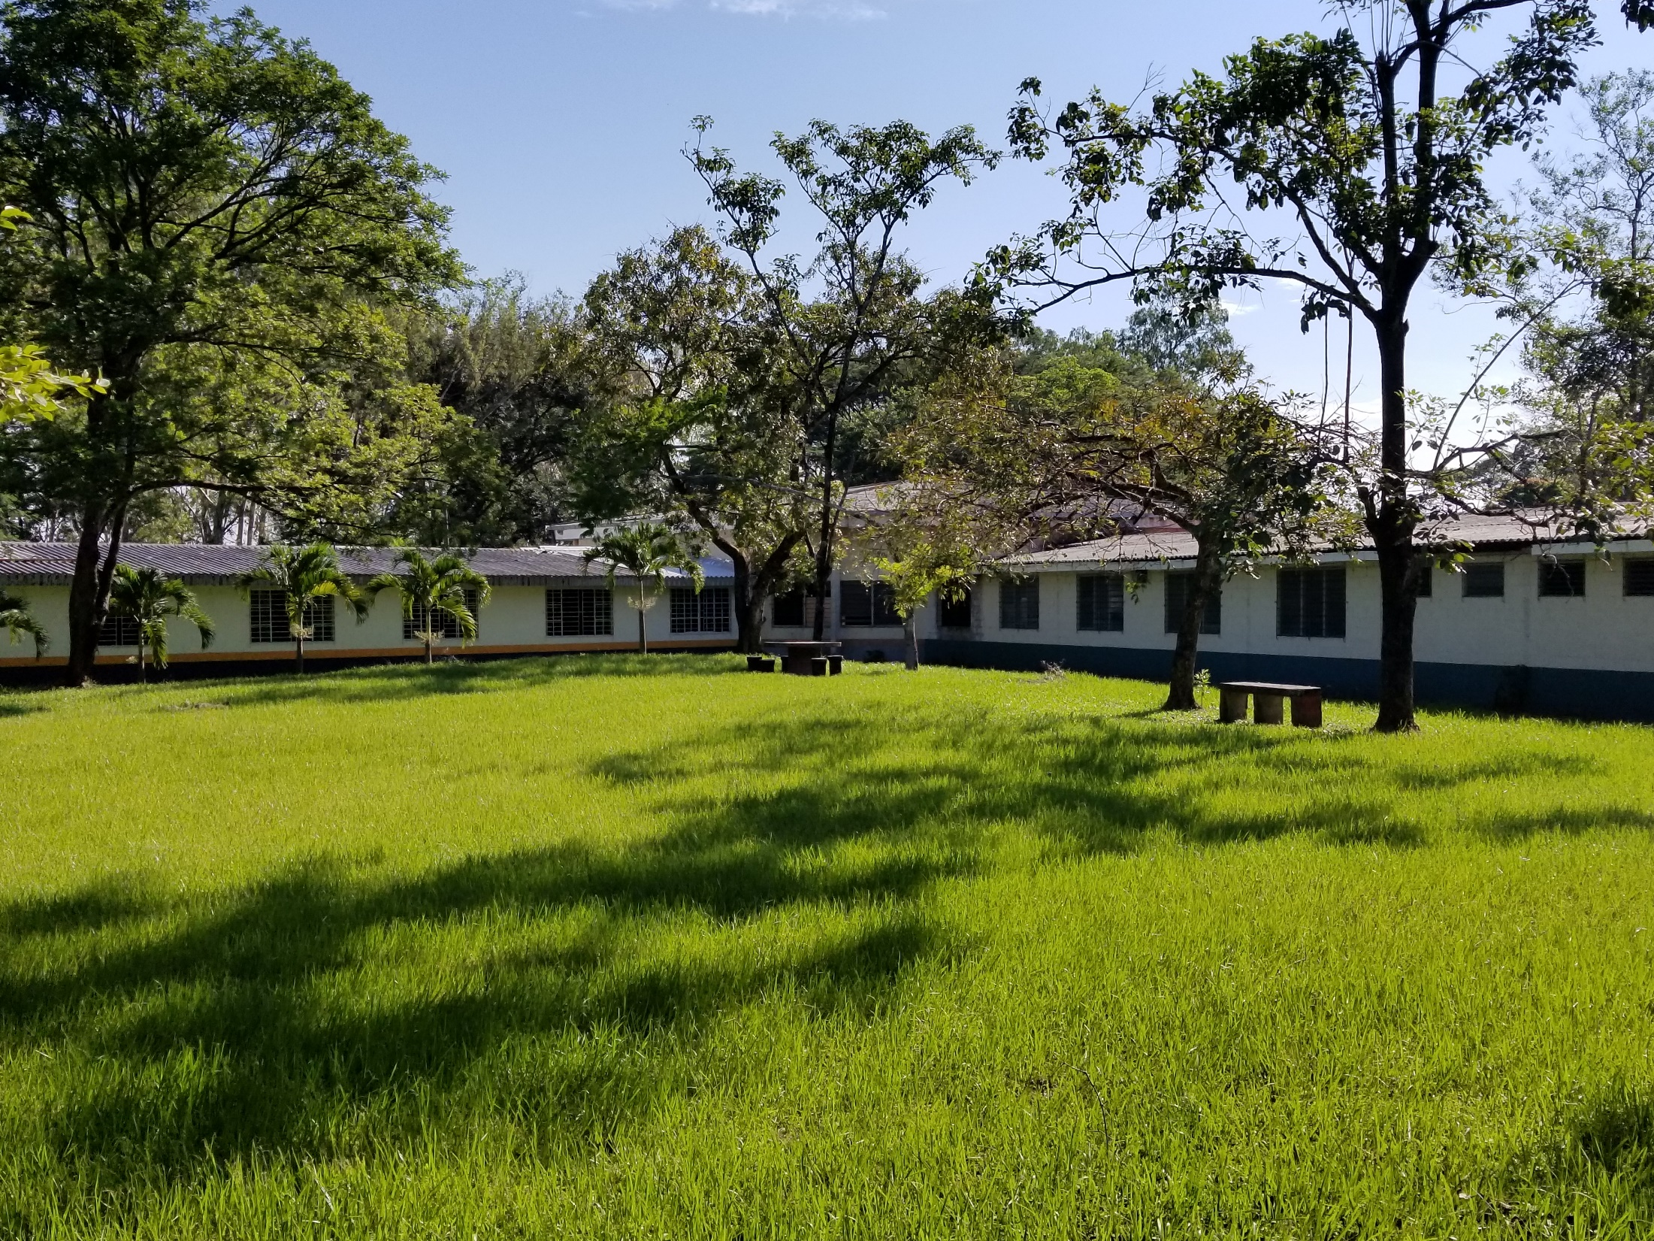
Notes:
About a block from there you will find the boys and girls dorms
Describe the center hub and wings
This is were we will be staying.
There are many other things going on during this mission trip besides building a cement block facility.
There will be a VBS program
Remodeling in the dorms where they will need lots of painters
Cooking the meals in the cafeteria
Might even have a dental clinic

Slide 55
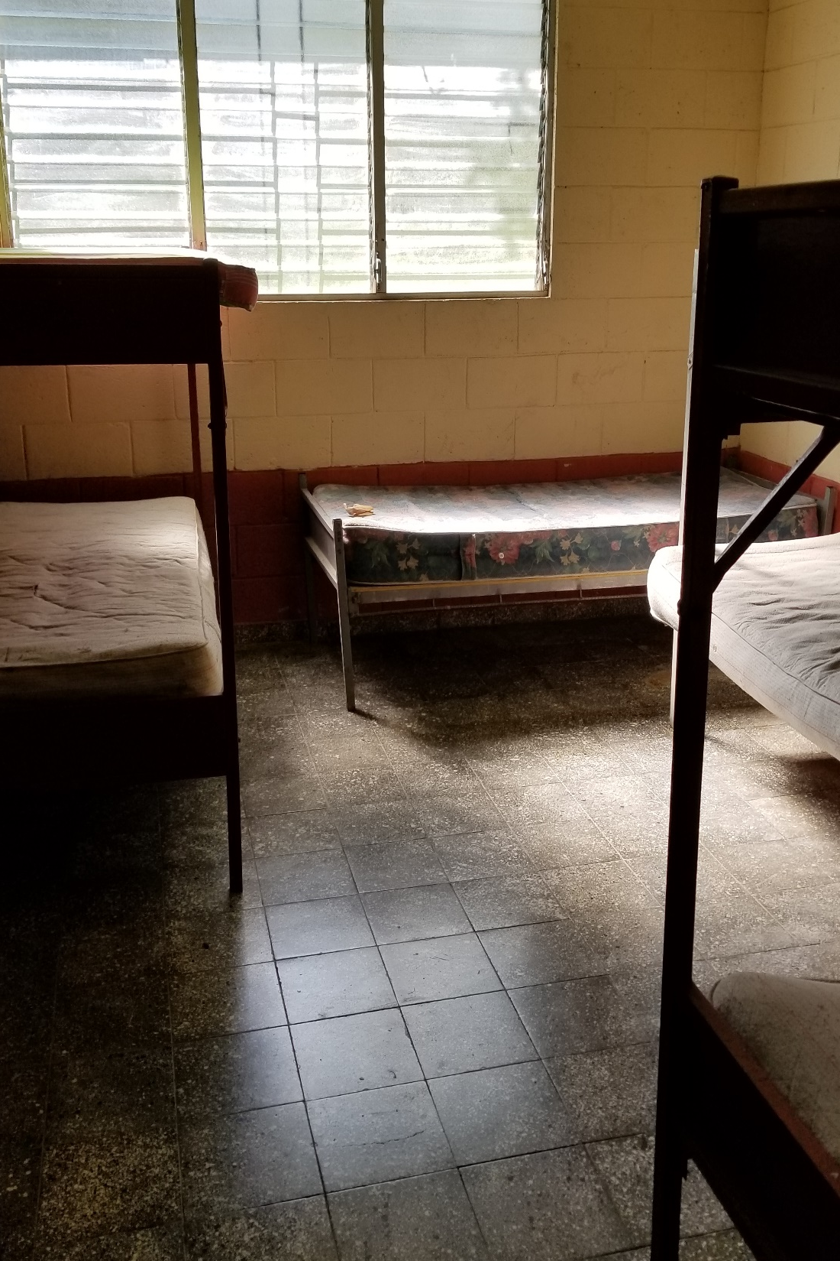
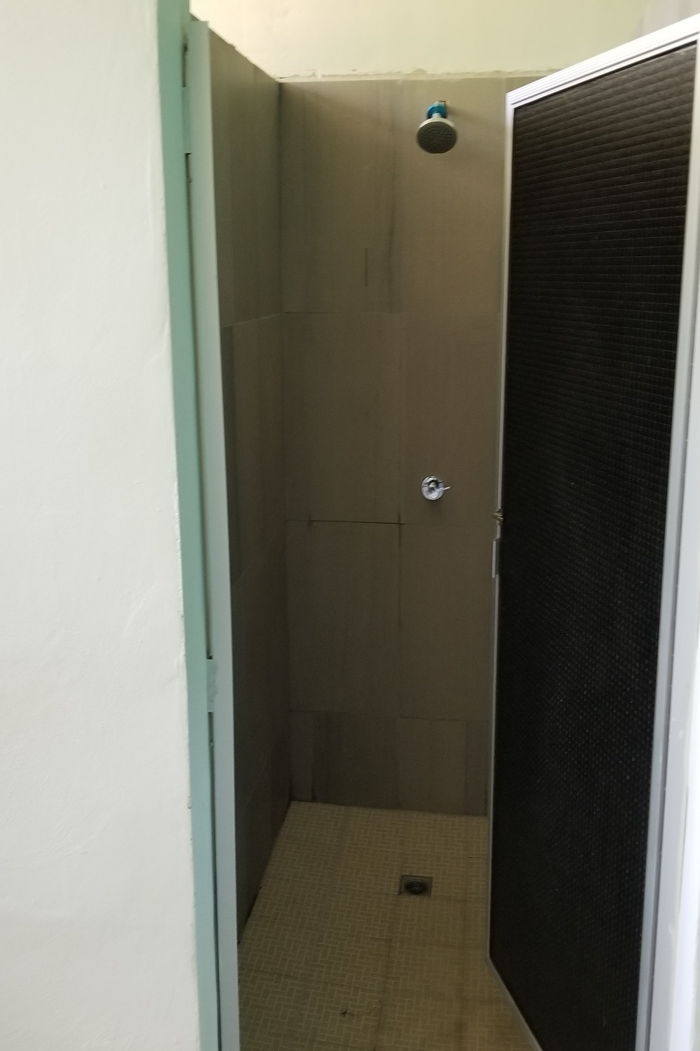
Notes:
Here is a room like the ones we will be staying in
You would need to bring your own sheets, pillows and towels
They have shared bathrooms and showers. But they won’t look as nice as this one – this one was recently remodeled
But most of the people here don’t have running water in their homes. They go to a community

Slide 56
Notes:
Well where they get their water and tote it home

Slide 57
Notes:
On the school grounds there is a pool that we will have access to when the work day is over

Slide 58
Notes:
Here is one of those hubs that I showed you at the center of the dorms. This is where we will hold most of our meetings
The women here in the picture is Aurora – she will be our coordinator for everything we do.

Slide 59
Notes:
This is Jack. He will be in charge of the construction projects
On the right is a picture of the cafeteria

Slide 60
Notes:
Its very basic and simple but way better than what the locals have
Please prayerfully consider coming and being a part of this mission trip.
The second (and perhaps more important thing that I want to ask you is to please prayerfully consider giving to the building of a church on the Apopa site )

Slide 61
Notes:
As I said, Mark and I were both convicted that God wants our church to pay for this building. And I would like to have it built now so that we can dedicate the building in March when we go back. I would like to see this women out here on the right still alive when we dedicate it in March. She has been praying for this for 10 years, and she sacrificially gave to this cause.
The people don’t have the money, but they will do all the work. All of them – men, women and children
Will you be a part of a cause greater than yourself?
You might say – Pastor I don’t have a lot of money
I understand that
I get it – it’s hard to make ends meet.
But let me just say this. You might not think that your rich, but compared to these people – you are
So can you do without that new car for another year?
Can you commit to staying home instead of taking that vacation?
Can you be like the widow that Jesus talked about, who gave out of her need rather than her excess?
Now you might say, Pastor I would love to give to this but I would have to spread it out over the next 12 months. That’s ok.
I have here a pledge sheet in my hand. The deacons are going to give each of you one. Please take it home and pray over. Ask the Lord what he would have you do
Fill it out and give it back to me by December 1 (that’s two weeks to pray about it and decide)
I know that we have lots of things that we need right here in the local church – but what is going to be our priority? What are we going to say to Jesus when He asks us what we did for the least of His children?
I’m not trying to shame anyone – I’m asking you to prayerfully consider that question
And just so you know how serious I am about this – here is my offering to this cause ($1000)
Were already a 10th of the way there.
Won’t you please help make it happen?
Remember our scripture reading? If you want to be perfect – give to the poor and you will have treasure in heaven

